Slide 2
Curriculum and Options 2020-22
Ian Butler
Vice Principal - Curriculum

Slide 3
Changes to GCSE grades

Slide 4
Curriculum hours

Slide 5
Curriculum hours

Slide 6
English language & Literature
Curriculum
Every pupil will study both Language and Literature
Both courses are 100% exams at the end of Y11
Students will be awarded a grade 9-1
Setting
Based on KS2 data, Y8 teacher assessment, base line tests, Y9 assessments, teacher recommendation
Examination at end of Year 11
English Language – 2 x 105 min exams
English Literature – 1 x 105 min & 1 x 135 min exams

Slide 7
Maths
Curriculum
AQA GCSE Mathematics (8300)
Students will be awarded a grade 9-1
The maths GCSE is made up of 5 different areas: Algebra. number, ratio and proportion, geometry, data and probability.
Setting
Based on KS2 data, Y8 teacher assessment, base line tests, Y9 assessments, teacher recommendation
Examination at end of Year 11
3 x 90 min external exams at either Higher (grade 9 to 5) or Foundation (grade 5 to 1)

Slide 8
Science
Curriculum
Every pupil will study either Combined Science (Double Science) or Single Sciences (Biology, Chemistry & Physics).
The decision on which route is taken at the end of Year 9 and is based upon performance throughout Year 9 and in the end of Year mock exam.
Both courses are 100% exams at the end of Y11
Awards
Students will be awarded a grade 2-18 grade. 6,6 or a 5,4 or a 7,8.
Or a 9-1 grade in each of the single sciences.
Examination at end of Year 11
6 x 75 min external exams at either Higher or Foundation level
6 x 105 min external exams at either Higher or Foundation level

Slide 9
OPTIONS KEY DATES AND DEADLINES
14th November 2019 - Options evening – Opportunity to meet Heads of Department to discuss individual options.
23rd January 2020– Options subject report issued to parents & carers. Option booklet available on website.

Slide 10
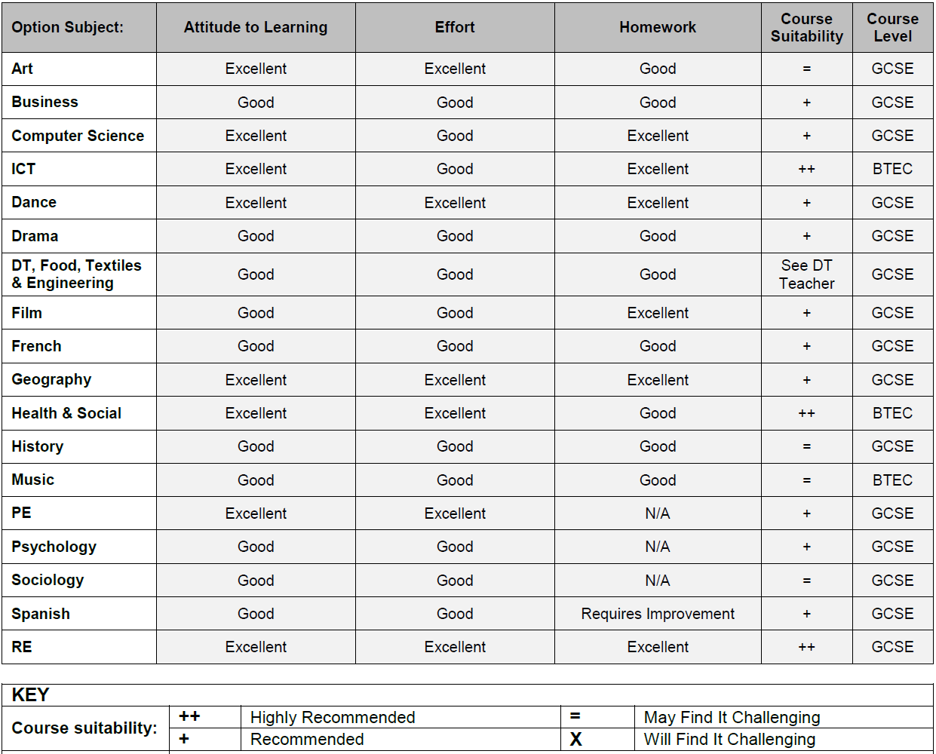
Notes:
Example Option Subject report

Slide 11
KEY DATES AND DEADLINES
14th November 2019 - Options evening – Opportunity to meet Heads of Department to discuss individual options.
23rd January 2020– Options subject report issued to parents & carers. Option booklet available on website.
10th February 2020 – Options process opens – students to take completed forms back to their tutor to get it checked that they have followed all of the criteria.
Monday 16th March 2020 – Final deadline for all option forms to be back with the tutor.
Start KS4 Options in Year 10.

Slide 12
PROCESS
Using all the information given, carefully choose four options and a reserve.
It is important to read the options form carefully. There are four option choices, but at least one choice must be either History or Geography.

Slide 13
PROCESS
Number the four option choices in terms of preference, 1 to 4, using the boxes alongside the subject. The reserve subject choice must be written into the box provided. This is the 5th choice of subject.

Slide 14
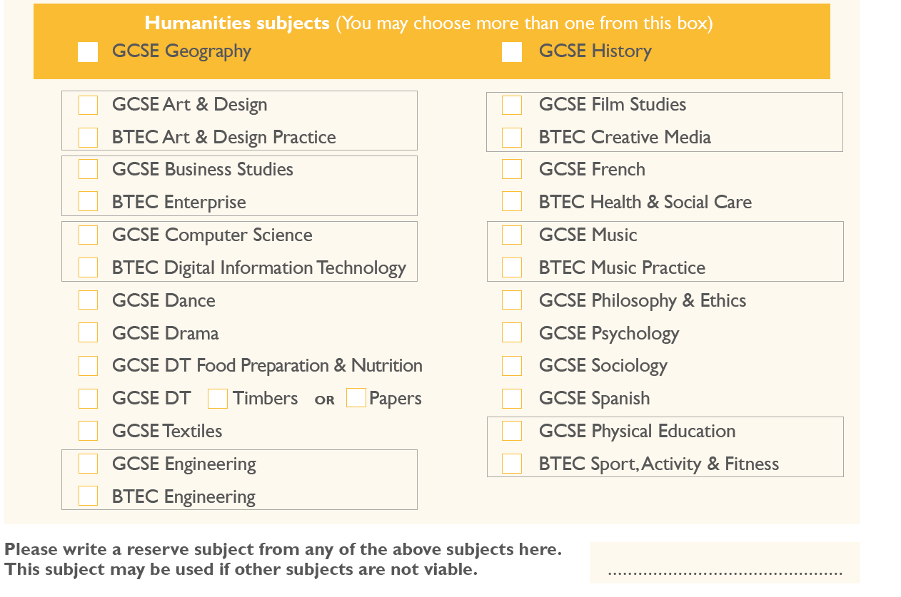
Notes:
This is the options form from 2019-20 and is subject to change for 2020 cohort

Slide 15
MAKING YOUR CHOICES
You must choose at least 1 option from History or Geography. (You can choose both)
You cannot choose more than 2 DT options.
You cannot choose both the GCSE and Technical Award options.

Slide 16
Notes:
This is the options form from 2019-20 and is subject to change for 2020 cohort

Slide 17
GOOD REASONS
Choose subjects in which you feel you will do well and are motivated. You are then more likely to do well and achieve.
Use the ATL, effort and teacher recommendation report to help you make an informed choice.
Talk to subject teachers in your lessons and on the Year 9 options evening.
Think about your future career. We offer a broad curriculum which helps to keep options open in the future.
Choose subjects that match how you learn best. Look at the subject pages to see how each subject is examined. Some students prefer a course with a large quantity of coursework, whereas some prefer subjects which are mainly based on examinations. Make sure you plan your courses to play to your strengths.

Slide 18
BAD REASONS
Picking a subject just because your friend is doing it. The subject may not suit you and you may not be in the same class anyway.
You like the teacher you’ve got this year and you would really like to work with them in your option choice.
Don’t pick several subjects with lots of project work or rehearsals unless you are prepared to put in the time. Some students will cope with a large coursework load, but many will not.

Slide 19
GUIDANCE
We endeavour to meet all students’ first 4 option choices, but if this is not possible then we will use the reserve option and inform you of this change.
All courses are subject to demand. If not enough students choose a course, the subject will not be available.
If a large number of students express a preference for a course, we will do our best to put on additional classes to meet the demand, but this may not always be possible, for reasons of staffing and specialist facilities.
If subjects are oversubscribed, and we are unable to put on another additional class, preference will be given to students who have returned the form by the deadline. Other criteria may be used in particular subjects, for example homework record, or reliability in bringing kit or ingredients in practical lessons.

Slide 20
Key Contacts
Form tutor
Subject teachers and Head of Department
Richard Sinclair – Head of Year
Emma Foreman – Careers Advice and Guidance
Thomas Rowell & Sian Waterhouse – Learning Support
Ian Butler – Vice Principal Interim Vice Principal
Any concerns please email first initial followed by last name @bestacademies.org.uk
(e.g RSinclair@bestacademies.org.uk)

