Slide 1
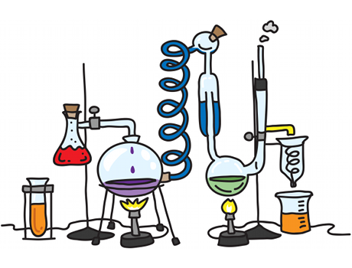
1
INDUCTION 2021
CONTENTS:
SUITABILITY
WHY CHOOSE IT?
EXPECTATIONS
SPECIFICATION
CONTENT
EXAMS
INDUCTION TEST
SUMMER PREP WORK

Slide 2
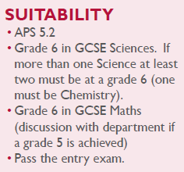
2
SUITABILITY:
In all topics, you will need to learn facts and build a body of knowledge but also to understand and apply the ideas. Many topics include calculations and so you should feel comfortable rearranging equations and using numbers.
Importantly, chemistry is a hands-on science and you will carry out experiments on a regular basis. This is to consolidate your theory work, but also provide you with the opportunity to use new apparatus and build your skills and confidence to complete safe and accurate practical work.

Slide 3
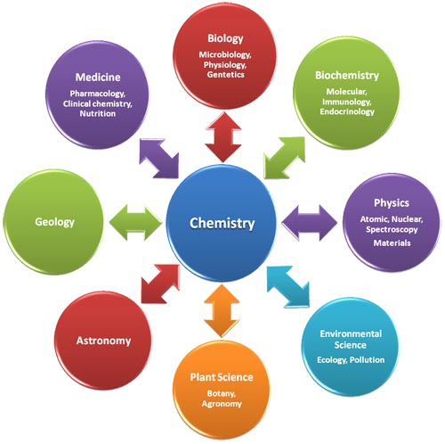
3
WHY CHOOSE IT?
Chemistry A level is a highly respected A level, with its broad variety of tested skills, and it is a good choice for many degrees and careers. Chemistry has been described as the ‘central science’ and is often combined with either physics or biology. It is usually a compulsory choice for anyone wishing to pursue medicine, dentistry and veterinary science, as well as chemistry-based degrees such as pharmacy, pharmacology and biochemistry.
It has both theoretical and practical aspects which keeps lessons interesting and varied.
It is taught by very experienced members of staff- Mr Hardy (bad cop) & Dr Haigh (good cop).
It enables you to develop crucial employability skills including researching, problem solving and analysing. Chemistry often requires teamwork and communication skills too, which is great for project management.

Slide 4
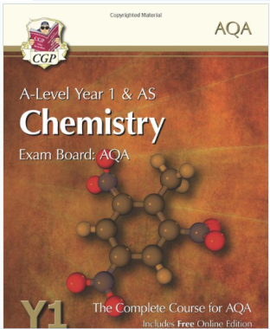
4
EXPECTATIONS:
ATTENDANCE- needs to be extremely high otherwise you won’t do well. A level chemistry is tough and every year we have students who find the transition difficult. What ever the topic, activity, or task you are set you will have to give your FULL commitment.
DEADLINES- always must be met.
RECORD KEEPING- you need to keep your study notes/work in an organised folder. You will also need to buy an A4 hardback lab book to write up your experiments in. You will have a minimum of 12 experiments over the two years. If your lab book is assessed as up to standard you will also be accredited with the experimental award on your final certificate.
TEXTBOOKS- we strongly advise you to purchase the recommended book(s).
https://www.amazon.co.uk/New--Level-Chemistry-AQA-Student/dp/1782943218/ref=sr_1_3?s=books&ie=UTF8&qid=1467284369&sr=1-3&keywords=aqa+chemistry+as+year+1

Slide 5
5
SPECIFICATION:
https://filestore.aqa.org.uk/resources/chemistry/specifications/AQA-7404-7405-SP-2015.PDF

Slide 6
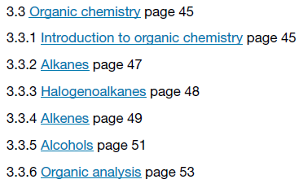
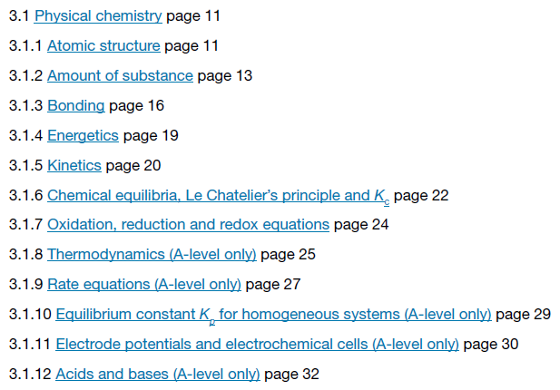
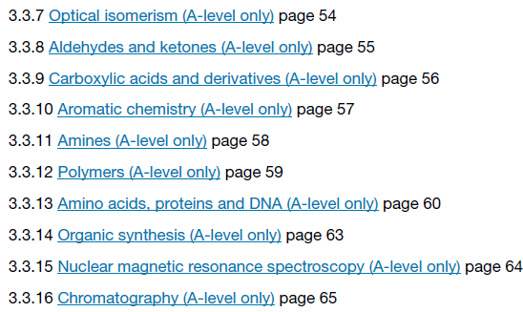
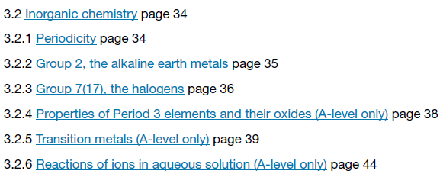
6
CONTENT:
3 main topics:
Physical Chemistry
Inorganic Chemistry
Organic Chemistry

Slide 7
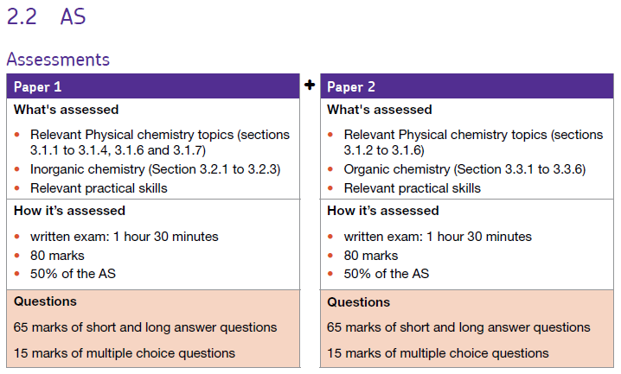
7
EXAMS:
Content that will be taught and internally examined in year 12 but will not count to your overall grade.

Slide 8
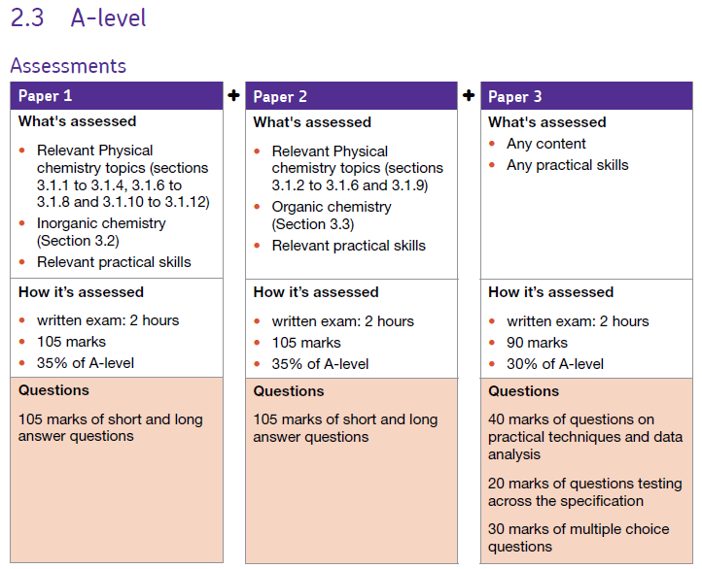
8
EXAMS:
Content that will be taught and externally examined in year 13 and will count to your overall grade.

Slide 9
9
INDUCTION TEST:
First lesson in September.
We would expect you to know the following as a minimum:
4.1 Atomic Structure and the periodic table:
subatomic particles, electronic structure, noble gases, halogens, alkali metals
4.2 Bonding, structure and the properties of matter :
bonding x3, properties of small molecules/alloys/ionic/covalent compounds
4.3 Quantitative chemistry:
balancing equations, Mr, moles, amount of substances in equations, limiting reactions
4.4 Chemical changes:
reactivity series, metal extraction, salts, electrolysis, metal+acid reactions,
4.5 Energy changes:
exothermic and endothermic reactions, reaction profiles
4.6 The rate and extent of chemical change:
calculating rate, factors, reversibility/equilibrium
4.7 Organic chemistry :
crude oil, hydrocarbons , alkanes, fractional distillation, cracking
4.8 Chemical analysis:
chromatography, gas tests,
4.9 Chemistry of the atmosphere:
atmosphere composition, atmosphere evolution, climate change, pollutants
4.10 Using resources:
sustainable development, potable water, waste water treatment
https://filestore.aqa.org.uk/resources/chemistry/specifications/AQA-8462-SP-2016.PDF
INCLUDING ‘TRIPLE’ (CHEMISTRY ONLY) TOPICS

Slide 10
11
SUMMER PREP WORK:
The most important thing you can do to prepare over summer is to know GCSE Chemistry like the back of your hand. You cannot build a tower block on shaky foundations. If you were a ‘triple’ student then revise all Chemistry you were ever taught for GCSE. If you were a ‘combined’ student then it is expected that you to learn the extra ‘triple’ content before the induction test in September….on top of revising the ‘combined’ content.
https://filestore.aqa.org.uk/resources/chemistry/specifications/AQA-8462-SP-2016.PDF
Pre-reading:
‘Head Start to A-Level Chemistry’- GCP
‘Essential Maths Skills for A-Level Chemistry’- GCP
List of good A-Level Chemistry websites: (with the caveat that I cannot check every web page that appears on these websites)
http://www.chemguide.co.uk
http://www.s-cool.co.uk/a-level/chemistry
http://www.a-levelchemistry.co.uk
http://www.physicsandmathstutor.com/chemistry-revision/a-level-aqa/
http://www.rsc.org/learn-chemistry/wiki/A-Level_Chemistry_Revision
http://www.docbrown.info/page13/page13.htm

