Slide 1
BTEC Level 3 National Extended Certificate in Health and Social Care = one A Level
Believe – Achieve – Succeed – Exceed

Slide 2
Aims of this session
To help you to understand how this course works and the units you will be studying.
To discuss the expectations of the course.
Opportunities for you to ask any questions.

Slide 3
Questions to get you thinking…
Why did you decide to choose this subject?
Where do you hope your A level choices will take you in the future? What are your aspirations OR future career prospects?
How do you think next year will be different from your GCSEs?
What do you think will be the biggest challenge?

Slide 4
Sixth form ethos
Believe – Achieve – Succeed – Exceed
As a department we want all of you to aim to achieve all Distinction grades in every one of your HSC units.
Expectations are high and you should be aiming for the best.
(UCAS subject references and Overall UCAS points score)

Slide 5
Our Expectations of You
That you will make a commitment to achieving the very best that you are capable of.
That you meet the deadlines set for the assessments.
That you engage and contribute in all learning activities.

Slide 6
Your expectations of us
That we will deliver the content that will enable you to achieve your very best.
That we make learning fun and interesting.
That you will receive timely academic guidance and feedback.

Slide 7
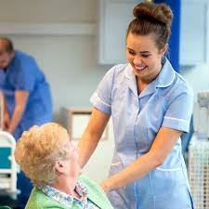
What is the difference between the Health and Social Care Sector?

Slide 8
The health and social care sector
Health care includes all hospital activities, medical nursing homes, GP services
Social care includes residential nursing care, domiciliary care (care in the home), social work

Slide 9
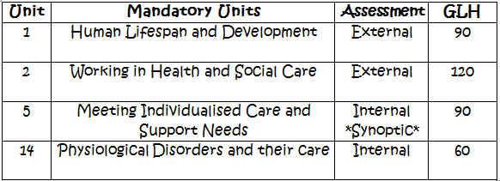
The Course Overview
Equivalent to 1 A level
Unit 1 & Unit 5 in Year 12
Unit 2 & Unit 14 in Year 13
*NOTE- You must get at least a PASS in your internal units to gain a Level 3 qualification

Slide 10
Units studied and Points System
Year 12 = 180 GLH | Year 13 = 180 GLH
Unit 1 – Exam (90 GLH) Unit 5 – Coursework (90 GLH) | Unit 2 – Exam (120 GLH) Unit 14 – Coursework (60 GLH)

Slide 11
Unit 1 Human Lifespan Development
Written exam set and marked by Pearson - 1.5 hours/ 90 marks
Develops knowledge and understanding of patterns of human growth and development, exploring key aspects of growth and development, and the experience of health and wellbeing.

Slide 12
Unit 2 Working in Health and Social Care
Externally assessed
Aims to help you understand what it is like to work in the health and social care sector.
To understand responsibilities that you need to understand and carry out such as maintaining the safety of and safeguarding individuals
You look at the range of roles and responsibilities of people who work in health and social care settings, learning about the organisations that provide services in this sector, and the different settings in which these services are delivered according to the needs of the service user.

Slide 13
Unit 5 Meeting Individual Care & Support Needs – Miss Blessing
Internally assessed through assignment
To provide care and support individuals need, you need to have a good understanding of the principles behind providing quality care and support.
You will learn about the values and principles of meeting care and support needs and look at some of the ethical issues that arise when personalising care.
You will examine factors that can impact the professionals who provide the care and support, and the challenges that must be overcome to allow access to good quality care and health services.

Slide 14
Unit 14 Physiological Disorders
Internal assessment – assignment
It is essential to understand the nature of physiological disorders and how to provide appropriate treatment and care.
This includes being aware of the causes and effects of physiological disorders, as well as the roles of different professionals involved in providing treatment and care for service users. I
You will learn about the signs and symptoms of physiological disorders and how they are investigated and diagnosed. You will also learn about the different types of treatment and support available for individual service users, including surgery, rehabilitation and complementary therapies.

Slide 15
Useful documents
Specification
https://qualifications.pearson.com/content/dam/pdf/BTEC-Nationals/Health-and-Social-Care/2016/specification-and-sample-assessments/9781446938003_BTEC_Nat_ExCert_HSC_AG_Spec_Iss3C.pdf

Slide 16
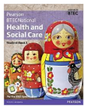
Recommended textbook
BTEC National Health and Social Care Student Book 1
Publisher: Pearson
Author: Marilyn Billingham, Pamela Davenport, Hilary Talman, Nicola Matthews, Beryl Stretch, Elizabeth Haworth
ISBN: 9781292126012

Slide 17
Additional material for the examined units
BTEC National Health and Social Care Revision Guide
Publisher: Pearson
Author: Brenda Baker, James O'Leary, Marie Whitehouse, Georgina Shaw
ISBN: 9781292230443
BTEC National Health and Social Care Revision Workbook
Publisher: Pearson
Author: Georgina Shaw, James O'Leary, Elizabeth Haworth, Brenda Baker
ISBN: 9781292230580

Slide 18
New changes you need to consider
- 'N grade' is only given for units 1, 2, 3 and 4.
- Holistic teaching - no coaching should be given after the assignment brief has been given out. Teachers must encourage independence.
- Referencing is essential at level 3. Neil's tool box was suggested as a good app to use.
Students are entitled to a re-submission – but if they miss a deadline it is not allowed to be given.
- Up to 15 days can be given for a re-submission.

Slide 19
Any Questions? Then please email myself or Miss Blessing kchamberlain@bestacademies.org.uk kblessing@bestacademies.org.uk

