Slide 1
BTEC L3 Creative Digital Media
Taster session

Slide 2
Course name…
BTEC Level 3 National Extended Certificate in Creative Digital Media Production
Equivalent of 1 A level

Slide 3
Why Media?
Interested in working in the industry
Want a balance between coursework (project work) and examinations
You’re creative, and this is a chance to express that
You want to learn technical and practical skills

Slide 4
Our course
Pearson
2 x exam units
2 x coursework units

Slide 5
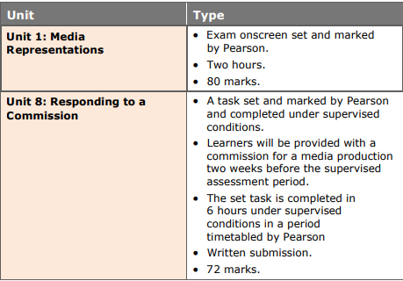
Examination units

Slide 6
Coursework units
Unit no. | Unit name | GLH
4 | Pre production Portfolio | 90
10 | Film Production- Fiction | 90

Slide 7
grading
PASS | MERIT | DISTINCTION | DISTINCTION*
E | C | A | A*
Near Pass
Only for exams
Distinction* is not a different grade. It is only achievable from a
culmination of distinctions

Slide 8
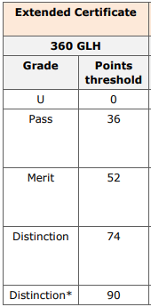
Adding up your grades
There are different points associated with grades in each unit. You add these up to find out your overall grade

Slide 9
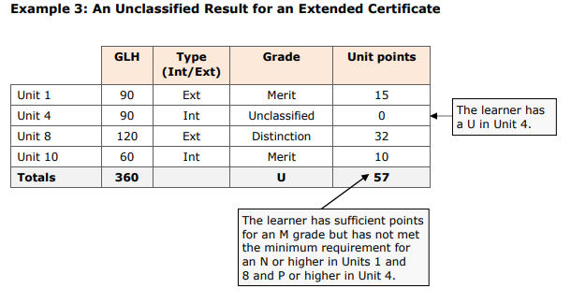

Slide 10
Btec rules
You get given an assignment brief- with a clear deadline date
You submit your work on the due date. The assessor (us) will then feedback to you and allow a resubmission.
You will have 10 days to produce this resubmission
If you fail to meet the initial deadline, you will have 10 days to submit your coursework still… but you cannot achieve higher than a PASS (E grade)

Slide 11
Folder
Please make sure you have bought a folder with dividers for September
You have 4 units, but when you consider all the assignments you have you may want more
We will provide an exercise book for internal assessments
We may be using a lot of online platforms (google classroom) so if you have access to a tablet/laptop that could be very useful

Slide 12
Summer work
We want you to prepare a Googleslides presentation on any media text that you are interested in. This text can come from any of these examples;
Film/TV
Advertising
Games
Music Videos
Magazines

Slide 13
Summer work
Presentation title;
How does [your example] represent gender or ethnicity?
What types of people are represented?
Are these representations fair? Positive? Negative?
How have these representations been formed? What has the producer/director done to create this image?
How have people responded to these representations? Are there differing responses? Has this changed in time?

Slide 14
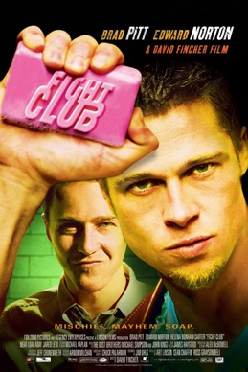
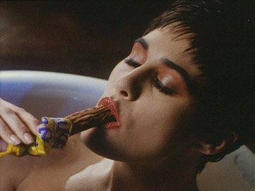
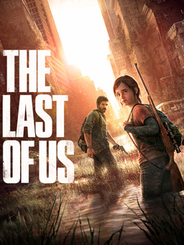
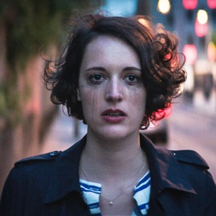
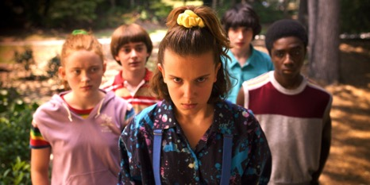
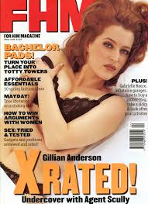
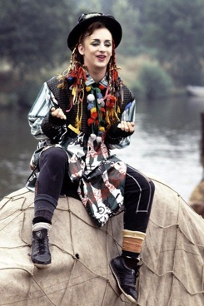
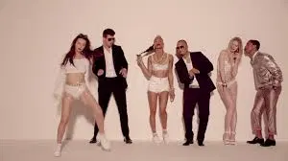
GENDER

Slide 15
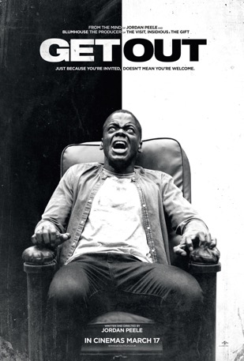
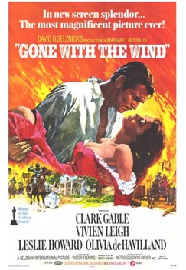
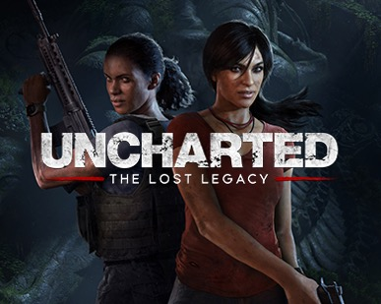
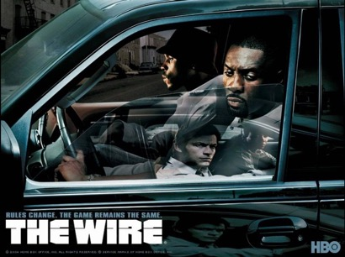
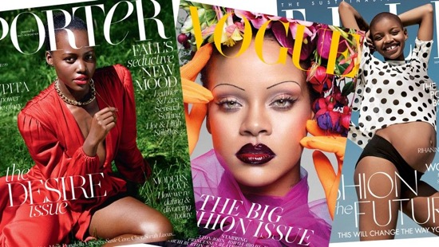
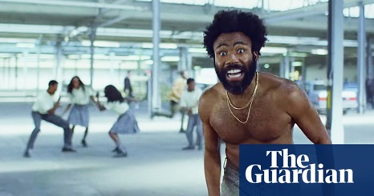
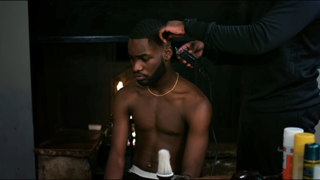
ETHNICTY

