Slide 1
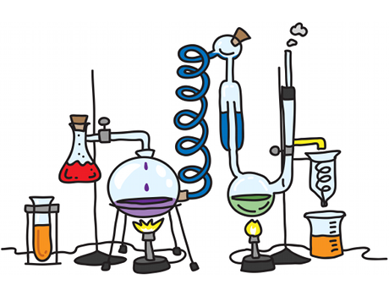
1
INDUCTION 2020
CONTENTS:
SUITABILITY
WHY CHOOSE IT?
EXPECTATIONS
SPECIFICATION
CONTENT
EXAMS
INDUCTION TEST
SUMMER PREP WORK

Slide 2
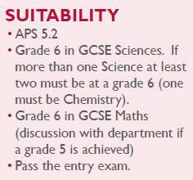
2
SUITABILITY:
In all topics, you will need to learn facts and build a body of knowledge but also to understand and apply the ideas. Many topics include calculations and so you should feel comfortable rearranging equations and using numbers.
Importantly, chemistry is a hands-on science and you will carry out experiments on a regular basis. This is to consolidate your theory work, but also provide you with the opportunity to use new apparatus and build your skills and confidence to complete safe and accurate practical work.

Slide 3
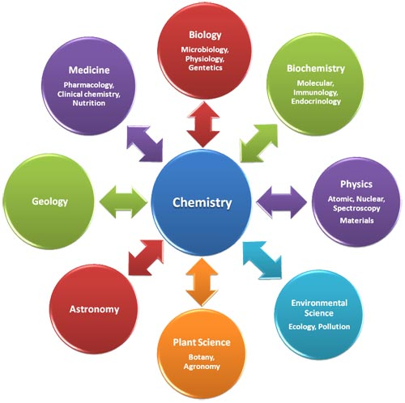
3
WHY CHOOSE IT?
Chemistry A level is a highly respected A level, with its broad variety of tested skills, and it is a good choice for many degrees and careers. Chemistry has been described as the ‘central science’ and is often combined with either physics or biology. It is usually a compulsory choice for anyone wishing to pursue medicine, dentistry and veterinary science, as well as chemistry-based degrees such as pharmacy, pharmacology and biochemistry.
It has both theoretical and practical aspects which keeps lessons interesting and varied.
It is taught by very experienced members of staff- Mr Hardy (bad cop) & Dr Haigh (good cop).
It enables you to develop crucial employability skills including researching, problem solving and analysing. Chemistry often requires teamwork and communication skills too, which is great for project management.

Slide 4
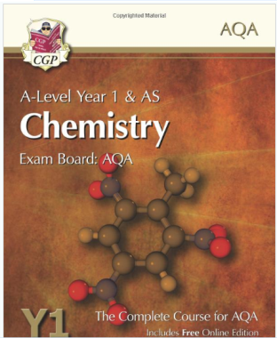
4
EXPECTATIONS:
ATTENDANCE- needs to be extremely high otherwise you won’t do well. A level chemistry is tough and every year we have students who find the transition difficult. What ever the topic, activity, or task you are set you will have to give your FULL commitment.
DEADLINES- always must be met.
RECORD KEEPING- you need to keep your study notes/work in an organised folder. You will also need to buy an A4 hardback lab book to write up your experiments in. You will have a minimum of 12 experiments over the two years. If your lab book is assessed as up to standard you will also be accredited with the experimental award on your final certificate.
TEXTBOOKS- we strongly advise you to purchase the recommended book(s).
https://www.amazon.co.uk/New--Level-Chemistry-AQA-Student/dp/1782943218/ref=sr_1_3?s=books&ie=UTF8&qid=1467284369&sr=1-3&keywords=aqa+chemistry+as+year+1

Slide 5
5
SPECIFICATION:
https://filestore.aqa.org.uk/resources/chemistry/specifications/AQA-7404-7405-SP-2015.PDF

Slide 6
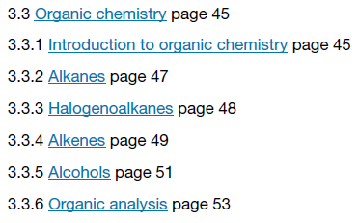
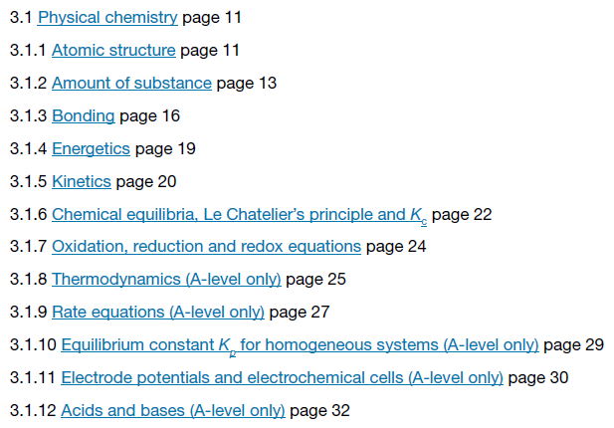
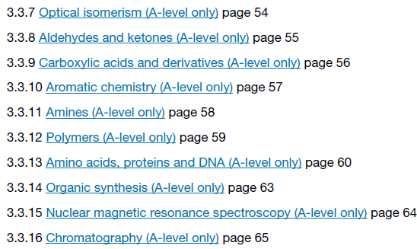
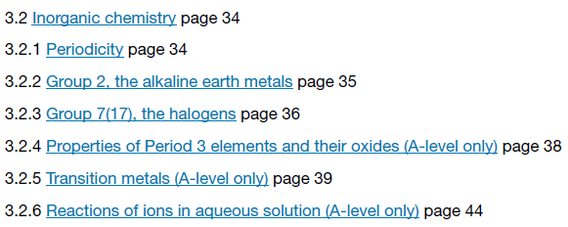
6
CONTENT:
3 main topics:
Physical Chemistry
Inorganic Chemistry
Organic Chemistry

Slide 7
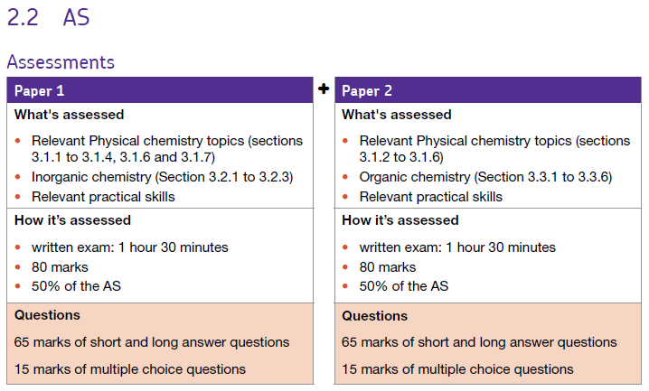
7
EXAMS:
Content that will be taught and internally examined in year 12 but will not count to your overall grade.

Slide 8
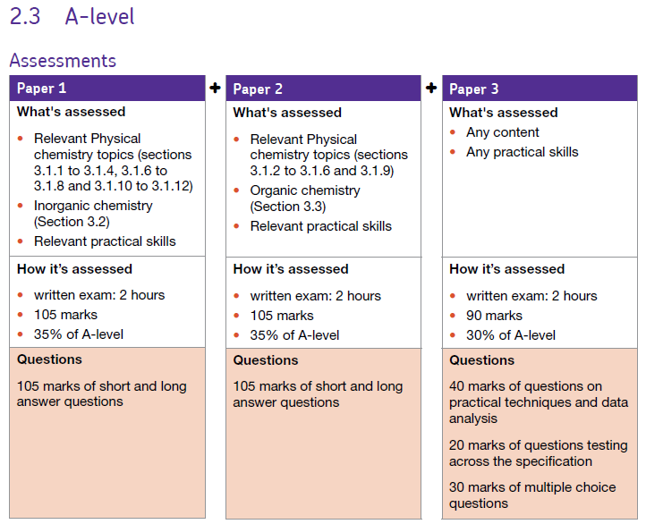
8
EXAMS:
Content that will be taught and externally examined in year 13 and will count to your overall grade.

Slide 9
9
INDUCTION TEST:
First lesson in September.
We would expect you to know the following as a minimum:
4.1 Atomic Structure and the periodic table:
subatomic particles, electronic structure, noble gases, halogens, alkali metals
4.2 Bonding, structure and the properties of matter :
bonding x3, properties of small molecules/alloys/ionic/covalent compounds
4.3 Quantitative chemistry:
balancing equations, Mr, moles, amount of substances in equations, limiting reactions
4.4 Chemical changes:
reactivity series, metal extraction, salts, electrolysis, metal+acid reactions,
4.5 Energy changes:
exothermic and endothermic reactions, reaction profiles
4.6 The rate and extent of chemical change:
calculating rate, factors, reversibility/equilibrium
4.7 Organic chemistry :
crude oil, hydrocarbons , alkanes, fractional distillation, cracking
4.8 Chemical analysis:
chromatography, gas tests,
4.9 Chemistry of the atmosphere:
atmosphere composition, atmosphere evolution, climate change, pollutants
4.10 Using resources:
sustainable development, potable water, waste water treatment
OVERVIEW

Slide 10
PAPER 1
PAPER 2
10
4.1 Atomic Structure and the periodic table
4.2 Bonding, structure and the properties of matter
4.6 The rate and extent of chemical change
4.7 Organic chemistry
4.7.1.1 Crude oil, hydrocarbons and alkanes
4.7.1.2 Fractional distillation and petrochemicals
4.7.1.3 Properties of hydrocarbons
4.7.1.4 Cracking and alkenes
4.1.1.1 Atoms, elements and compounds
4.1.1.2 Mixtures
4.1.1.3 The development of the model of the atom
4.1.1.4 Relative electrical charges of subatomic particles
4.1.1.5 Size and mass of atoms
4.1.1.6 Relative atomic mass
4.1.1.7 Electronic structure
4.1.2.1 The periodic table
4.1.2.2 Development of the periodic table
4.1.2.3 Metals and non-metals
4.1.2.4 Group 0
4.1.2.5 Group 1
4.1.2.6 Group 7
4.2.1.1 Chemical bonds
4.2.1.2 Ionic bonding
4.2.1.3 Ionic compounds
4.2.1.4 Covalent bonding
4.2.1.5 Metallic bonding
4.2.2.1 The three states of matter
4.2.2.2 State symbols
4.2.2.3 Properties of ionic compounds
4.2.2.4 Properties of small molecules
4.2.2.5 Polymers
4.2.2.6 Giant covalent structures
4.2.2.7 Properties of metals and alloys
4.2.2.8 Metals as conductors
4.2.3.1 Diamond
4.2.3.2 Graphite
4.2.3.3 Graphene and fullerenes
4.6.1.1 Calculating rates of reactions
4.6.1.2 Factors with affect the rates of chemical reactions
4.6.1.3 Collision theory and activation energy
4.6.1.4 Catalysts
4.6.2.1 Reversible reactions
4.6.2.2 Energy changes and reversible reactions
4.6.2.3 Equilibrium
4.6.2.4 The effect of changing conditions on equilibrium (HT ONLY)
4.6.2.5 The effect of changing concentration (HT ONLY)
4.6.2.6 The effect of temperature changes on equilibrium (HT ONLY)
4.6.2.7 The effect of pressure changes on equilibrium (HT ONLY)
4.8 Chemical analysis
4.8.1.1 Pure substances
4.8.1.2 Formulations
4.8.1.3 Chromatography
4.8.2.1 Test for hydrogen
4.8.2.2 Test for oxygen
4.8.2.3 Test for carbon dioxide
4.8.2.4 Test for chlorine
GCSE CombinedChemistry
4.10 Using resources
4.3 Quantitative chemistry
4.4 Chemical changes
4.10.1.1 Using the Earth's resources and sustainable development
4.10.1.2 Potable water
4.10.1.3 Waste water treatment
4.10.1.4 Alternative methods of extracting metals (HT ONLY)
4.10.2.1 Life cycle assessment
4.10.2.2 Ways of reducing the use of resources
4.3.1.1 Conservation of mass and balanced chemical equations
4.3.1.2 Relative formula mass
4.3.1.3 Mass changes when a reactant or product is a gas
4.3.1.4 Chemical measurements
4.3.2.2 Moles (HT ONLY)
4.3.2.2 Amounts of substances in equations (HT ONLY)
4.3.2.3 Using moles to balance equations (HT ONLY)
4.3.2.4 Limiting reactions (HT ONLY)
4.3.2.5 Concentration of solutions
4.4.1.1 Metal oxides
4.4.1.2 The reactivity series
4.4.1.3 Extraction of metals and reduction
4.4.1.4 Oxidation and reduction in terms of electrons (HT ONLY)
4.4.2.1 Reactions of acids with metals
4.4.2.2 Neutralisation of acids and salt production
4.4.2.3 Soluble salts
4.4.2.4 The pH scale and neutralisation
4.4.2.6 Strong and weak acids (HT ONLY)
4.4.3.1 The process of electrolysis
4.4.3.2 Electrolysis of molten ionic compounds
4.4.3.3 Using electrolysis to extract metals
4.4.3.4 Electrolysis of aqueous solutions
4.4.3.5 Representation of reactions at electrodes as half equations (HT ONLY)
4.9 Chemistry of the atmosphere
4.9.1.1 The proportions of different gases in the atmosphere
4.9.1.2 The Earth's early atmosphere
4.9.1.3 How oxygen increased
4.9.1.4 How carbon dioxide decreased
4.9.2.1 Greenhouse gases
4.9.2.2 Human activities which contribute to an increase in greenhouse gases in the atmosphere
4.9.2.3 Global climate change
4.9.2.4 The carbon footprint and its reduction
4.9.3.1 Atmospheric pollutants from fuels
4.9.3.2 Properties and effects of atmospheric pollutants
DETAILED
4.5 Energy changes
4.5.1.1 Energy transfer during exothermic and endothermic reactions
4.5.1.2 Reaction profiles
4.5.1.3 The energy changes of reactions (HT ONLY)
CONTENT YOU SHOULD KNOW AS MIMIMUM:

Slide 11
11
SUMMER PREP WORK:
The most important thing you can do to prepare over summer is to know GCSE Chemistry like the back of your hand. You cannot build a tower block on shaky foundations. If you were a ‘triple’ student then revise all Chemistry you were ever taught at SWA. If you were a ‘combined’ student then I would strongly advise you to learn the ‘triple’ content on top of revise the ‘combined’ content.
Pre-reading:
‘Head Start to A-Level Chemistry’- GCP
‘Essential Maths Skills for A-Level Chemistry’- GCP
List of good A-Level Chemistry websites: (with the caveat that I cannot check every web page that appears on these websites)
http://www.chemguide.co.uk
http://www.s-cool.co.uk/a-level/chemistry
http://www.a-levelchemistry.co.uk
http://www.physicsandmathstutor.com/chemistry-revision/a-level-aqa/
http://www.rsc.org/learn-chemistry/wiki/A-Level_Chemistry_Revision
http://www.docbrown.info/page13/page13.htm

