Slide 1
Graphic Communications
AS Introduction to the course
Exploring and responding to different artists. designers, illustrators and typographers to experiment with a variety of media to develop your visual communication skills

Slide 2
Project Title: ‘Eat’
Exploring artists and techniques
AO1/AO2

Slide 3
What do we want you to do before you start in September?
Research and investigate 5 of the illustrators that interest you.
Find out about the designers/photographers and illustrators , how they work, what inspires them, who they have created work for, find more of their work. Collect research on each and respond to those that really interest you by creating your own response to their work. . Display and present on A3 pages (or in a new sketchbook if you have one), do at least one double page spread of research per artist/designer as an absolute minimum, (no maximum but do have a holiday!), so 5 double page spreads.
We would like to see at least one response per artist where you have worked from observation or from your own photo, exploring the style and technique of your artist. To help you think of what you could actually do, each response could be reflecting one of the following terms: fresh, sweet, savoury, baked, home grown, healthy, calorific, organic, tasty.
You will be using this work as inspiration and to get ready for your topic of ‘Eat’ in September!

Slide 4
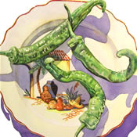
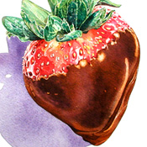
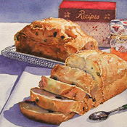
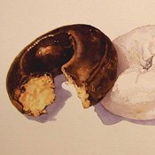
Ivy Glick & Associates Irena Roman Watercolour

Slide 5
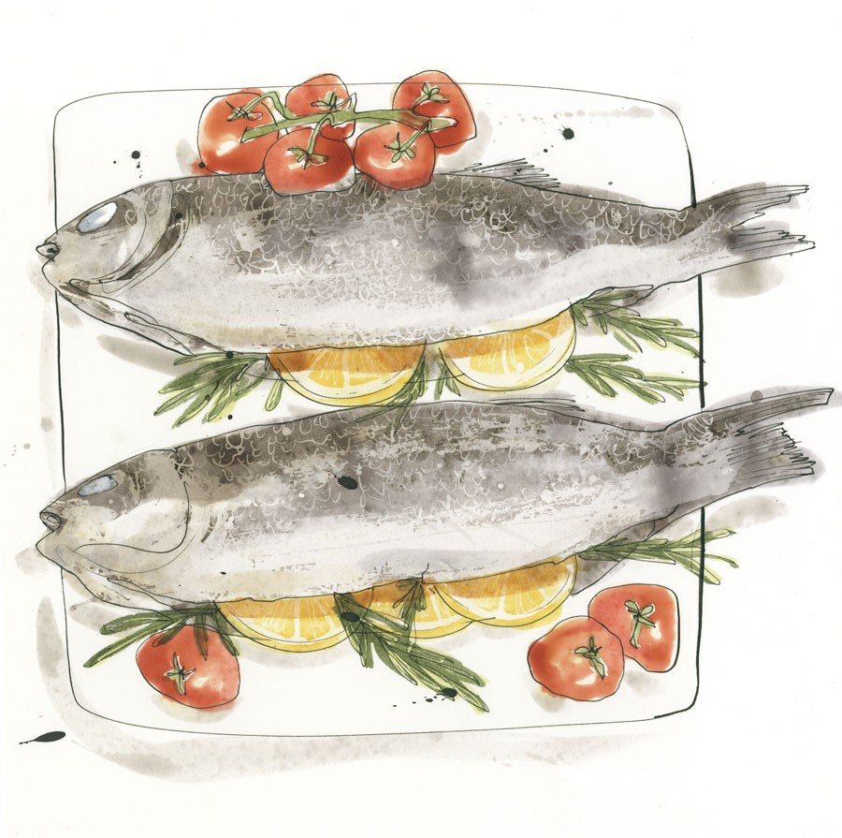
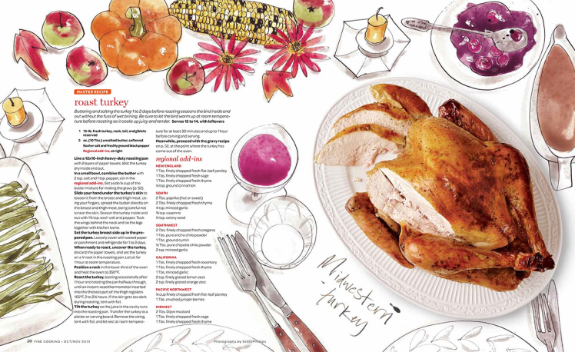
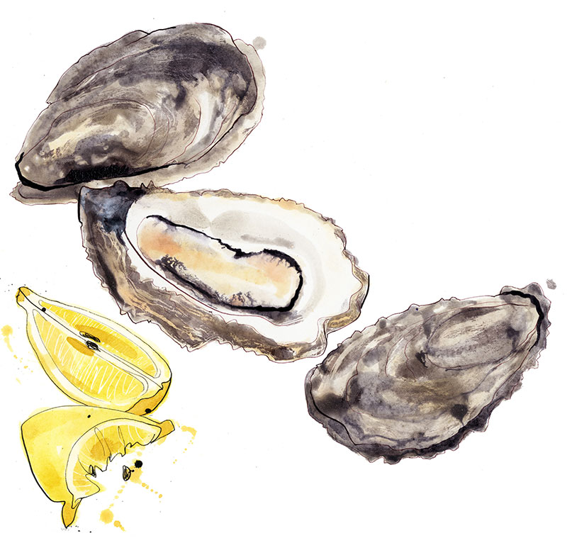
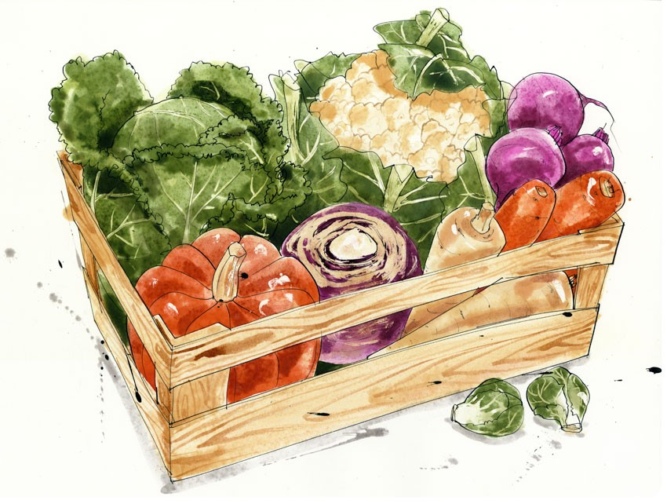
Louise Morgan http://www.louisemorgan.co.uk/food-and-drink

Slide 6
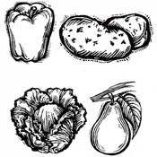
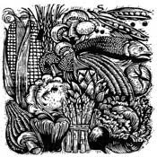
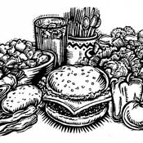
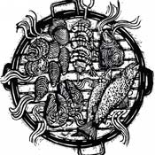
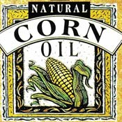
Ivy Glick & Associates Jerry Dadds Woodcut, line, scratchboard and colour pencil

Slide 7
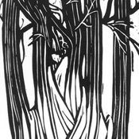
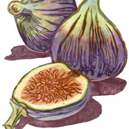
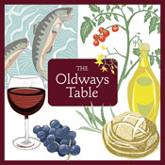
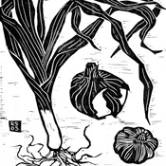
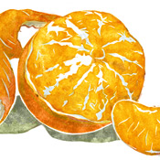
Ivy Glick & Associates Rigel Stuhmiller Blockprinting

Slide 8
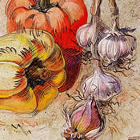
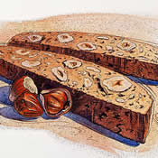
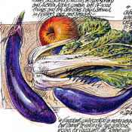
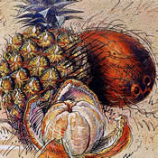
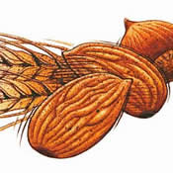
Ivy Glick & Associates Derek Grinnell Watercolour, pen and ink, gouache, mixed media

Slide 9
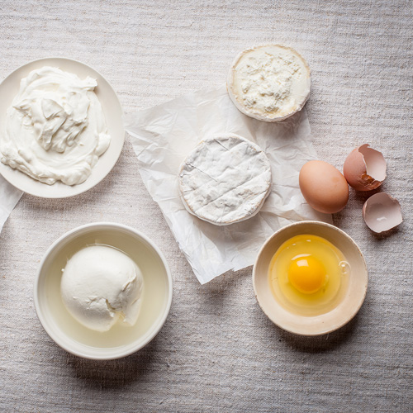
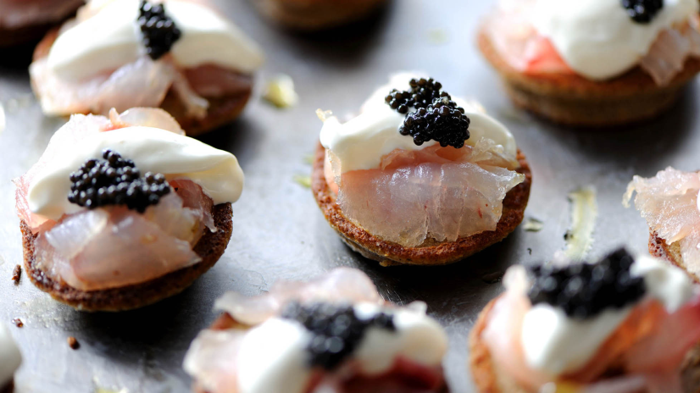
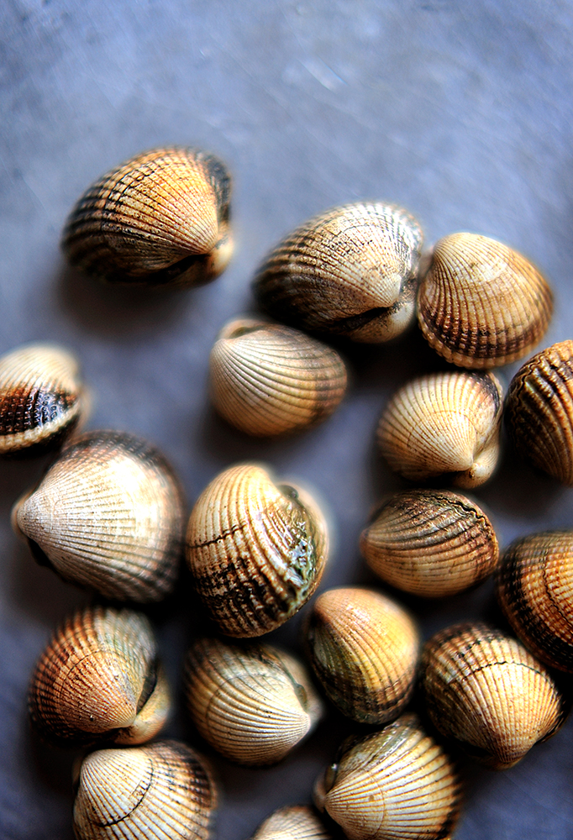
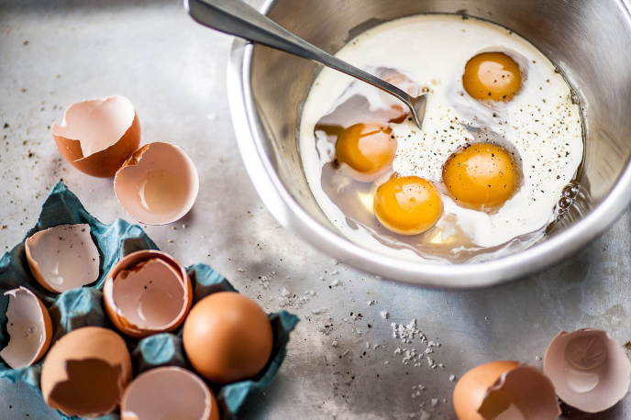
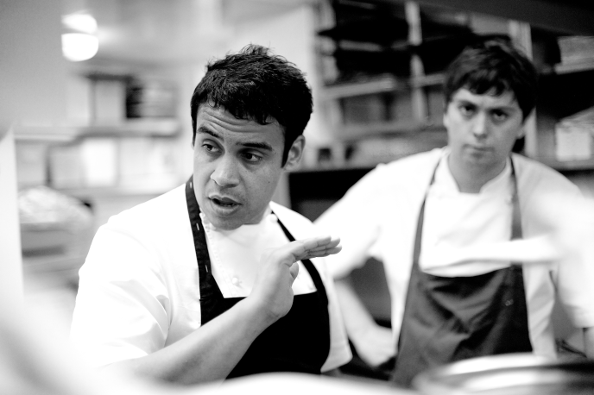
David Griffen – food photographer
https://www.davidgriffen.co.uk/

Slide 10
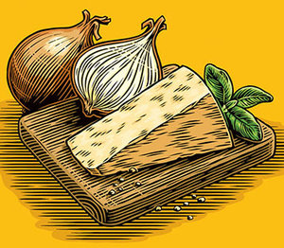
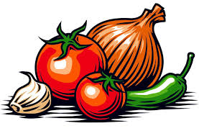
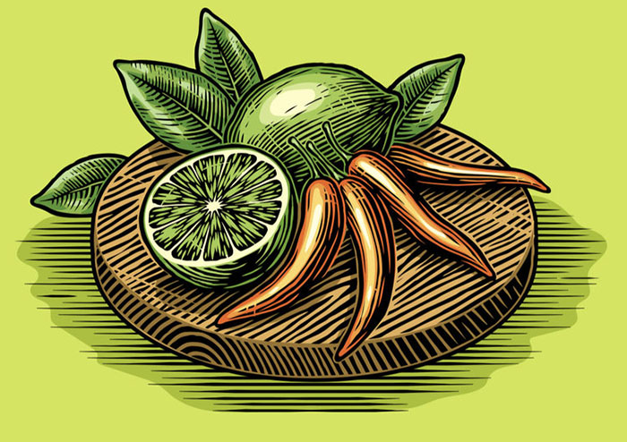
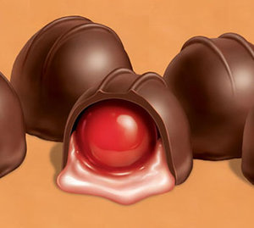
Gary Bullock - illustrator
https://www.bullockillustration.com/

Slide 11
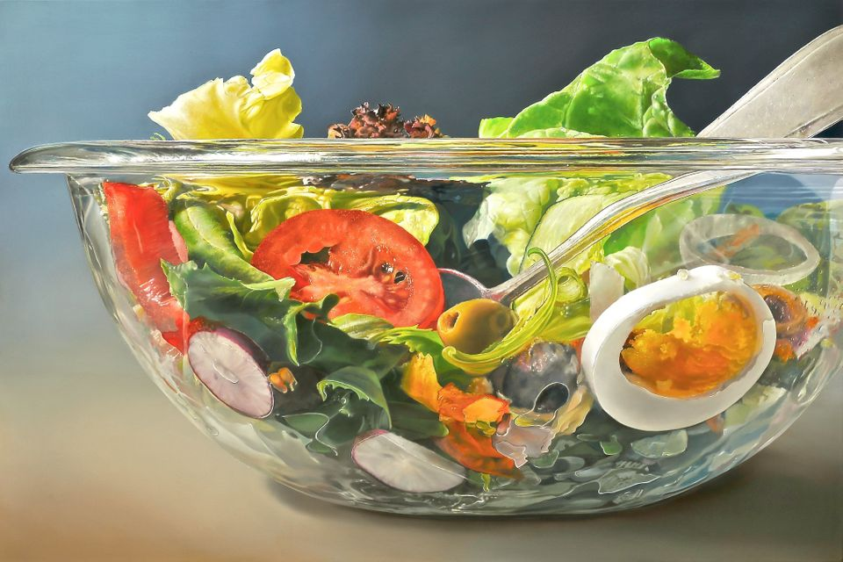
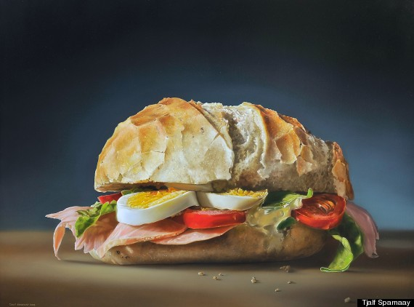
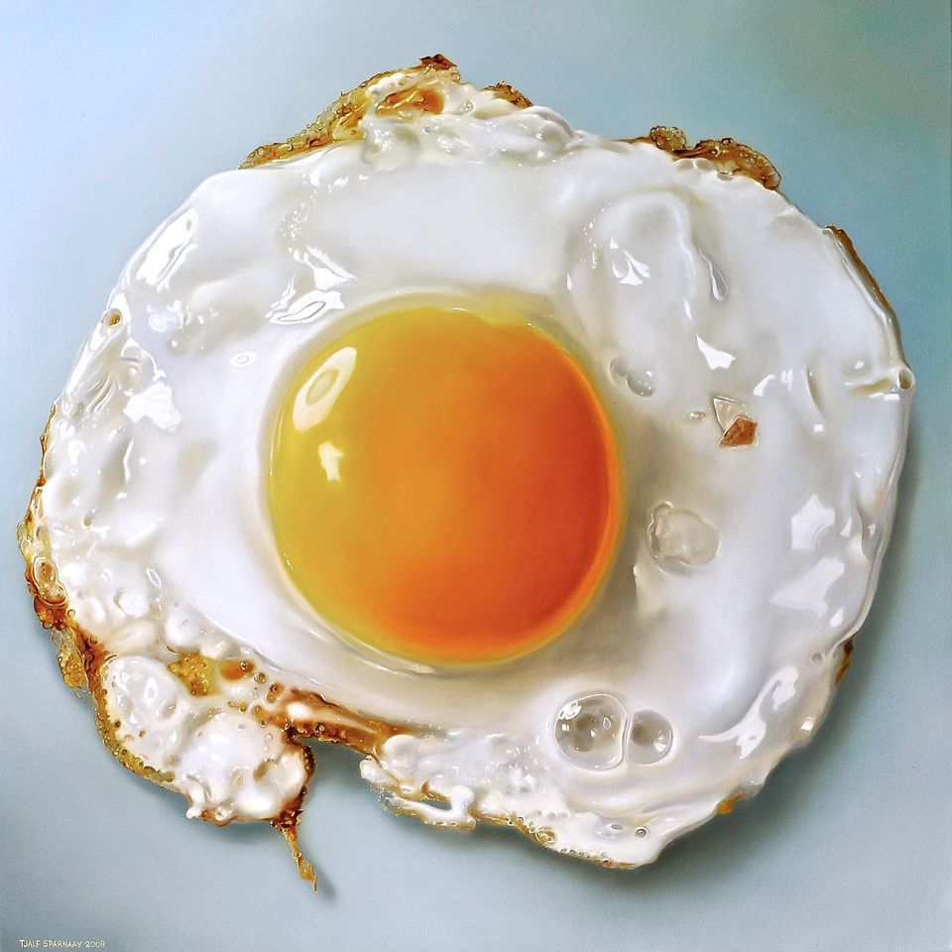
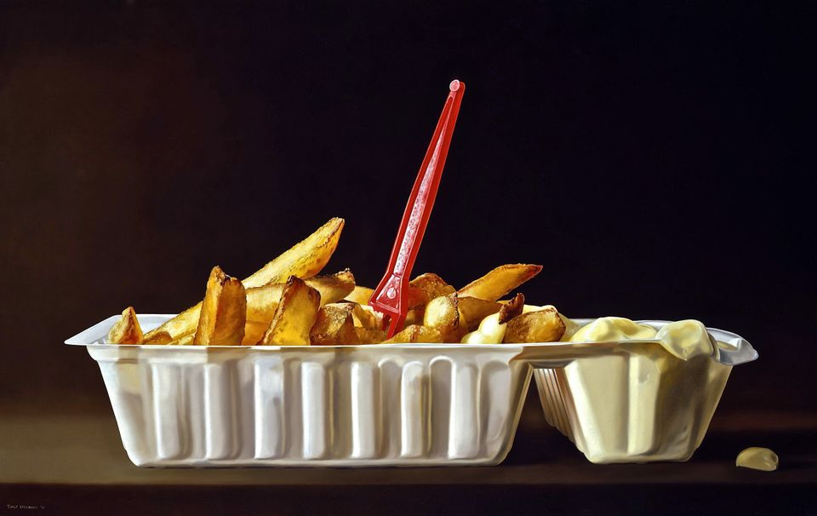
Tjalf Sparnaay
Painter- Photorealism
https://www.tjalfsparnaay.nl/en

Slide 12
How to start to research… Who are they? What media do they use? What process and methods do they go through to create their work Who do they work for or who have they worked for and do you have any examples of this? This is work that you see commercially, eg. Is it on packaging, posters, ad campaigns. What do you like about their work? With your response how did you create it to get the same effect?

Slide 13
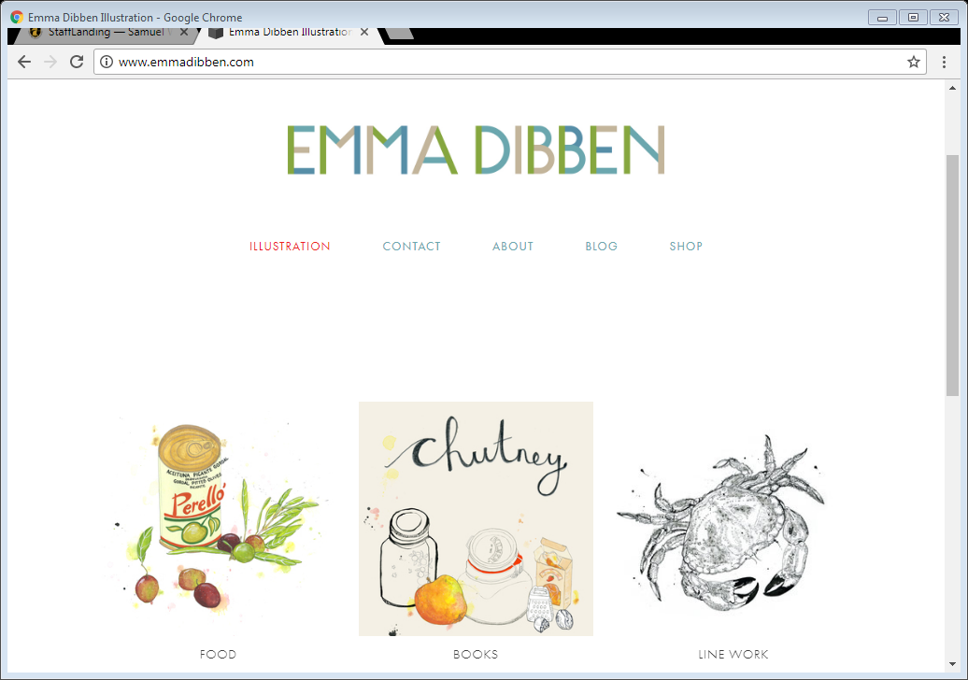
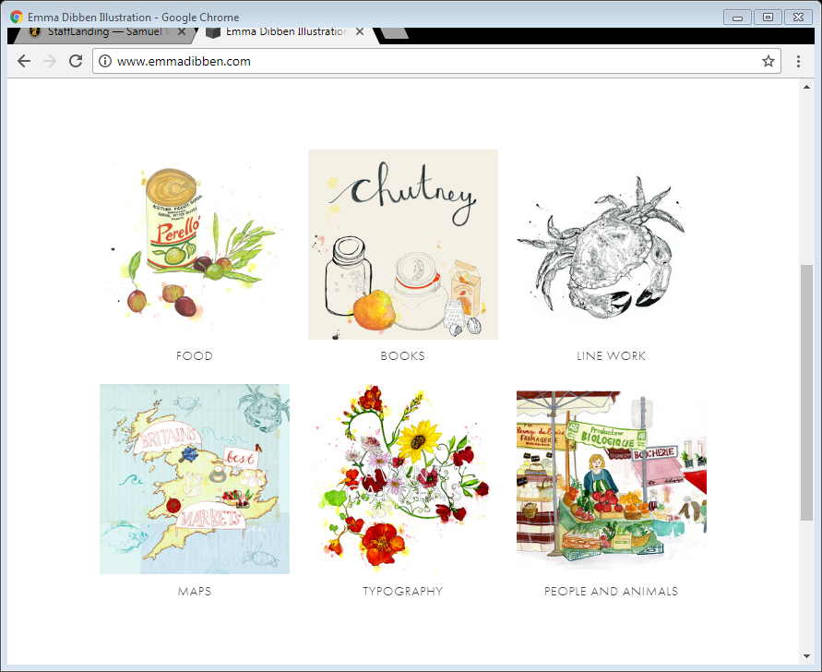
Emma Dibben

Slide 14
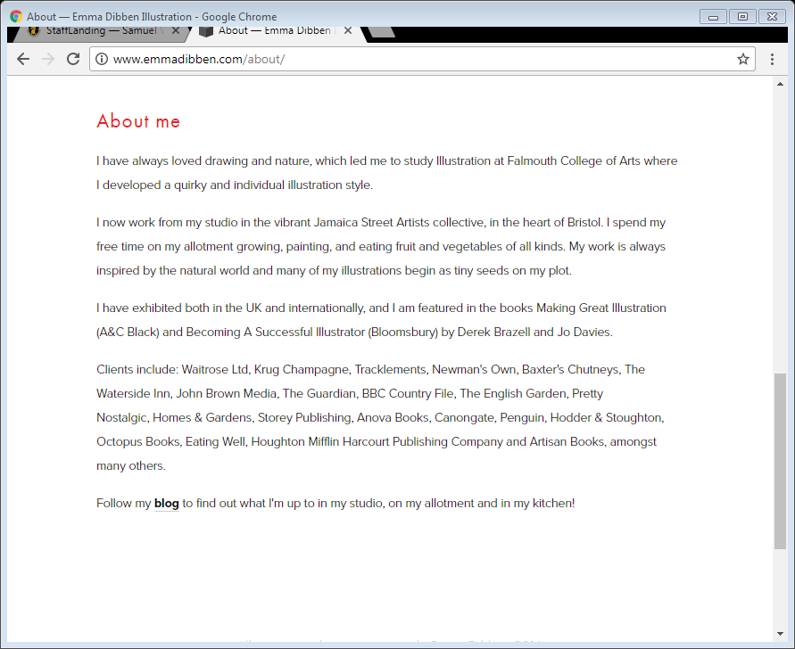
Emma Dibben

Slide 16
Emma Dibben

Slide 17
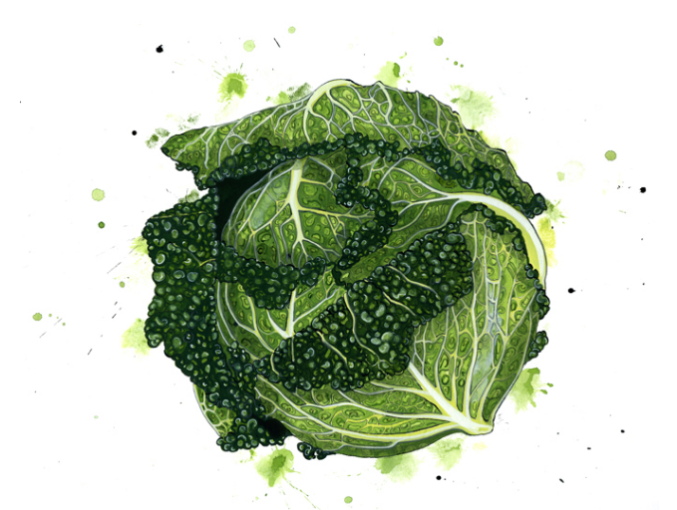

Slide 18
In September
You will use your research to start your project on the theme ‘Eat’ which will lead you into your chosen brief but the first couple of weeks will be exploration and experimentation.
You will be exploring visual language using different media and techniques, developing a range of skills.
You will take your own photography and create visual reference through drawings and using a variety of media and understanding composition.
You will respond to artists/designers/photographers to develop your skills and help create your own responses to help create ideas in answer to a brief.

Slide 19
Example briefs for ‘Eat’
Creating a brand identity for a restaurant or tapas type bar
Creating a brand identity for a deli and café/interior/packaging
Creating an identity and product range for a organic farm shop and delivery box service
Producing a new book about Mediterranean Cooking (or other culture), cover and illustrations and publicity launch.
Creating a brand identity for a bakery/interior graphics and packaging
Exhibition graphics for promoting a show on food at the NEC.
Create a website design for online ordering
Creating graphics/posters for the interior of a shop
Creating an identity for a fresh fish delivery company and advertising
Creating a brand identity for a new range of bath products that resemble food products
New Fashion brand identity, shop and promotional material

