Slide 1
BTEC Level 3 National Extended Certificate in Information Technology
360 Guided Learning Hours
(Basically - one A Level)
4 units
3 are mandatory
That means we can chose……. ONE!! What excitement!!

Slide 2
Unit 1 (exam) Unit 2 (set assignment - database) Unit 3 (portfolio) – 300 GLH
Unit 5 (modelling) OR Unit 6(Website development) – 60 GLH

Slide 3
Unit 1: Information Technology systems
Two hour exam, which is worth 90 marks.
The exam will assess your understanding of computer systems and the implications of their use in personal and professional situations.

Slide 4
Unit 2: Creating Systems to Manage Information
A task set and marked by Pearson and completed under supervised conditions.
• In part A, learners will be provided with a brief to complete five activities in the set task in three hours on the afternoon of the first day.
• In part B, learners will be provided with a brief to complete three activities in the set task in two hours on the morning of the second day.
• Completed using a computer and submitted electronically.
• 66 marks.
Includes thing like….
Knowledge of database development terminology, standards, concepts and processes
Create a software product to meet a client brief
Optimise the performance of a database solution
Evaluate the success of a database’s design and performance

Slide 5
Unit 3: Using Social Media in Business
Learning aims
A Explore the impact of social media on the ways in which businesses promote their products and services
B Develop a plan to use social media in a business to meet requirements
C Implement the use of social media in a business.

Slide 6
Unit 5: Data Modelling
Internally assessed by assignment.
Design a data model to be used by a business
Create a data model to meet a clients requirements.
There is going to be a fair amount of spreadsheet work!!!

Slide 7
Summer Course Preparation Project – Task 1
Produce a Google Docs presentation which is designed to teach other students about the features and uses of each of the following digital devices, using the Internet to do your research:
Your presentation should:
Include a slide about each device.
Describe what the device is used for and how it helps us as individuals and organisations.
Talk about the different features/specification of the devices and compare some, as part of this you should compare Laptops, Personal Computers and Tablets in terms of their:
Performance
Repair and Upgrade Ability
Average Cost
Portability
Health & Safety Considerations when using this Display Screen Equipment (DSE)
Compare their range of Uses for Individuals and Organisation
Multifunctional devices Personal computers Mobile devices Servers Entertainment systems | Digital cameras – still, video Navigation systems Data capture and collection systems Communication devices and systems.

Slide 8
Summer Course Preparation Project – Task 2
Answer the following Questions?
Q1)
Describe some of the hardware and software making up the IT system at our school. List the different categories of users; for example, teaching staff and students. Do some departments have specialised IT equipment and software?
Q2)
What features would you look for in a PC that was going to be used for playing games software?
Q3)
Why have sales of digital cameras fallen since 2010?
Q4)
Reseach the follow Data capture devices are used for and suggest applications for there use: magnetic card readers, RFID readers, biometric devices and sensors.

Slide 9
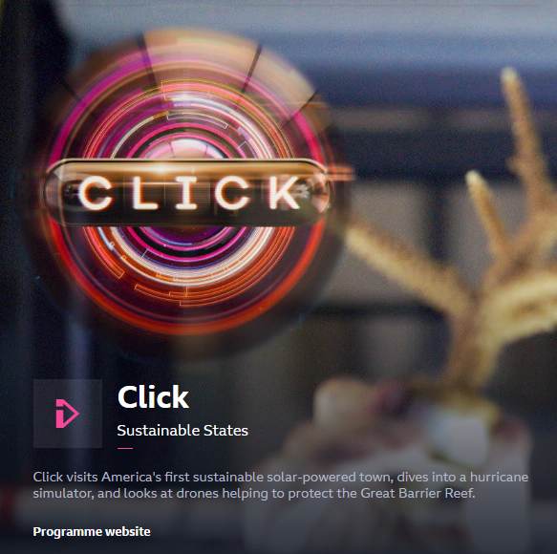
Summer Course Preparation Project – Task 3
Watch an episode of BBC click (the full version)
What were the main points of the episode?
Taking ONE of the stories and DISCUSS the positives and negatives of that story in relation to modern society. (this should be about half a side of A4)

