Slide 1
Welcome to Psychology!
Miss Priano – apriano@bestacademies.org.uk
Mrs Nye – lnye@bestacademies.org.uk
Ms Compton (joining us in September)
Please contact us if you have any questions/concerns over the summer holidays.

Slide 2
A2 – 2 years – ALL exams at the end of year 13.
Paper 1 - Introductory Topics
Social influence
Memory
Attachment
Psychopathology
2 hours
96 marks
33% of A level
Multiple choice, short answer and extended writing.
Paper 2: Psychology in Context
Approaches
Biopsychology
Research methods (worth double)
2 hours
96 marks
33% of A level
Multiple choice, short answer and extended writing.
Paper 3: Issues and Options
Issues and Debates
Aggression
Schizophrenia
Relationships
96 marks
33% of A level
2 hours
Multiple choice, short answer and extended writing.

Slide 3
Rules/expectations
Attendance – 90% or a call home will be made to let parents know.
Absent – how do you catch up?
1st) Check on the learning platform – most PowerPoints are available on there
2nd) Speak to other members of the class.
3rd) Email teacher – when you know what you have missed to ask a specific question. DON’T come to the next lesson unprepared!
Equipment – you provide your OWN paper, pens, folders – make sure you keep your notes well organised. We provide your assessment folder and plastic wallets.
Attitude in the classroom – if you are disruptive, not completing work etc you will be asked to leave and calls home will be made.
Independent learning – priority – you will have time allocated on your TT to Psychology. Make sure you complete the work set and if nothing is set, start working on revision notes/going over class notes.
Homework – handed in not emailed, with your name on it!
No phones unless specified by the teacher.
PREP work checks will be carried out every 4 weeks, with an expectation of 3 hours a fortnight of work completed.

Slide 4
Books
These are the 3 textbooks we will be using in class throughout year 12.
Take some time to look over them and try them out before choosing one to buy.

Slide 5
ANY QUESTIONS?
Then drop myself or Miss Priano an email!

Slide 6
Meet Bob
Bob is 15 and is a persistent truanter.
Bob has a bad temper
Bob gets into fights on a regular basis.
Bob is not concerned if he does not pass his exams.
We need to be able to explain people’s behaviours from many different psychological viewpoints – these are known as approaches.

Slide 7
Task
On the next 5 slides is information about different approaches in psychology.
In psychology there is not an agreement on what causes humans to behave in the way they do.
Some Psychologists believe that our behaviour is due to our biology, some that we learn to behave in the way we do and others than believe that we are driven by our unconscious minds and what happened to us in childhood!
TASK: You need to explain Bob’s (previous slide) behaviour using the information on each of the approaches. So there will need to be 5 paragraphs - one for each approach. Use as many of the key terms associated with that approach as you can.

Slide 8
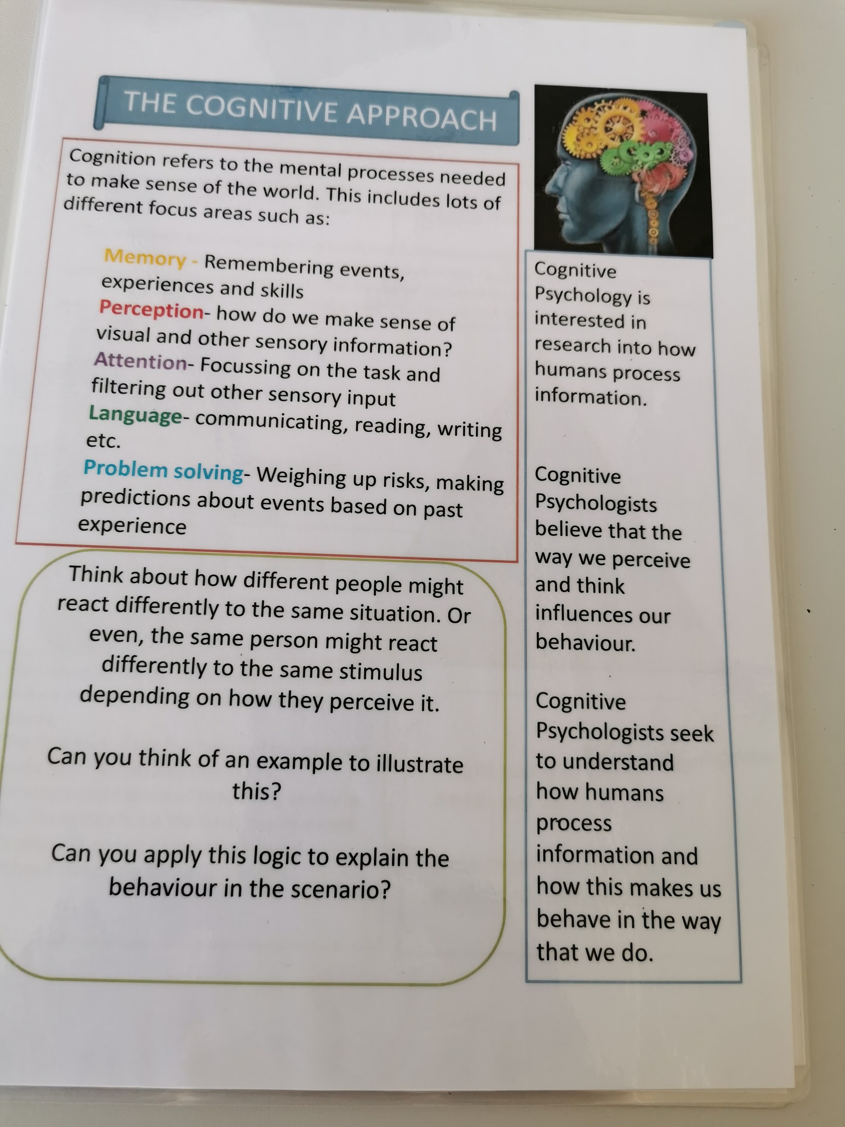

Slide 9
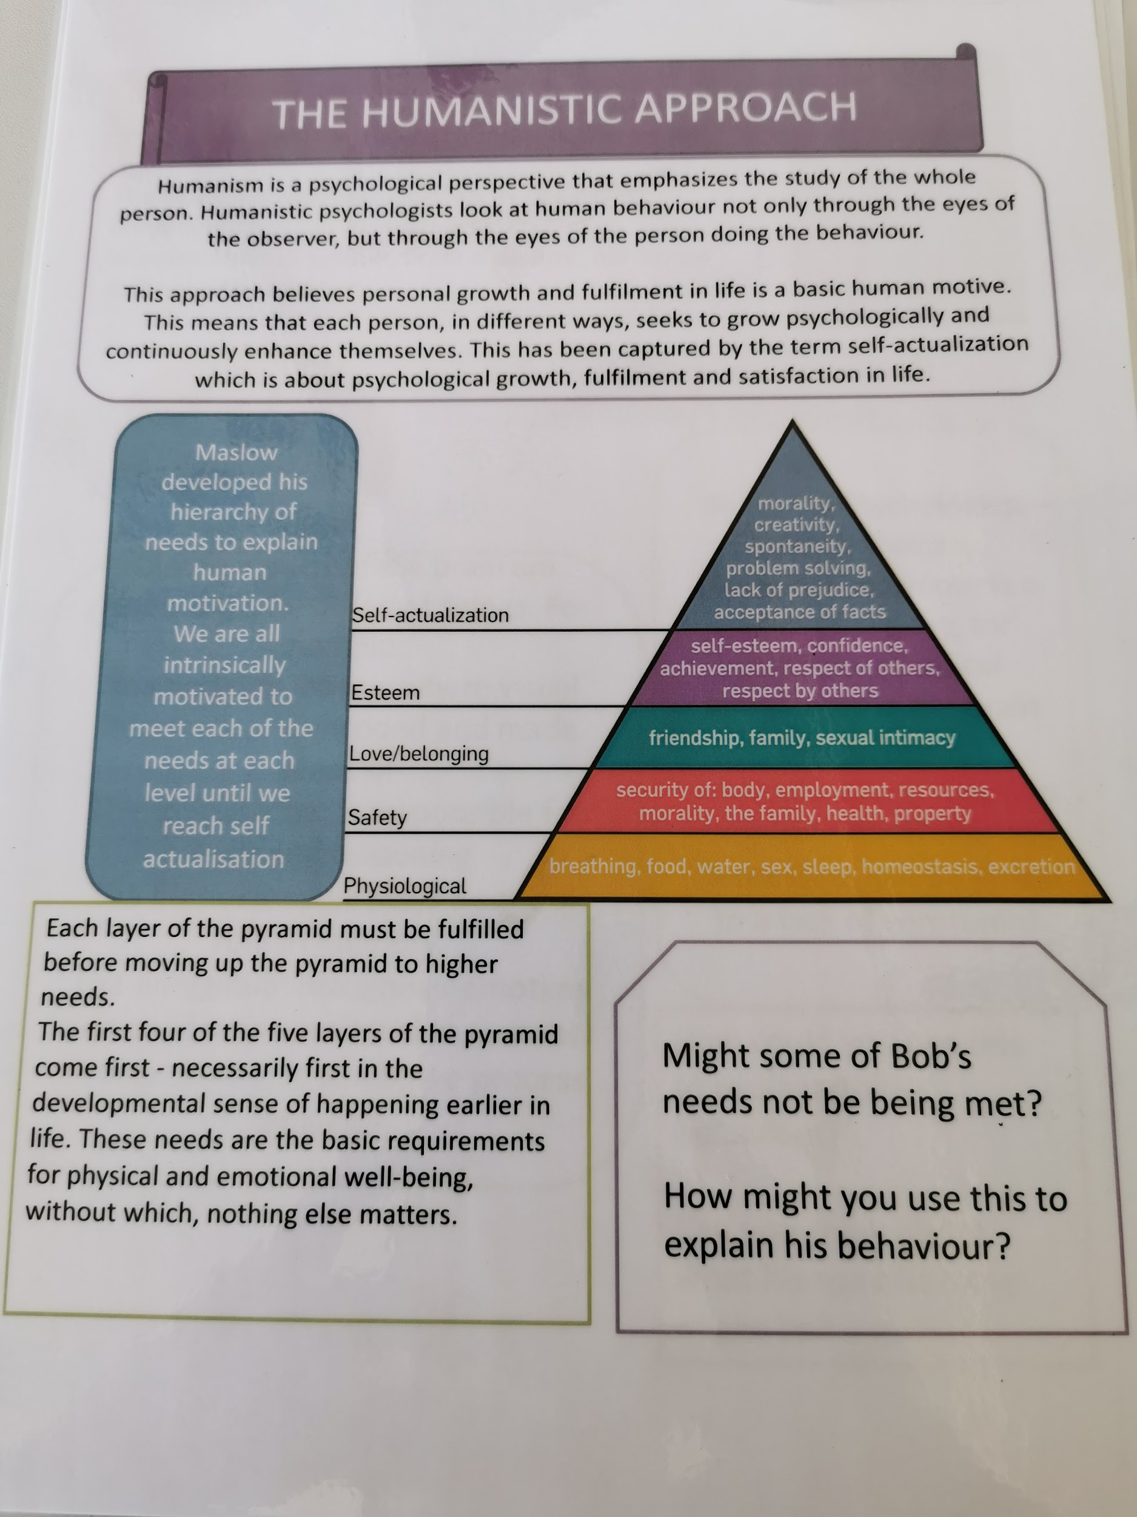

Slide 10
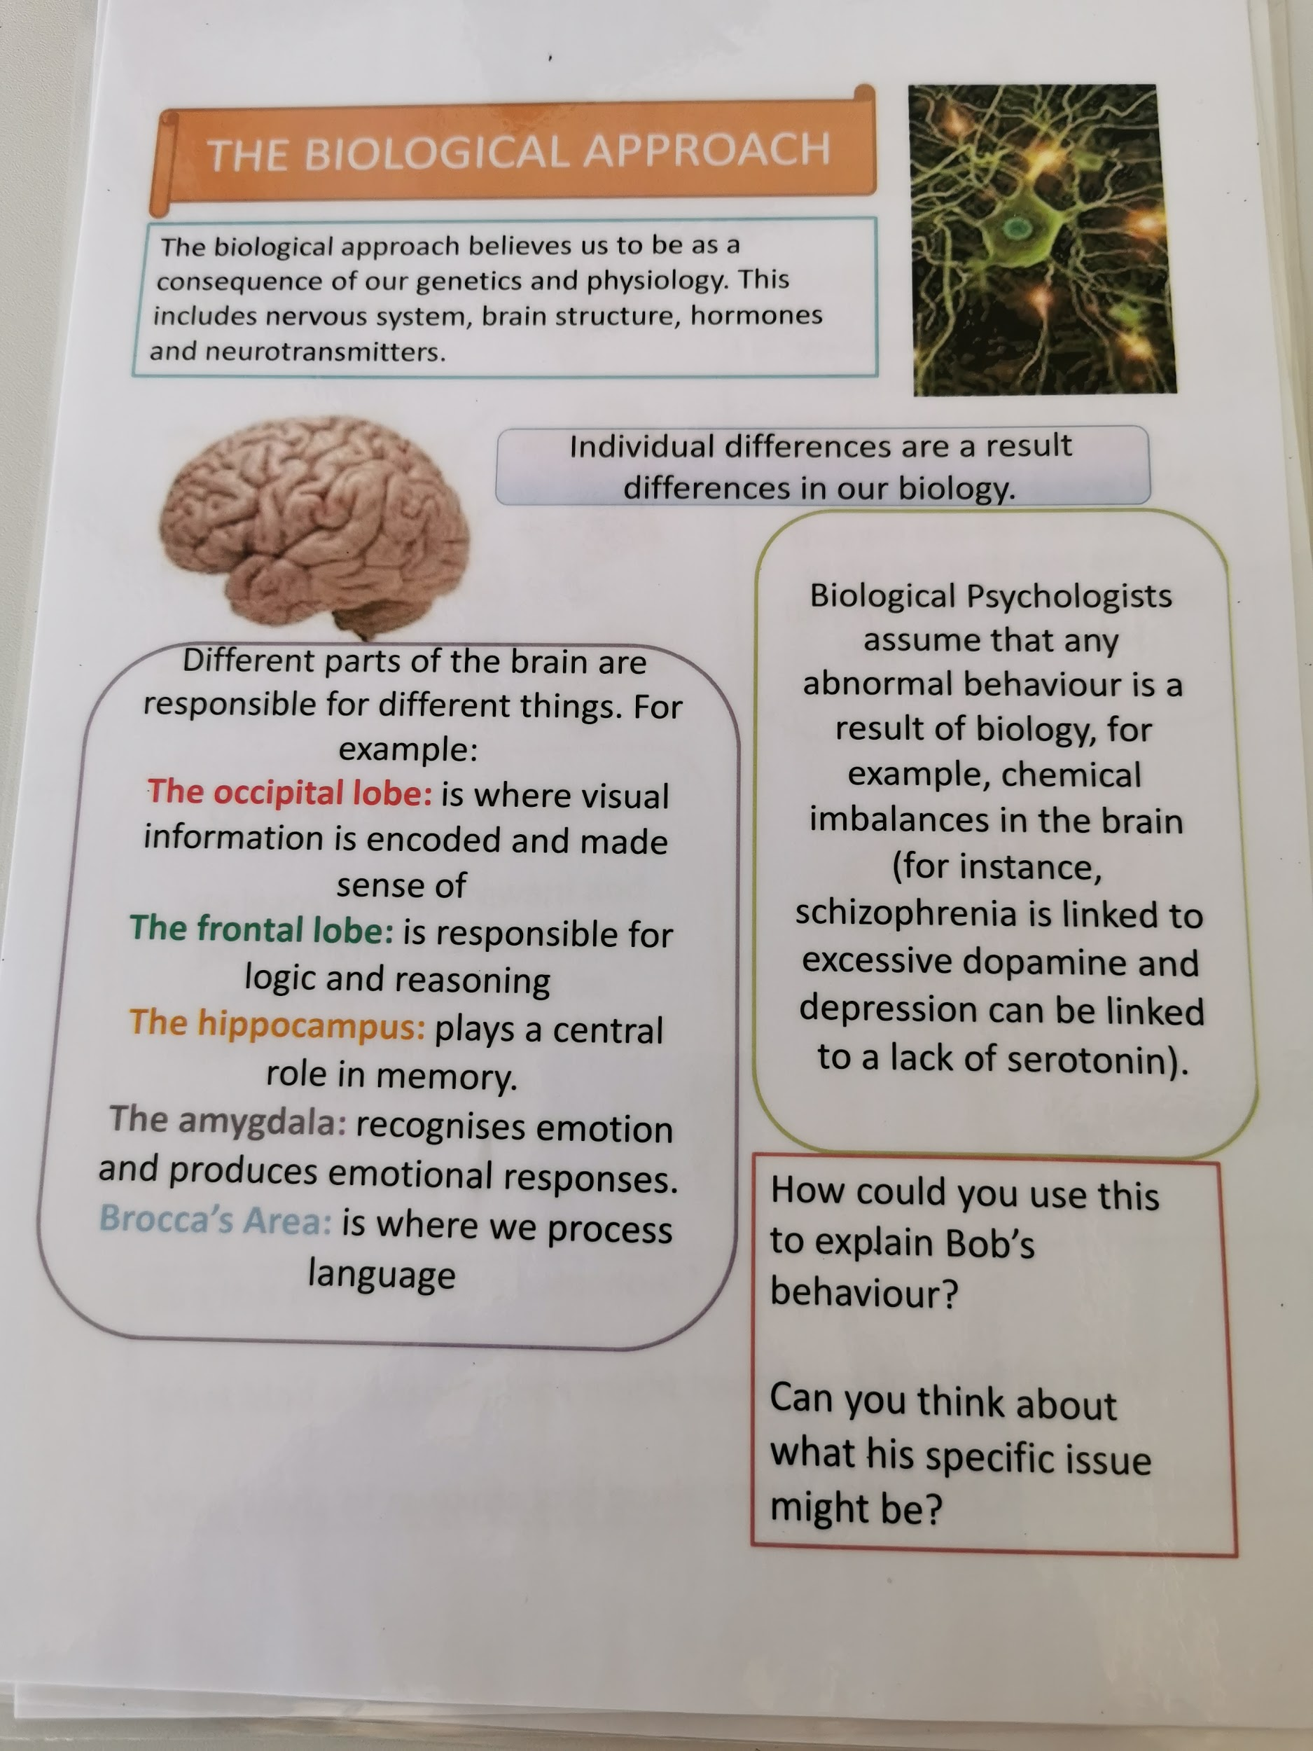

Slide 12
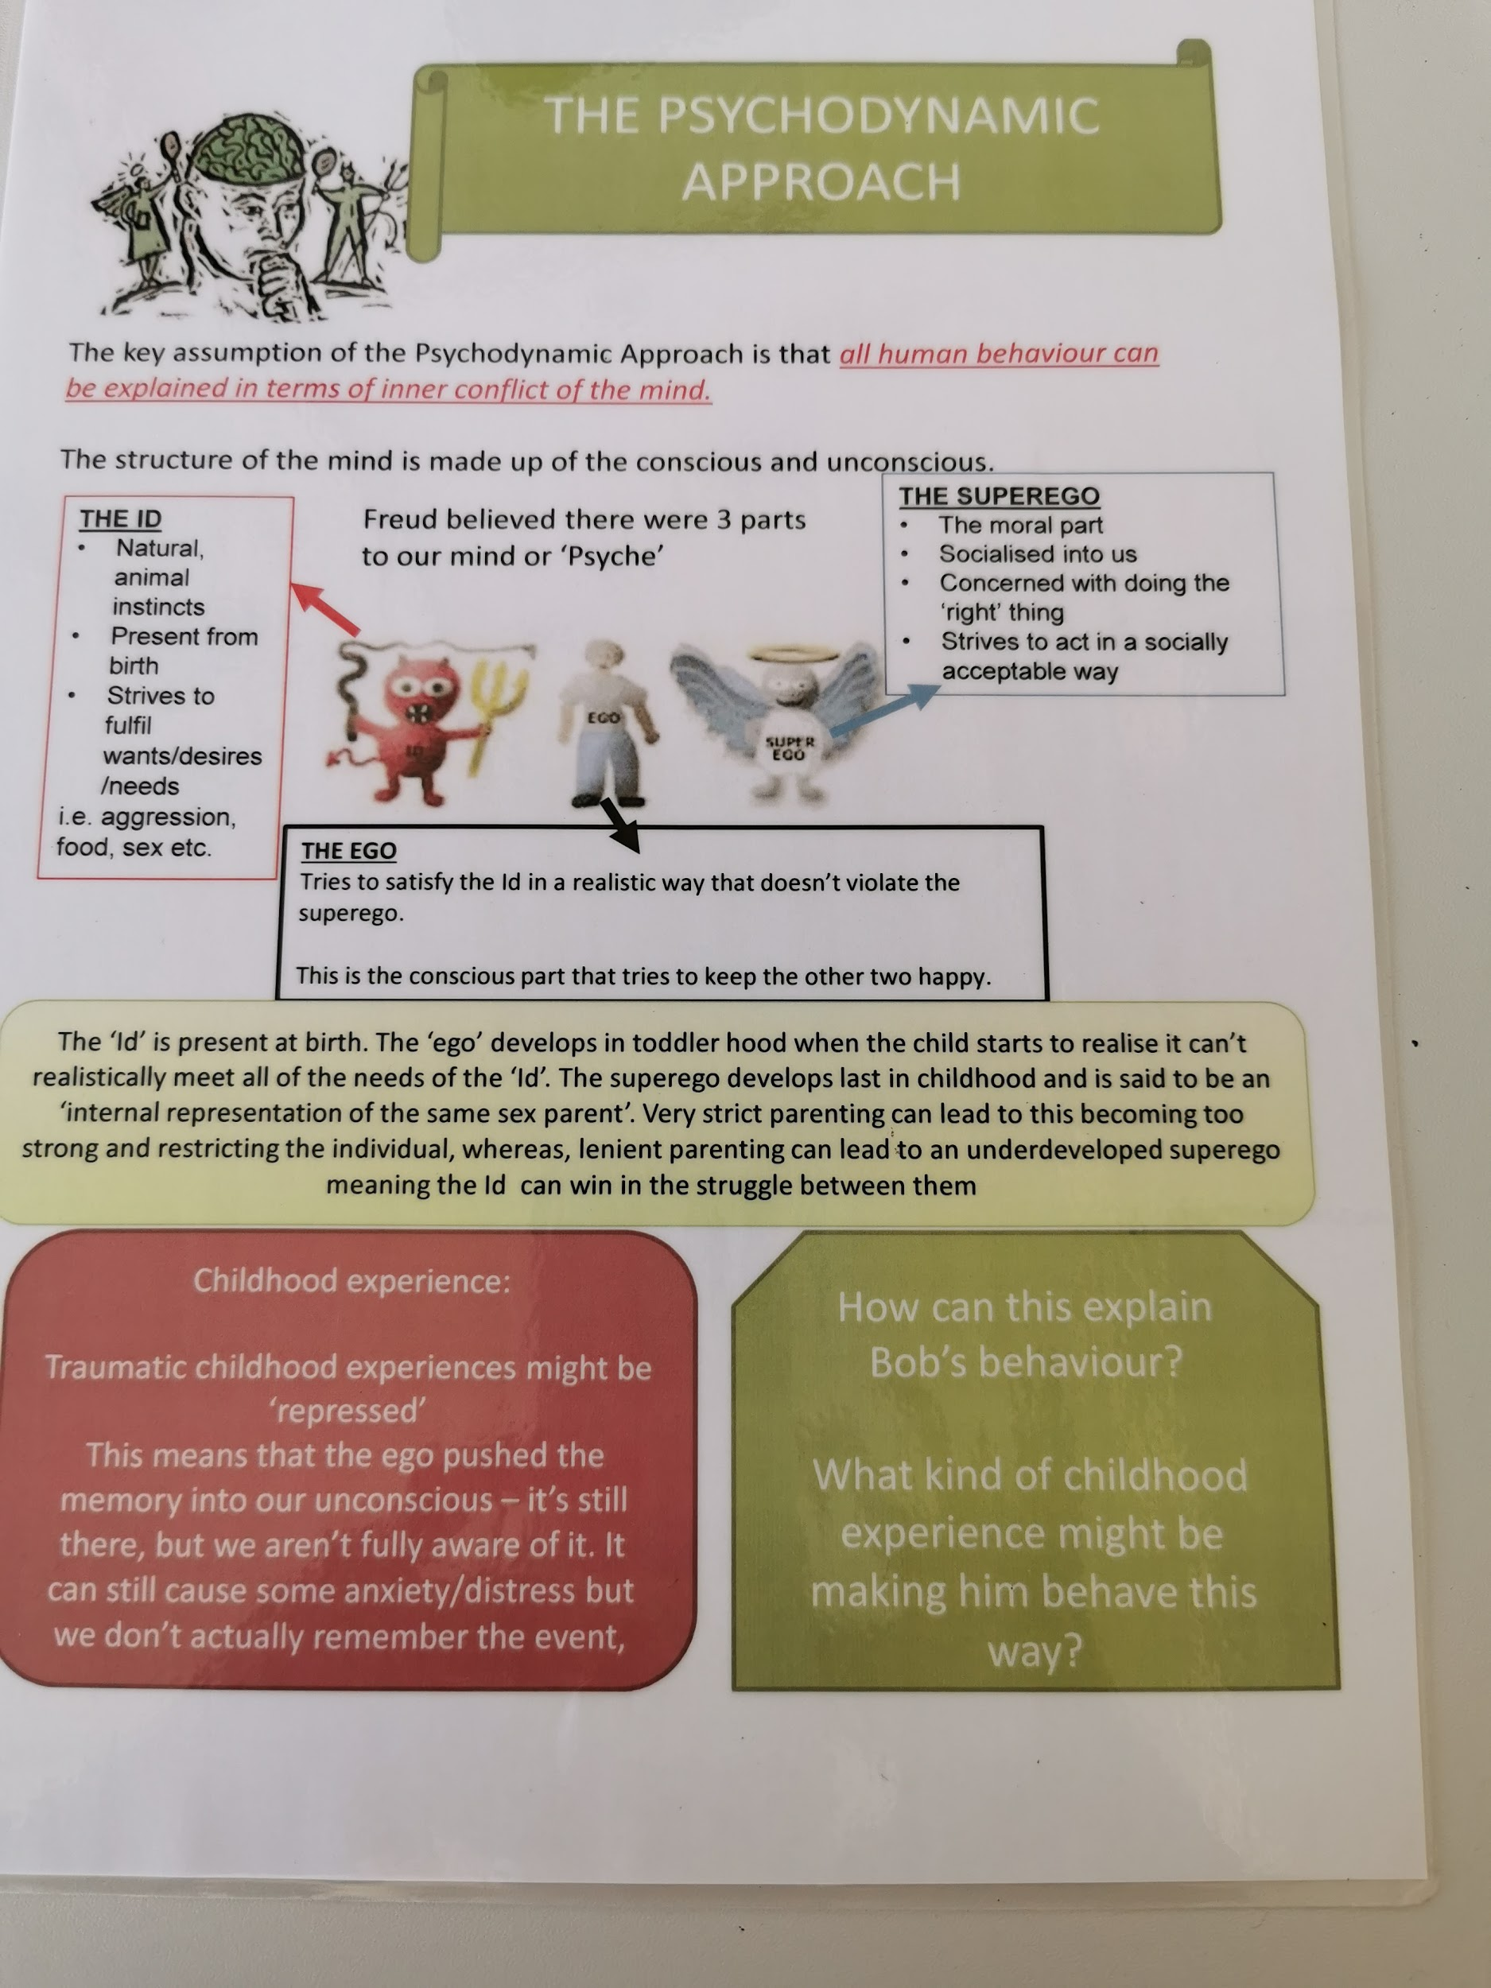

Slide 13
Additional work!
We recommend that you conduct some reading over the summer. Find an area in psychology that you find interesting.
On the next few slides are some books and films that you may enjoy watching!

Slide 14
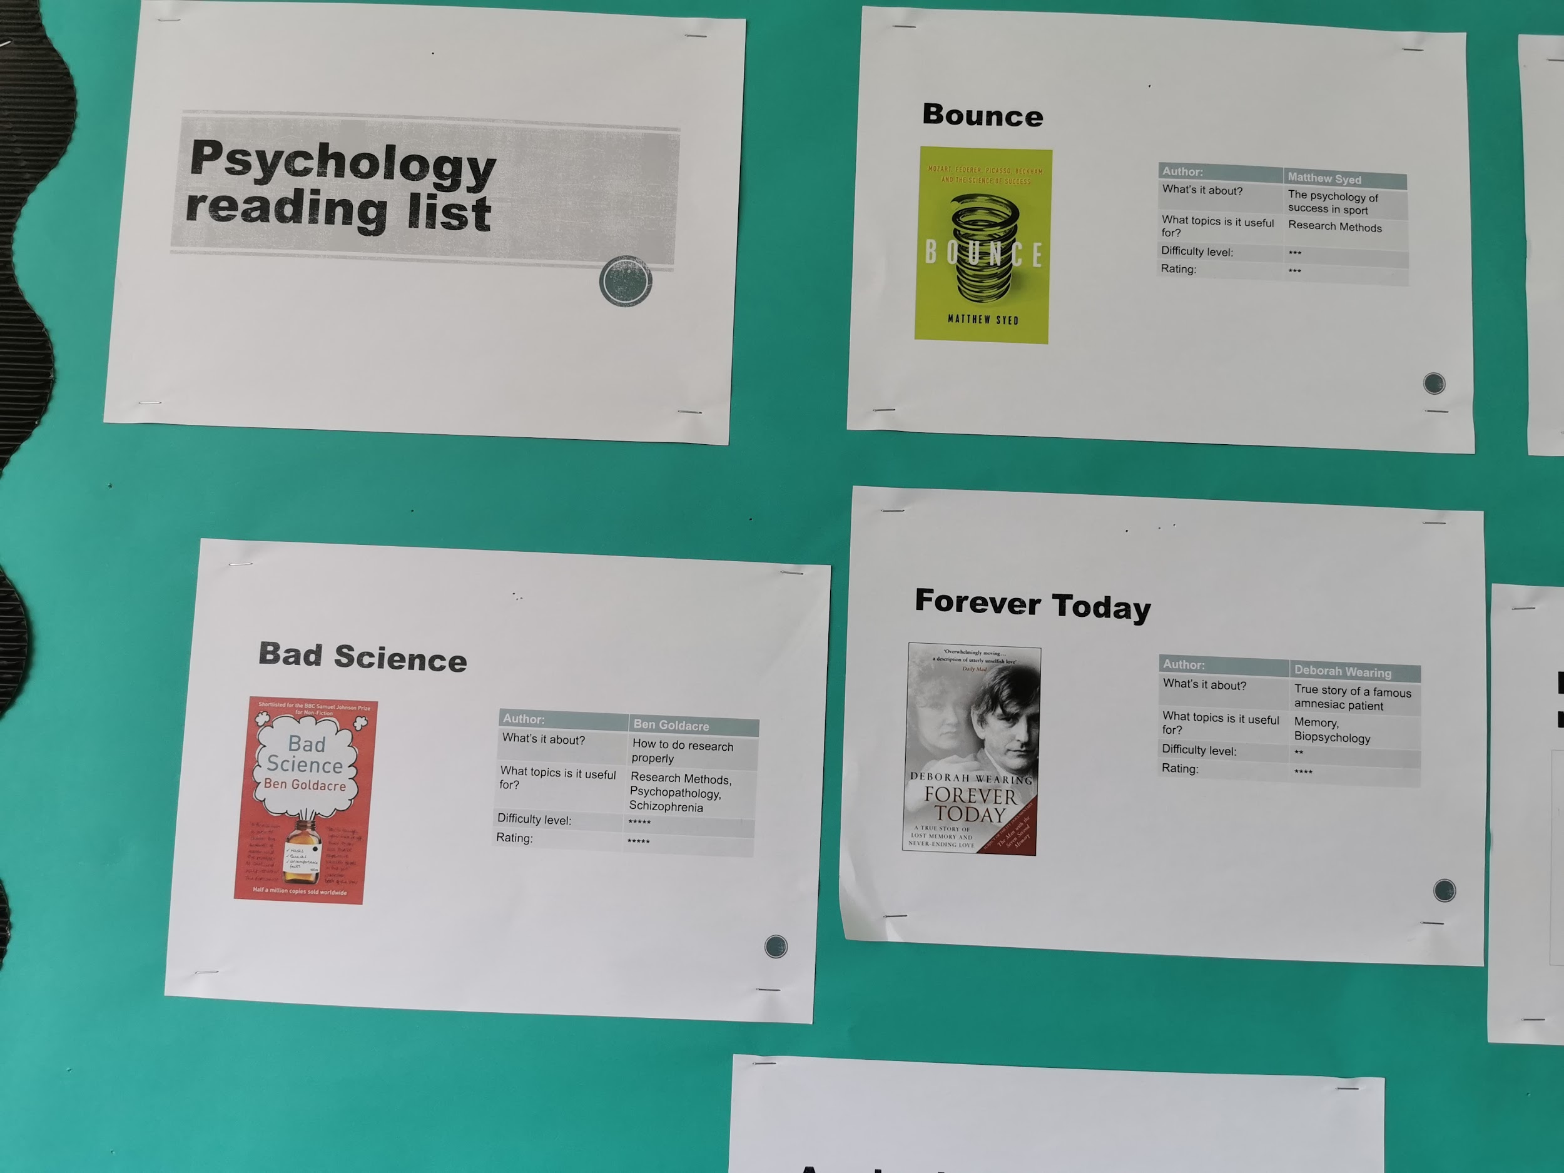
Reading and films!

Slide 15
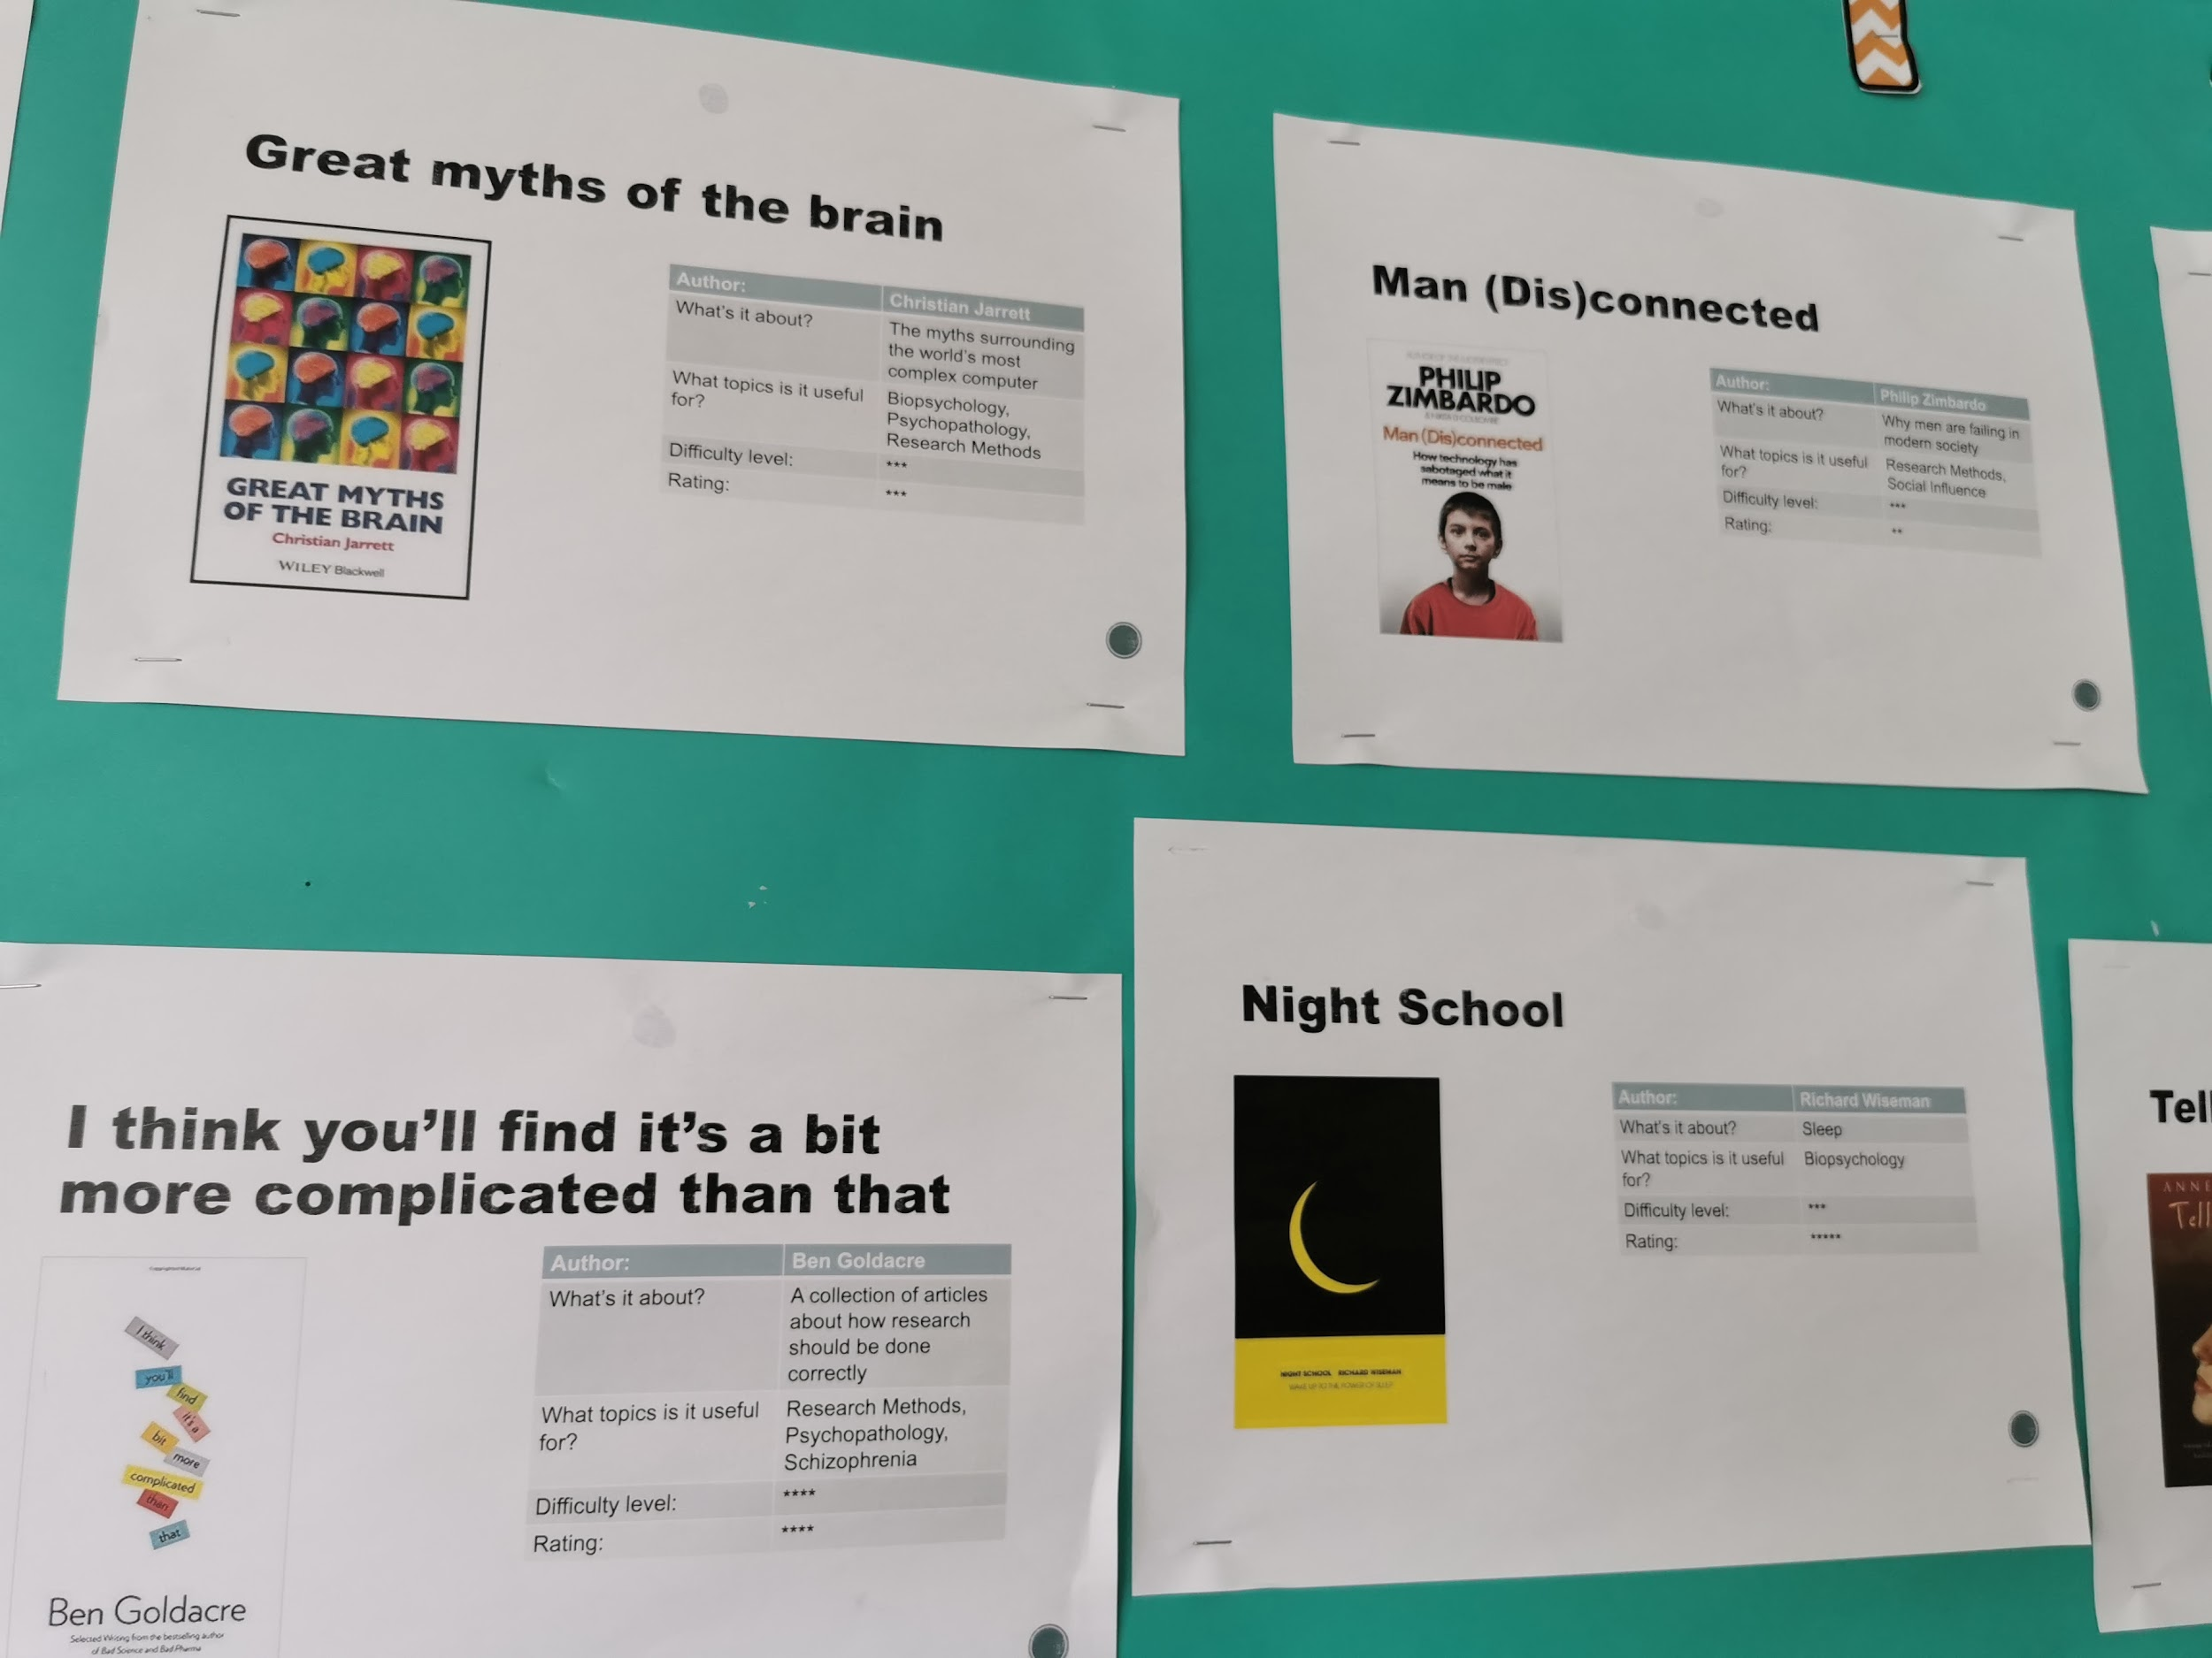

Slide 16
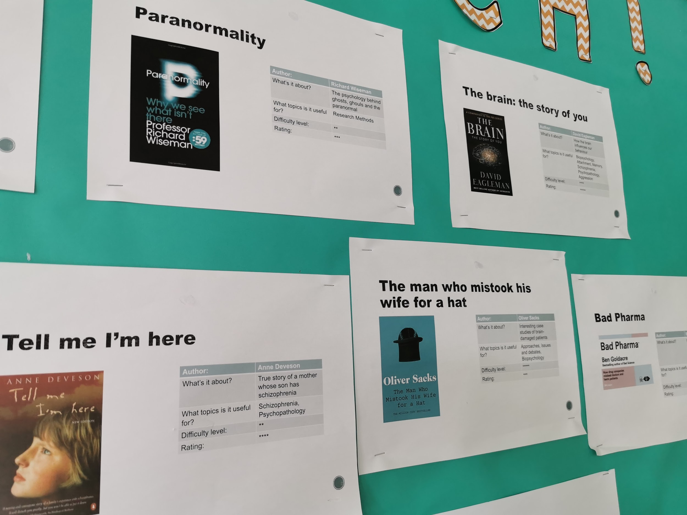

Slide 17
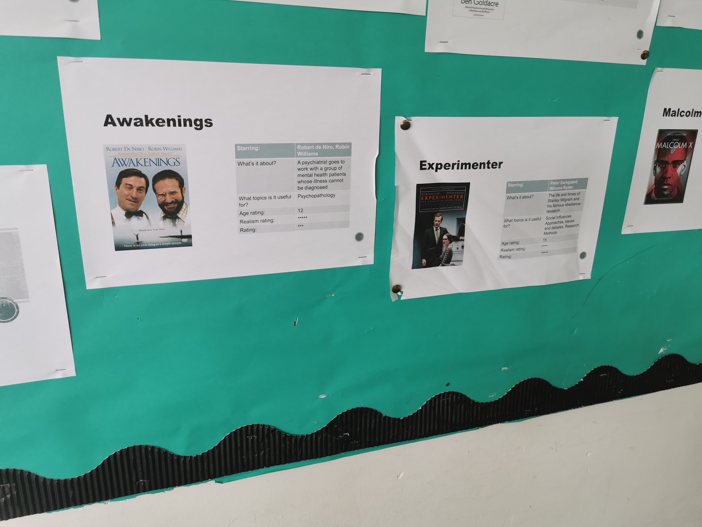

Slide 18
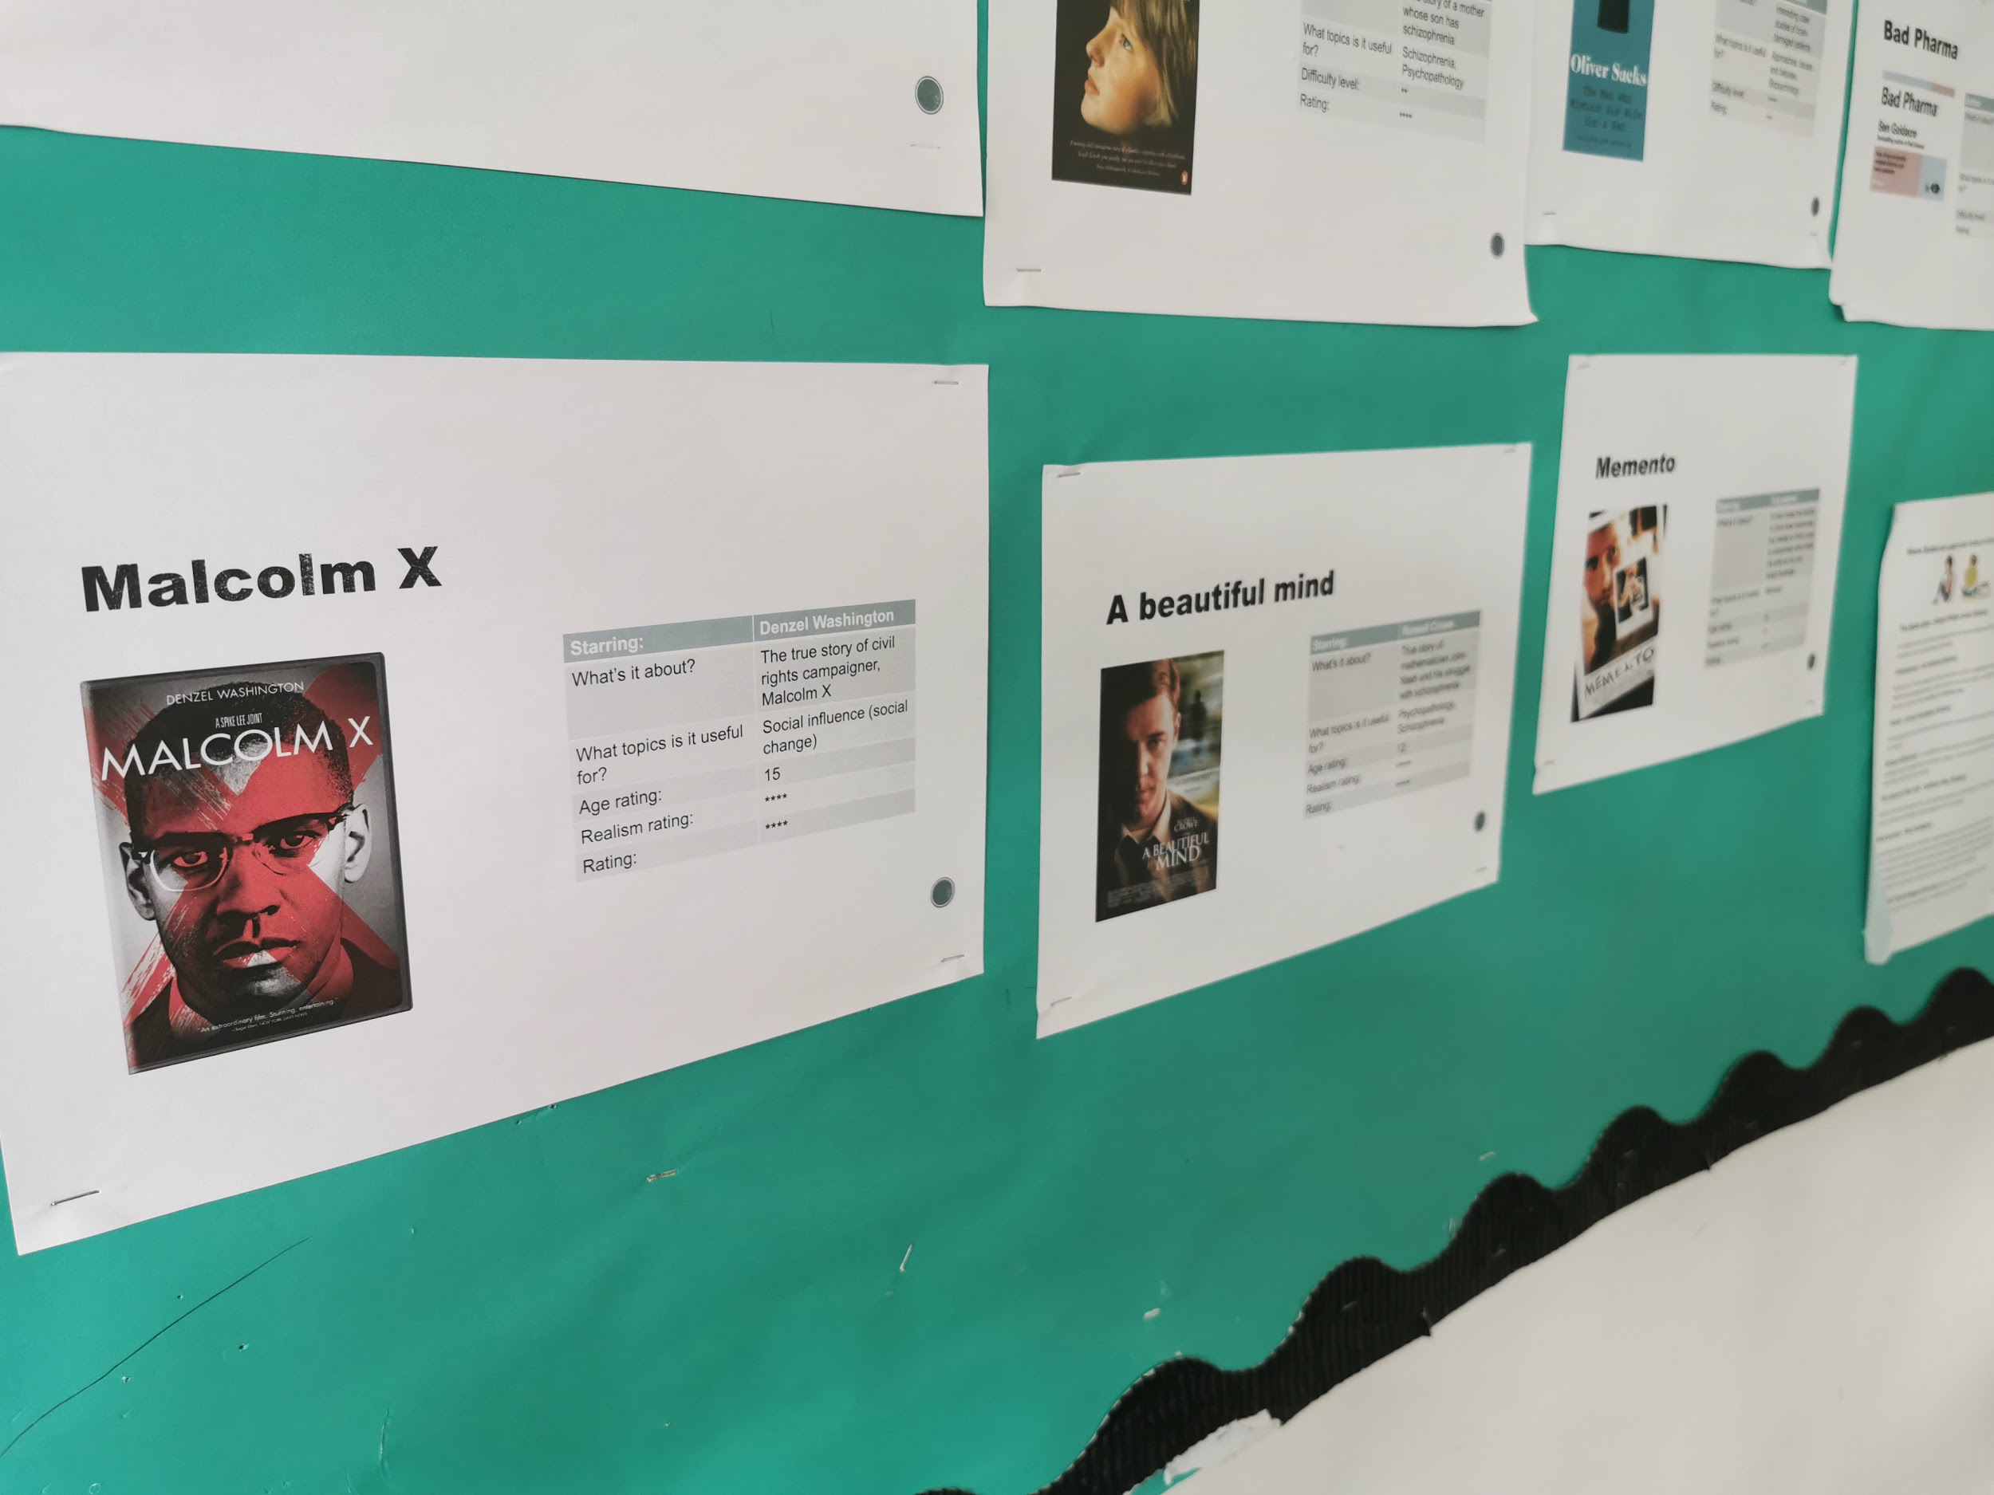

Slide 19
