Slide 1
Geography A Level – Summer Prep Programme
Mr Huckle – Head of Sixth Form

Slide 2
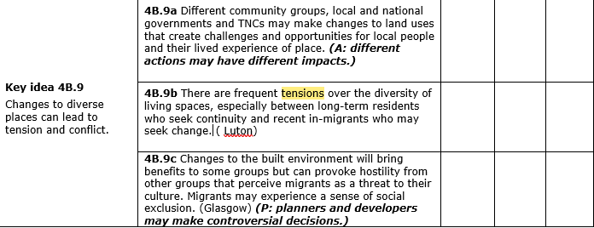
Diverse Places Unit of Study

Slide 3
Issues, problems, conflicts, arguments,:
Cultural
Social
Economic
Political
People who have lived in a location for a long period of time
Give a reason/s for the point you have stated.
Migrants coming from another country
Could be hinting at:
Urban and Rural areas
Two areas within an urban area e.g Inner City and Suburbs
So you need LOCATION CASE STUDY detail/examples

Slide 4
The Socio-Cultural impacts (negatives) of immigration
https://www.youtube.com/watch?v=gNg51DSefeo
https://www.youtube.com/watch?v=uQCn-6N9hng
Ethnicity issues – a key component of both culture and society.
Geographical and spatial impacts e.g segregation of ethnic and minority groups that become concentrated in particular areas (enclaves).
Changing physical structure of the community – the degree to which a place starts to reflect the ethnicity and culture of the changing population of a place.
Discrimination in the job market – ethnic minorities are more likely to be unemployed and on low incomes, forcing them into areas of cheaper housing.
Discrimination by house sellers, estate agents, financial institutions etc.
Social hostility/unfriendliness from the majority population.
Racially motivated violence against ethnic minorities, or fear of such violence.

Slide 5
Structure:
Paragraph 1 (3 MARKS):
Explain ONE tension/problem/issue between long-term residents and international migrants. E.g segregation of ethnic groups within an urban area
Back up with a case study example location.
Paragraph 2 (3 MARKS)
Explain ONE OTHER tension/problem/issue between long-term residents and international migrants. E.g changing physical structure of the community
Back up with a case study example location.

Slide 6
Southall, West London
Southall is an area of west London that has had conflict for a number of reasons, mainly due to changes over time. This conflict has been between ethnic groups and long term issues in the area.
Task:
Use the case study sheet to answer the questions…
What was Southall like in the 1960s, 70s, 80s, and 90s? How does this compare to now?
What is being done to redevelop Southall and how has this changed the area?
What cultural conflicts exist in Southall?
Do you think Southall has been successfully redeveloped and managed?

Slide 7
Southall Case Study:
An area of West London that has seen conflict due to change over time.
1 – What was Southall like in the 1960s, 70s, 80s and 90’s? How does this compare to now?
3 – What cultural conflicts exist in Southall?
2 – What is being done to redevelop Southall and how has this changed the area?
4. Do you think Southall has been successfully redeveloped and managed?

Slide 8
Resources:
Ealing Council Southall Twitter: https://twitter.com/southallbigplan?lang=en
Ealing Council Article: https://www.ealing.gov.uk/news/article/1380/celebrating_southall_broadway
Regeneration Plans: https://www.london.gov.uk/what-we-do/regeneration/regeneration-project-southall
Independent Article: https://www.independent.co.uk/arts-entertainment/fear-and-loathing-in-southall-1585187.html
Punjabi Southall: https://www.theguardian.com/cities/2018/apr/04/how-london-southall-became-little-punjab-
‘Little India’: http://www.quirkyguide.com/place/little-india-southall-london

Slide 9
Social Exclusion in Glasgow:
Using the maps shown in Fig 21.18 and 21.19, describe the link between ethnic diversity and deprivation in Glasgow over time.
Explain the different causes of social tensions in Glasgow.
Analyse the impact that migration into Glasgow since 2001 has had on the city (Fig 21.20).

Slide 10
