Slide 1
Mr Ian Butler
9-1 Grades & Monitoring
Vice Principal – KS4 Progress, Curriculum, Data and Exams

Slide 2
Advice from Department of Education
https://youtu.be/pgZYx_fycrM

Slide 4
Conversions
Current GCSE grade | Reformed 9-1 grade
A**(Top 20% of grade 7) | 9
A* | 8
A | 7
B/B+ | 6
B-/C+ | 5
C- | 4
D | 3
E/F+ | 2
F&G | 1

Slide 5
Target Grades
Average KS2 in English & Maths | Current GCSE grade | Reformed 9-1 grade
118-<120 | A** | 9
113-<118 | A* | 8
109-<113 | A | 7
105-<109 | B/B+ | 6
101-<105 | B-/C+ | 5
91-<101 | C- | 4
81-<91 | D | 3
80-<81 | E/F+ | 2
 | F&G | 1

Slide 6
Monitoring progress

Slide 7
Curriculum content
https://www.samuelwhitbread.org.uk/
Learning Tab
Click on curriculum
Click on current year 9 (curriculum content)
View individual subject specifications by clicking on the links

Slide 8
Monitoring progress
Core Subject: | End of Yr 11 Target Grade | End of Yr 9 Target Grade | Yr 9 Baseline October 2018 | Current Grade January 2019 | Current Grade June 2019 | Attitude to Learning
English | 6 | 4 | 2 | 2+ | 4 | Excellent
Mathematics | 6 | 4 | 3- | 3 | 3+ | Excellent
Science | 6 | 4 |  | 4 | 5 | Excellent

Slide 9
What is combined science?
Students taking science will take one or more separate sciences – biology, chemistry and physics – or combined science. Combined science is really two GCSEs rolled into one qualification. Students will study biology, chemistry and physics but they won’t cover as much content as those students sitting separate sciences.
Combined science students will get an award consisting of two equal or adjacent grades from 9 to 1 (eg 9-9, 9-8, 8-8 through to 1-1), and it will count as two GCSEs when students apply for jobs, sixth form, or to university.

Slide 10
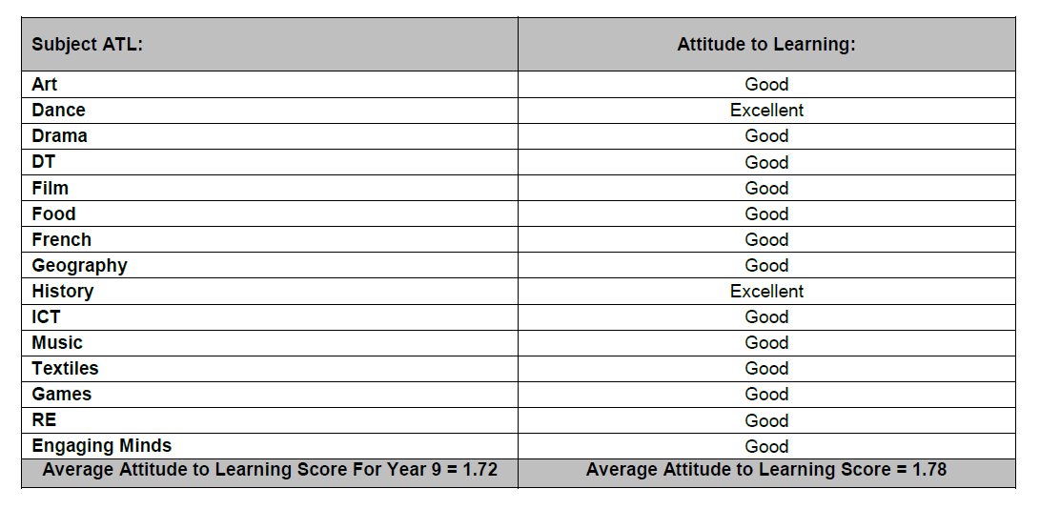
Attitude to Learning

Slide 11
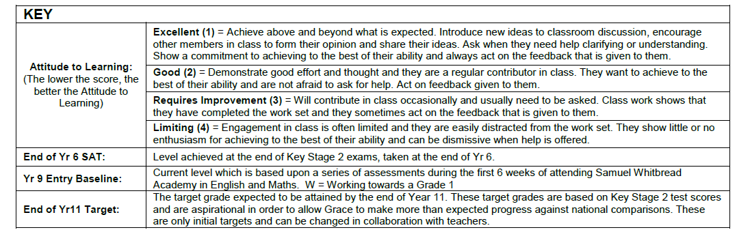
Attitude to Learning

