Slide 1
Opportunities in Music and Drama
Ethos
Extra-curricular
Performance Opportunities
Facilities & Successes
Options

Slide 2
Performing Arts Ethos
Inclusive
Recognise and develop talent
Opportunities for everyone, both on and off the stage.
Notes:
Opportunities for everyone-on and off the stage

Slide 4
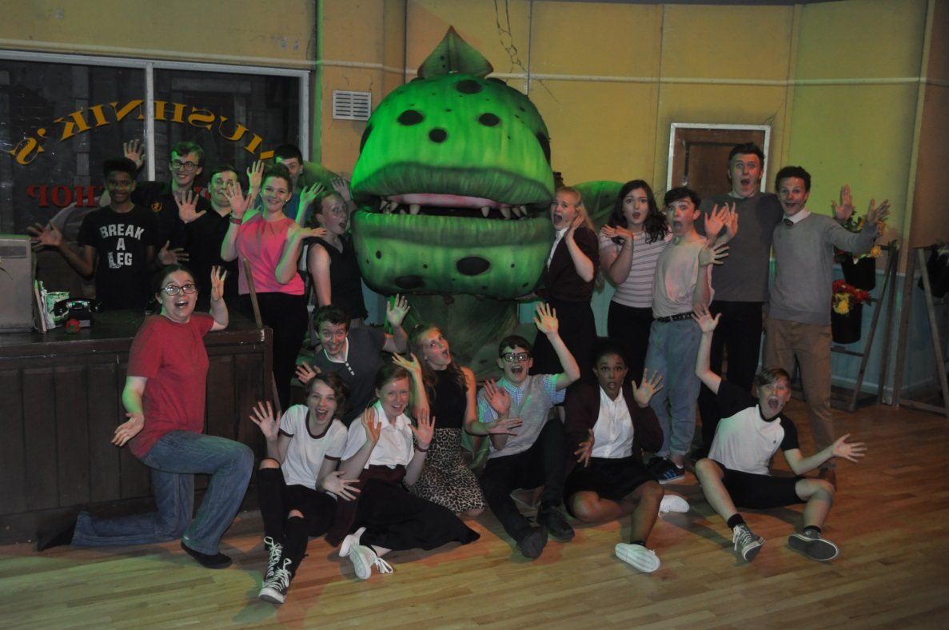
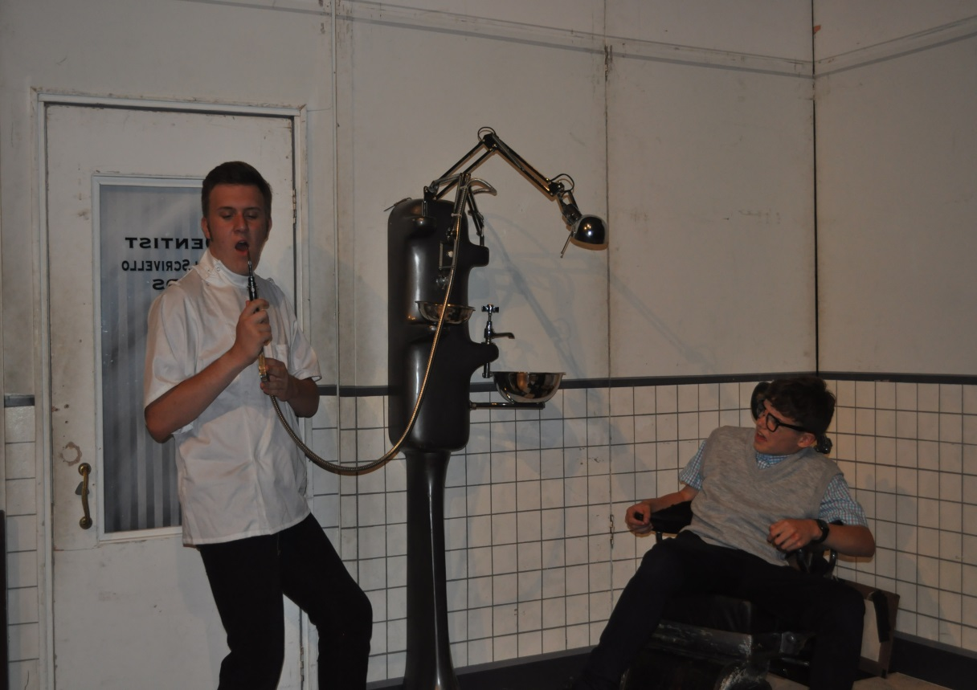
Arts Aims 17/18
Notes:
Talk about the mission that we set last year (a show each term!)

Slide 5
Performance Opportunities
Autumn Term:
Community Fundraising Concert
Cinderella the Pantomime
Music Christmas Concert
Spring Term:
Year 9 Theatre Company
Music Spring Concert Dance Showcase
KS4 Theatre Company
BEST Musical-A Night with Disney
Summer Term:
Sixth Form Theatre Company
BEST Summer Arts Festival
SWA School Musical-High School Musical
Off Stage Opportunities:
Set Build
Set Paint
Props
Light Design
Sound Design
Stage Hand
Stage Manager
Costumes
Make up
Hair

Slide 6
Performing Outside of the School
The Quarry Theatre
Bedford Corn Exchange
The Stables, Milton Keynes
Milton Keynes Art Festival
Gordan Craig Theatre
Cliffton Church
Middlesex University
Getting into the community-workshops in lower schools/ fetes/ residential homes & day centres.

Slide 7
Our facilities
Music:
4 Practice rooms
1 recording studio
1 tech suite-30 computers with music software
1 performance room
Set of class guitars
Set of class keyboards
Set of Djembes
Drama:
3 studio workspaces
Each studio rigged with lights
Theatre with projector room
Activities hall with lighting bars
Dance:
Newly refurbished sprung floor in theatre and main hall.
Dance studio with fully mirrored wall.
Ballet bar
Lighting bars in dance studio

Slide 8
Performing Arts Successes
SWA Choir- Champions at Bedfordshire Music Festival for 2 consecutive years.
SWA Chamber Choir- won 2 classes at Bedfordshire Music Festival
The Academy-Winners of County Battle of the Bands
Temper Theatre Company-National Connection semi-finalists ‘Bedbug’
‘A Midsummers Night Dream’ @ The Gordan Craig
The Academy & SWA Choir- Duke of Edinburgh & High Sherrif Instalation

Slide 9
Music Option
GCSE
BTEC with Performance
BTEC without Performance
Performance
Composition
Exam-studying 8 set works
Exam-Industry
Unit 2-Manage a product
Unit 4-Composition
Unit 5-Performance
Exam-Industry
Unit 2-Manage a product
Unit 4-Composition
Unit 6-MTR/ Unit 7-Remix

Slide 10
Drama Option
GCSE With performance
GCSE Without performance
Devised
Performance from a text
Exam-DNA (bringing it to life)
Devised following tech route
Performance from a text following tech route
Exam-DNA (bringing it to life)
Tech route-Plan lighting/set/sound/costume/ make up

Slide 11
Dance Option
GCSE
Performance
Choreography
Dance Appreciation (written exam)

Slide 12
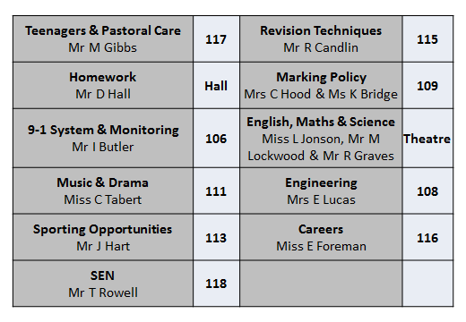
Presentation Rooms

