Slide 1
Think of a time when you have worked at something e.g. playing a sport, developing a hobby or working on a professional target/skill required at work…..
Have you received comments which have changed/ improved the way you do something?
What was said to you that helped you to progress?
Was the feedback un/helpful?
Why?
Notes:
This slide is intended to get the parents thinking about the purpose of assessment and feedback. We won’t respond to it till later in the presentation.

Slide 2
Marking Policy at SWA
What is marking, assessment and feedback?
How often will teachers at SWA mark/assess my child’s work?
How will this impact on my child’s progress?
What is the role of my child in the assessment and feedback process?

Slide 3
What is marking, assessment and feedback?

Slide 4
Assessment
“Assessment refers to all those activities undertaken by teachers and by their students in assessing themselves which provide information to be used as feedback to modify the teaching and learning activities in which they are engaged.”
Black & William, Inside the Black Box, 1998
Assessment of Learning
A snapshot of what has been learned- it is here that your child will be given a mark or grade.
Assessment for Learning
When your child’s teacher decides where the learner is in their learning, where they need to go and how best to get there.’
Notes:
Share with parents that marking will cover both of these over varying periods of time. Explain teachers assess in two ways.

Slide 5
How often will teachers at SWA mark/assess my child’s work?

Slide 6
How often will my child’s work be marked?
Every department has an assessment schedule pertinent to their own curriculum area.
Your child’s learning and progress will be regularly assessed.

Slide 7
How will marking and feedback impact on my child’s progress?

Slide 8
Feedback matters. Evidence shows that effective feedback makes a difference on a student’s learning and progress.
Hattie’s meta-analysis of thousands of studies, suggests that good feedback can improve the rate of learning in one year by at least 50%.

Slide 9
Feedback is only formative if it is successful in helping learners to improve
FEEDBACK has 3 crucial elements:
1. Evidence on your present condition
2. The desired goal
3. some understanding of a way to close the gap between the two

Slide 10
How do teachers implement effective feedback at SWA?
According to the Assessment Schedule for each department, your child will receive regular WWW (What Went Well) and EBI (Even Better If) feedback from their teachers.
This feedback will enable your son/daughter to recognise their next steps in learning and how to take them.

Slide 11
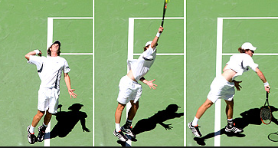
How do teachers implement effective feedback at SWA?
During class feedback, your child will have the opportunity to respond to their teacher’s feedback and practise, develop and model improvement. We call this MRI – My response is….
Notes:
Refer back to the starter. Use the example of Andy Murray – while playing a match, his coach might say ‘you played really well today; good job!’. But this is not feedback, it’s a value judgement. What Andy Murray would want to know is what did he do that was good and what area does he need to develop to get even better. He would then want his coach to develop activities to help him to improve upon this area. This is what is involved in feedback and mri.

Slide 12
What is the role of my child in the assessment and feedback process?

Slide 13
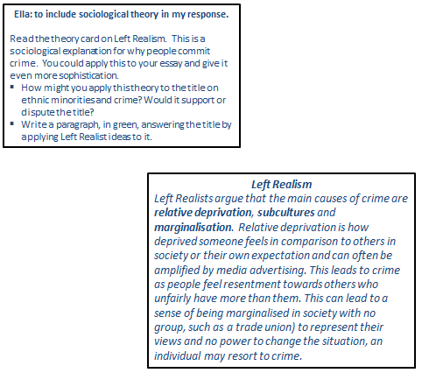
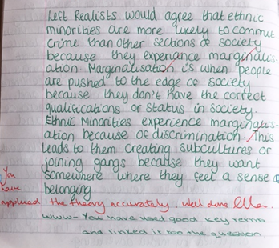
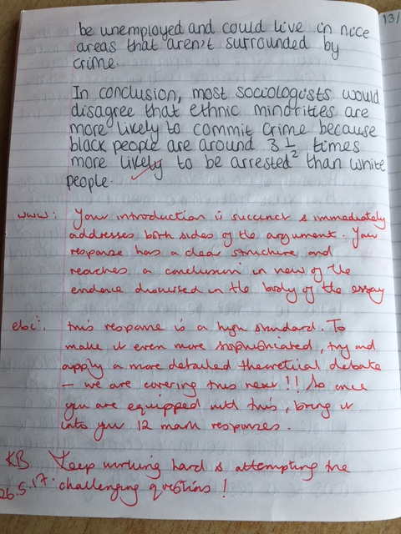
1. Engaging with their teacher’s feedback?
Notes:
Use this slide to show the responsibility of the pupil to engage with MRI.

Slide 14
2. Knowing ‘Their Big 6’
1. | Pupils know their Target Grade
2. | Pupils understand their current attainment.
3. | Pupils can explain what they need to do to improve.
4. | (In red) Effective WWW & EBI formative feedback on work.
5. | High quality student MRI (in green pen) in response to EBI showing improvement.
6. | Pupil work demonstrates ‘Pride in your Work’ principles.

Slide 15
3. Having Pride in their Work

Slide 16
What can you do to support your child?
praise effort and hard work
Ask them what their target grade is
Ask them what they are doing well at and what skill they are developing before inquiring about their grade.
Notes:
This slide is aping the starter but using the information from the presentation.

