Slide 1
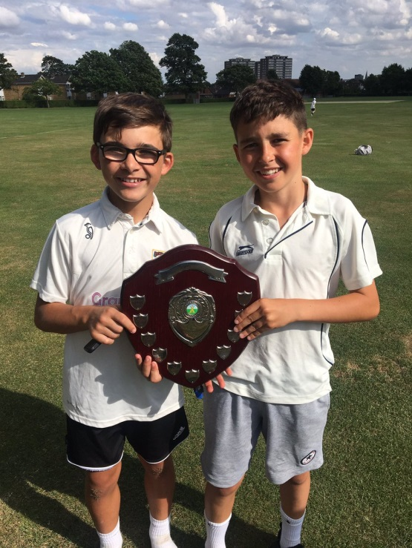
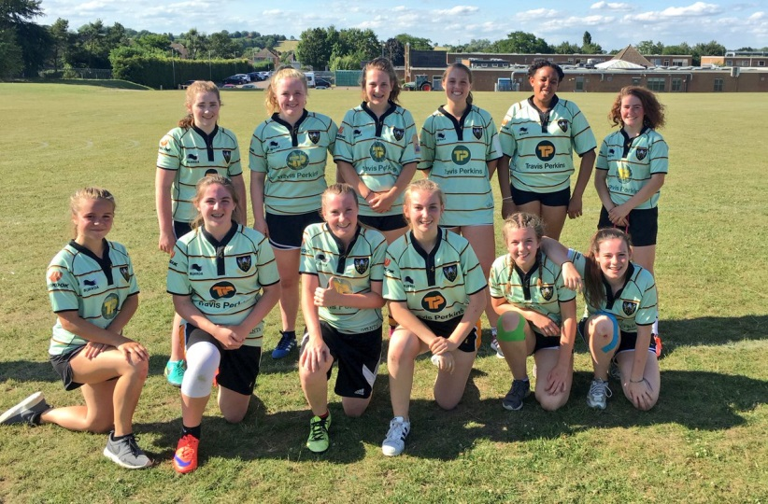
Extra-Curricular Activities
PE Department 2017-18

Slide 2
Extra-Curricular timetable

Slide 3
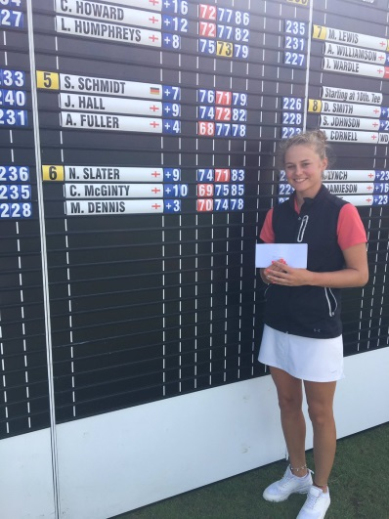
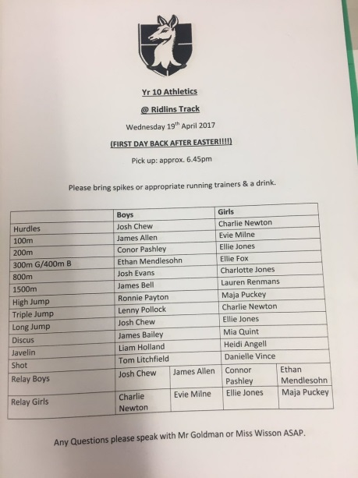
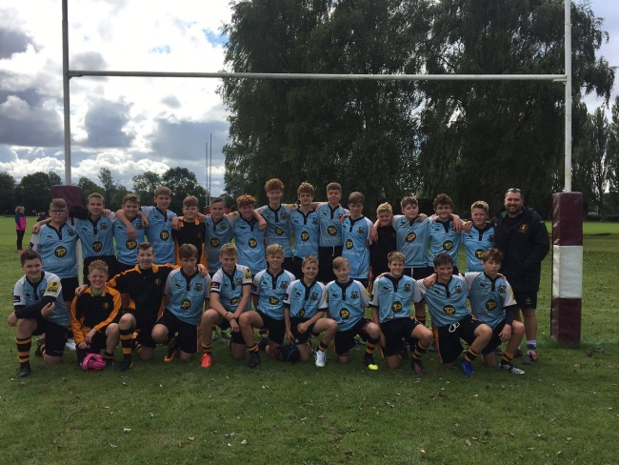
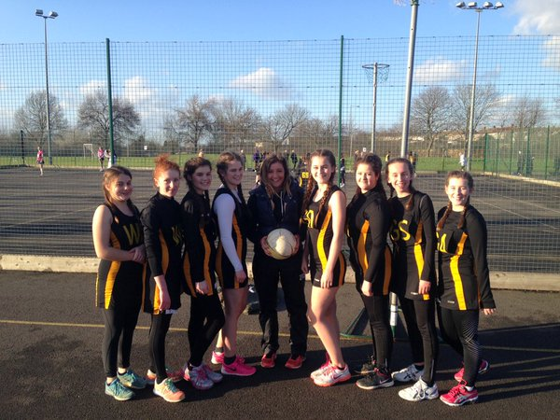
Twitter - @SamWhitPE

Slide 4
Department ethos
Succeed Win Achieve
vs.
SPORT FOR ALL

Slide 5
2016-17 Honours
SPORT
Athletics | T&F Cup Regional ‘A’ Finalists, District Champions U14 Boys & Girls, U15 Boys
Cricket | U14 District Champions, Girls Cricket indoor/outdoor County champions & Regional Finalists.
Netball | U14 Regional Finalists, U15 District League ……… , U16 District League…….
Football | 4 Teams in District Finals (3 Won), 3 out of 4 teams in County Finals (2 won), U14 & U18 ESFA Last 16.
Basketball | U14 County champions, U16 County Finalists, U18 District League Runners up.
Hockey | U16 Bedfordshire State School Champions
Rounders | U15 District League ……… , U16 District League…….
Rugby | 4 Teams in County Cup Finals (2 Won), U14 & U15 Sevens Champions.
Handball | County Girls runners up, County Boys Champions Regional finalists.
Gymnastics | Regional Finalists

Slide 6
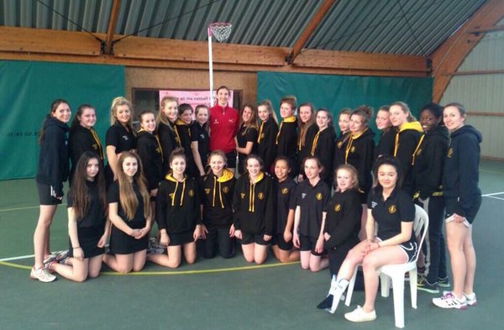
Sports Tour
2018 Sports tours
Football – Denmark
Rugby – France
Netball - Holland

Slide 7
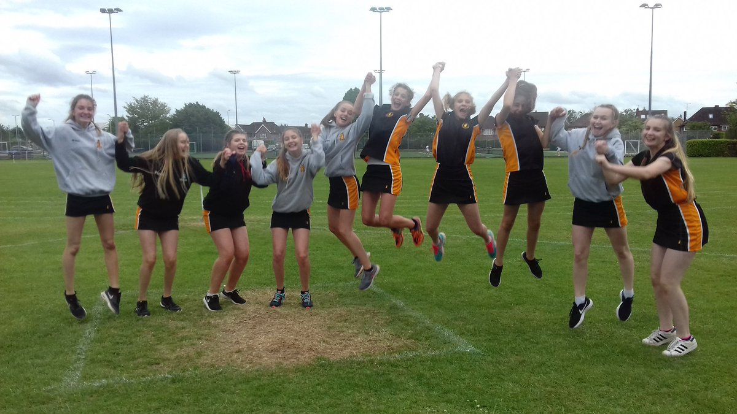
Core Games
4 hours a cycle
All students will experience a wide range of activities
Injury is a part of sport and students wont have to take part but do get changed
Forgetting kit does result in a same day lunchtime detention.

