Slide 1
Mathematics GCSE

Slide 2
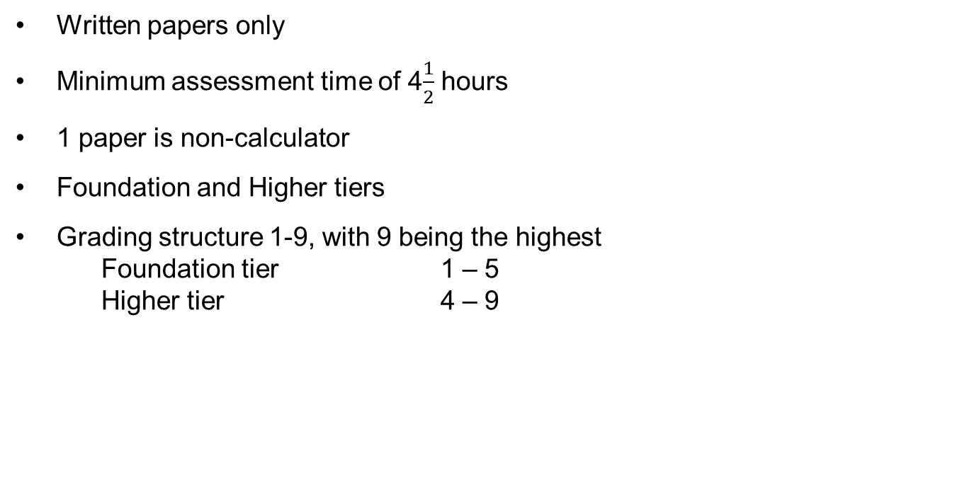
Requirements for all GCSEs in Mathematics
Written papers only
Minimum assessment time of 4$\frac{1}{2}$ hours
1 paper is non-calculator
Foundation and Higher tiers
Grading structure 1-9, with 9 being the highest
    Foundation tier 1 – 5
    Higher tier 4 – 9
Notes:
The tiering structure will remain the same, with an overlap between the tiers at grades 4 and 5. The way Ofqual will set standards for these new grades has not been finalised.
Higher tier will have an allowed grade 3
Double weighting = additional content = more assessment.
Expected that schools consider allocating more teaching time to support delivery
Held specific support courses addressing the needs of post-16 students in June likely to be repeated in the autumn

Slide 3
Foundation tier structure
120 marks
5
53 marks
C
D
E
F
G
4
50%
3
2
50%
1
Old
GCSE linear 175 marks
Current GCSE 240 marks

Slide 4
Higher tier structure
120 marks
9
A*
A
B
C
D
53 marks
8
50%
7
6
5
4
50%
Old GCSE linear 175 marks
Current GCSE 240 marks
Slide 26
Copyright © AQA and its licensors. All rights reserved.

Slide 5
It has got harder

Slide 6
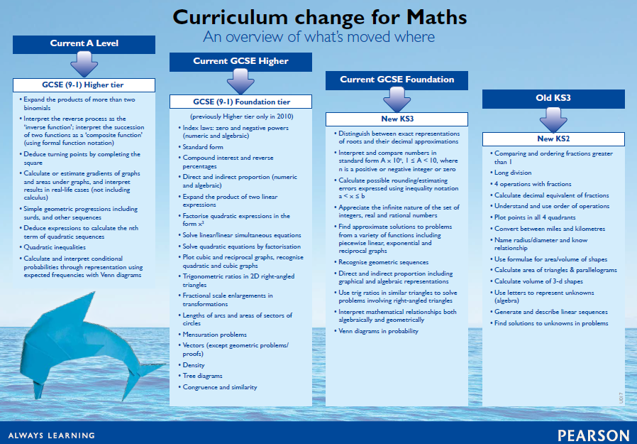

Slide 7
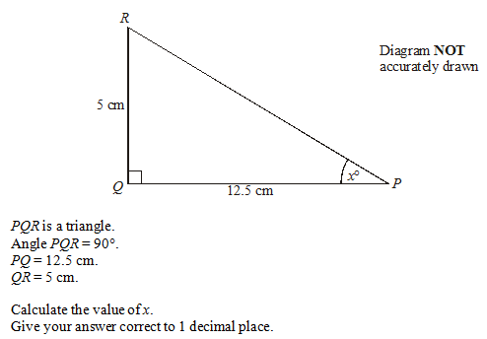

Slide 8
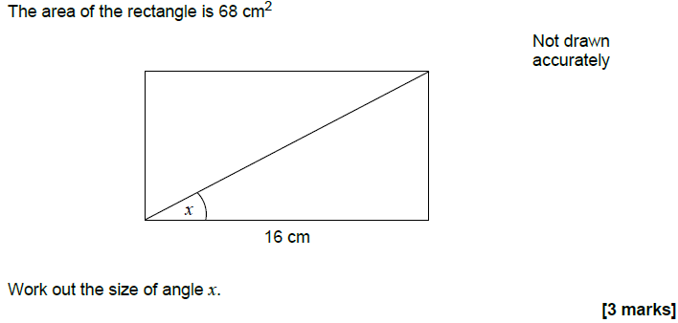

Slide 9
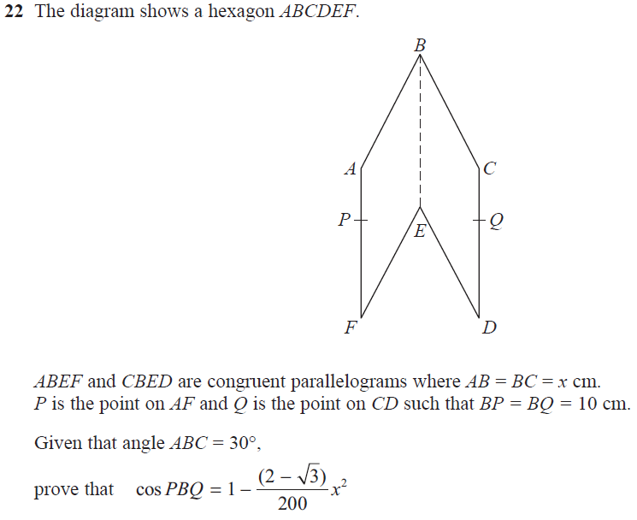

Slide 10
Maths revision is not a spectator sport
Notes:
Change your school on page 10 to your school’s name!! Change the my maths password on Page 15 to your school’s one! Change a few on page 16 to how many weeks there are left when you do your assembly. Page 27 needs to be altered as with page 10.
10

Slide 11
Maths Revision
How to revise
Brief exam hints

Slide 12
Effective Maths Revision has two phases:
Revisiting and learning work undertaken during the course – establish what you don’t know!
Practice, practice, practice.

Slide 13
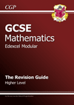
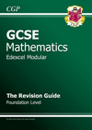
Revisit work you have done
Use a Revision Guide for the AQA Course.
Look up anything you don’t know and then have a go at some questions

Slide 14
Revisit work you have done
Use a website
vlemathswatch.co.uk
mathskitchen.com
Corbettmaths.com
Mathsgenie.co.uk

Slide 15
vlemathswatch.co.uk
Username :(4 digit pin)@samuelwhitbread
Password : grape1

Slide 16
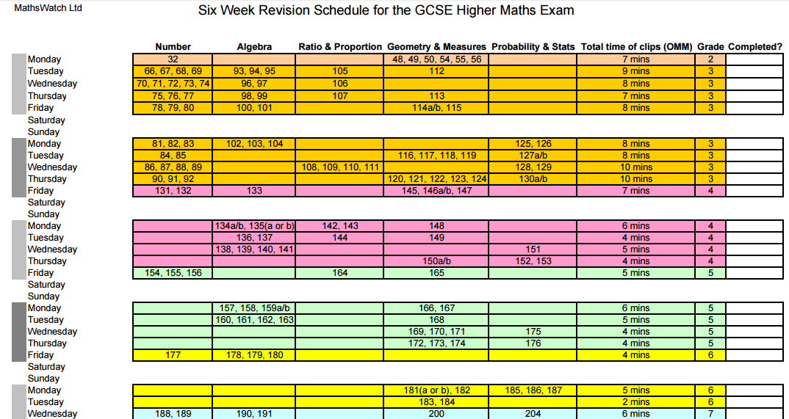

Slide 17
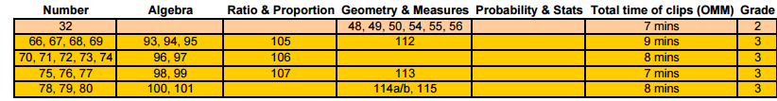
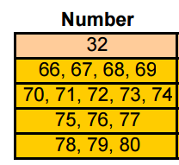
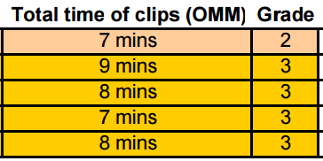

Slide 18
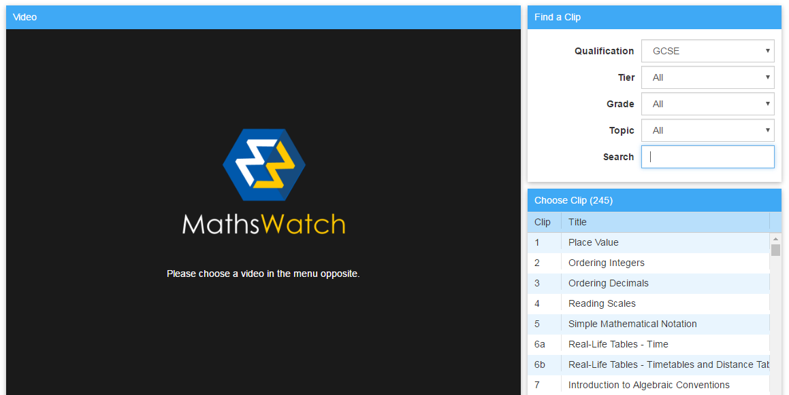

Slide 19
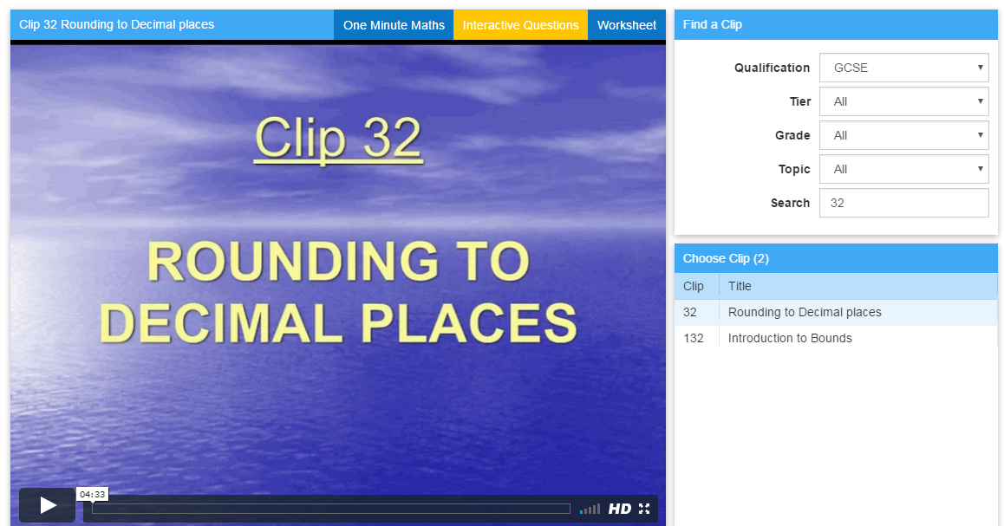

Slide 20
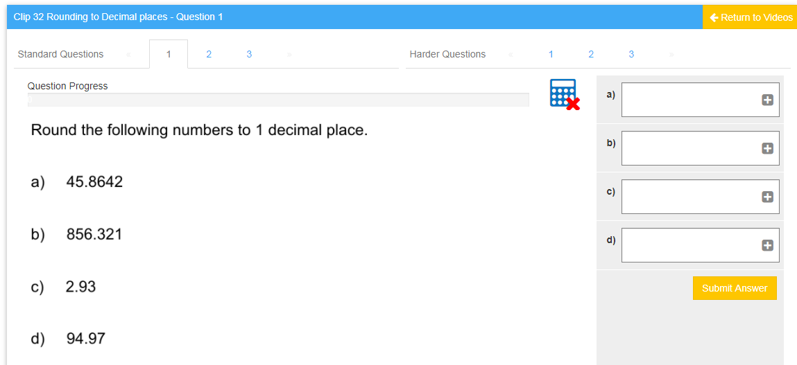

Slide 21


Slide 22
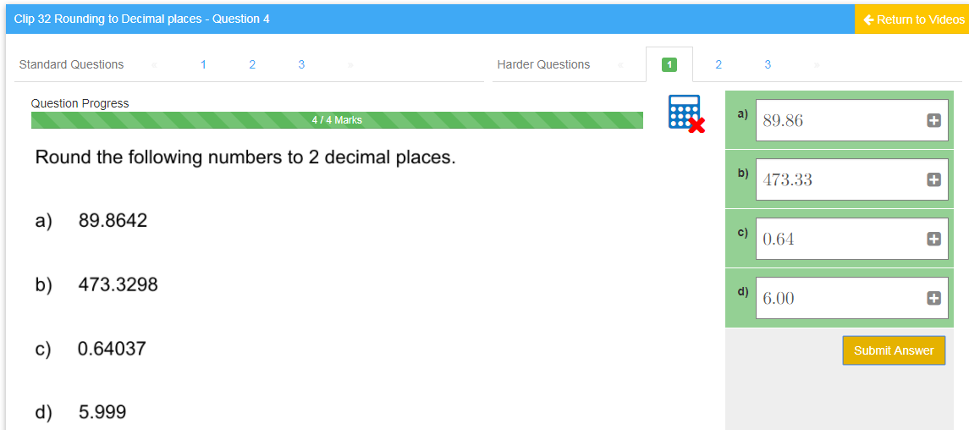

Slide 23
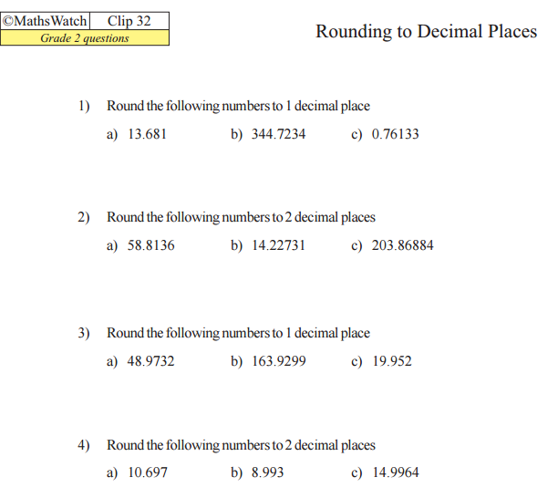

Slide 24
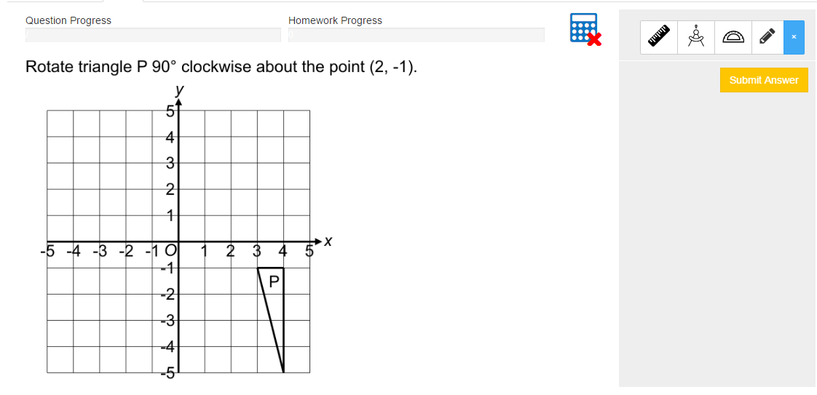

Slide 25
Remember the best way to revise maths is to do maths

Slide 26


Slide 27
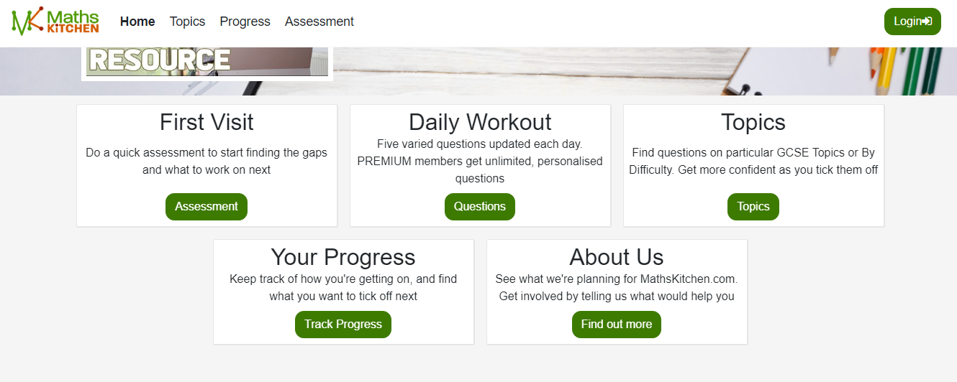

Slide 28
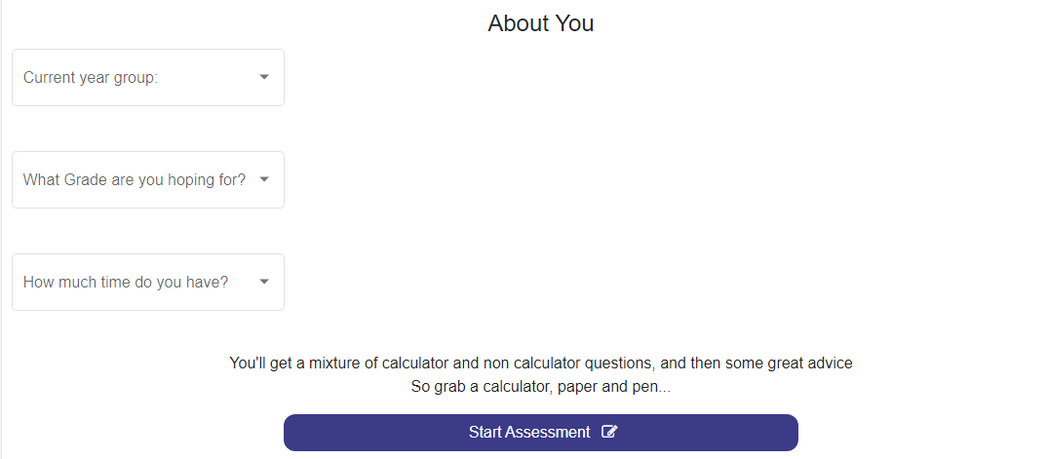

Slide 29
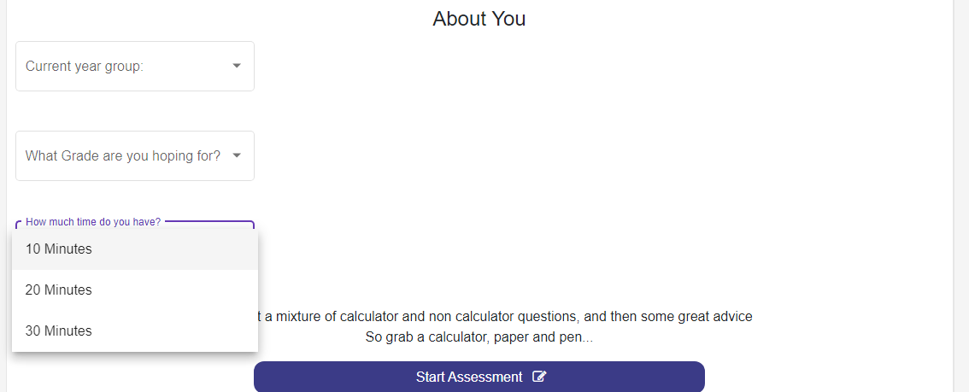

Slide 31
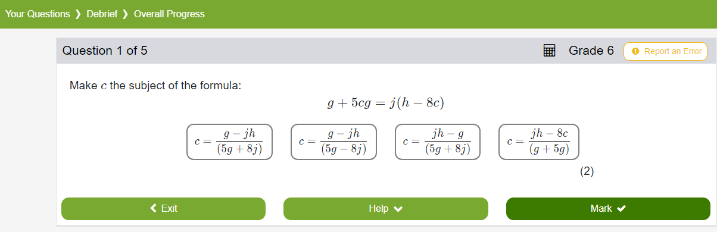

Slide 32
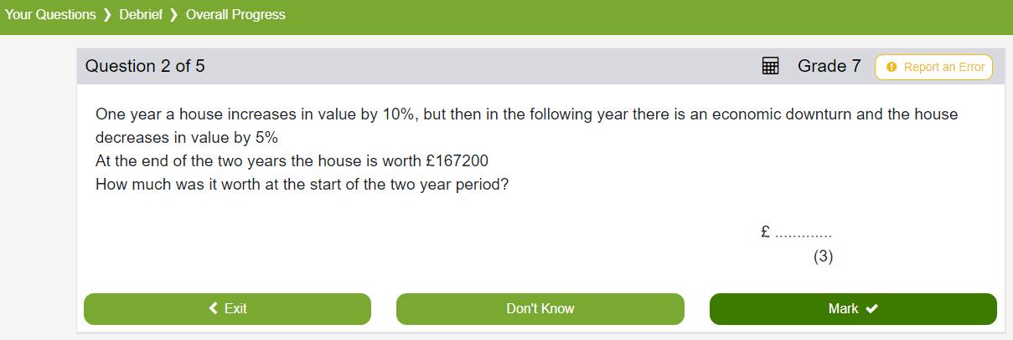

Slide 33
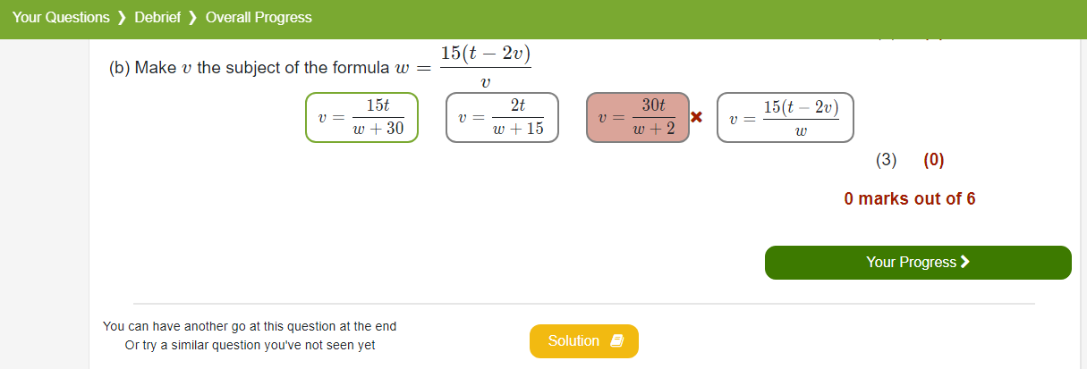
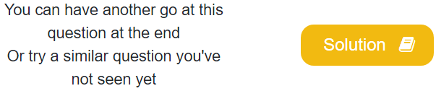

Slide 34
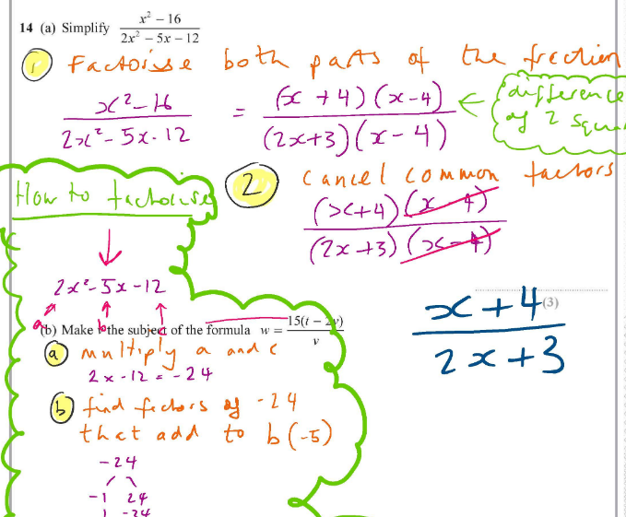

Slide 35
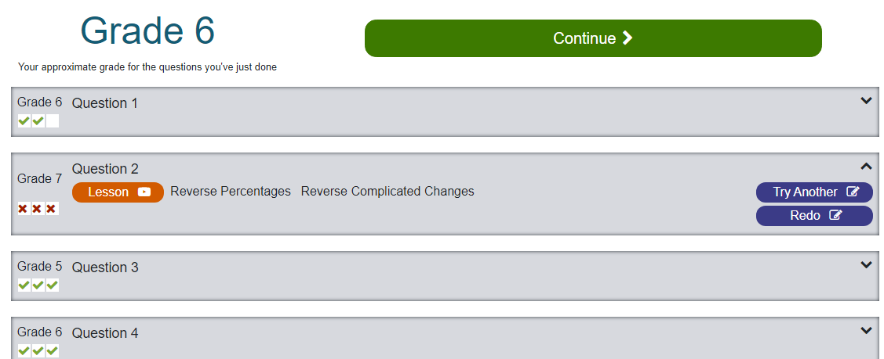

Slide 36
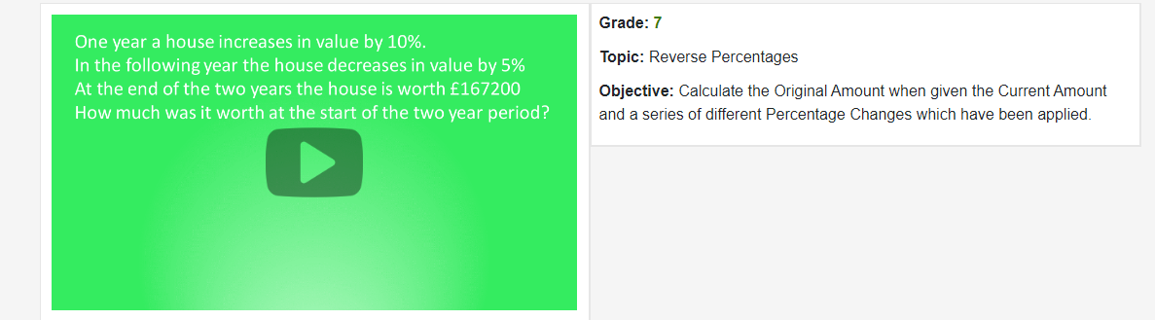
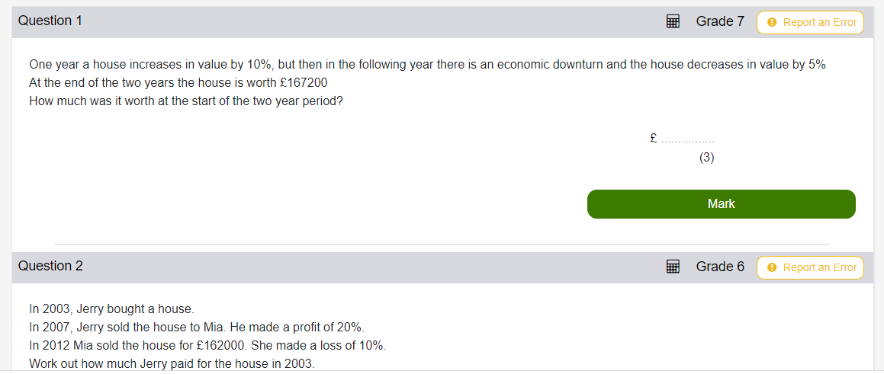

Slide 38
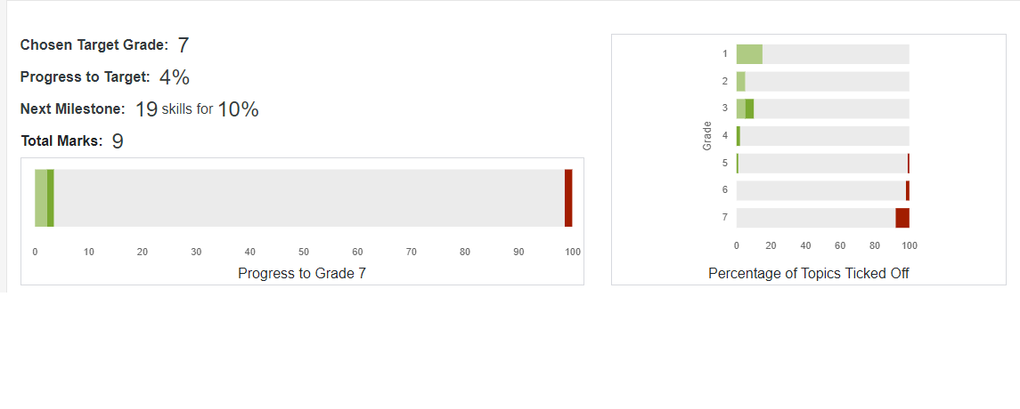

Slide 39
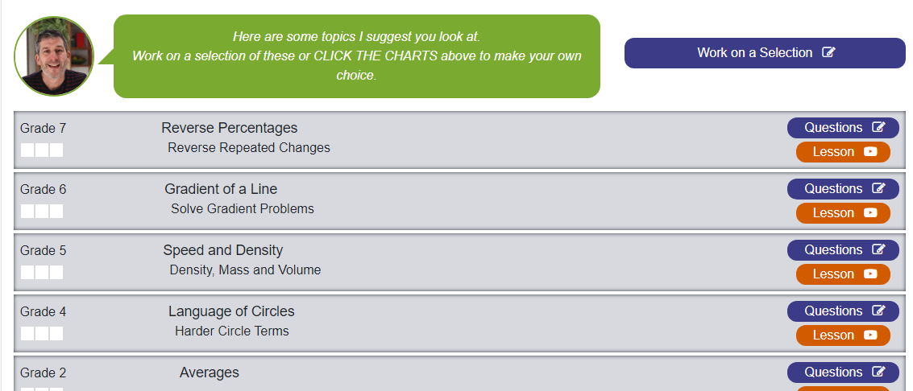

Slide 40
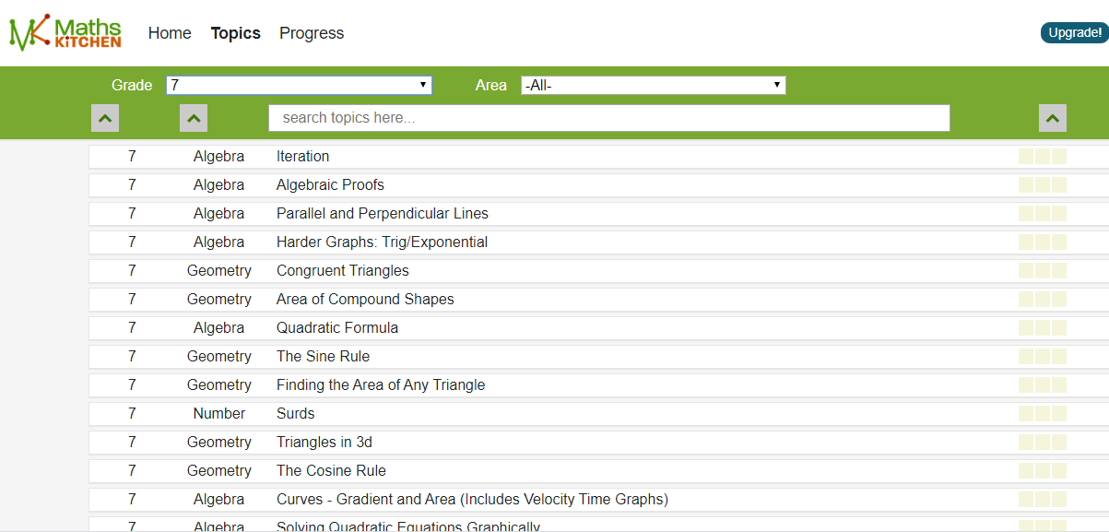

Slide 41
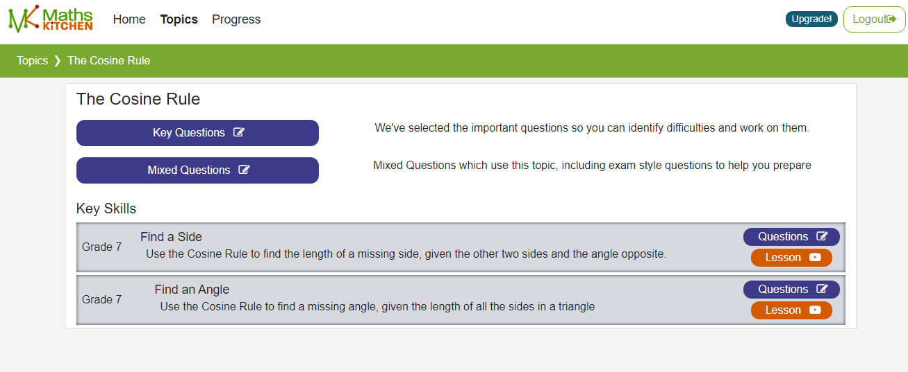

Slide 42
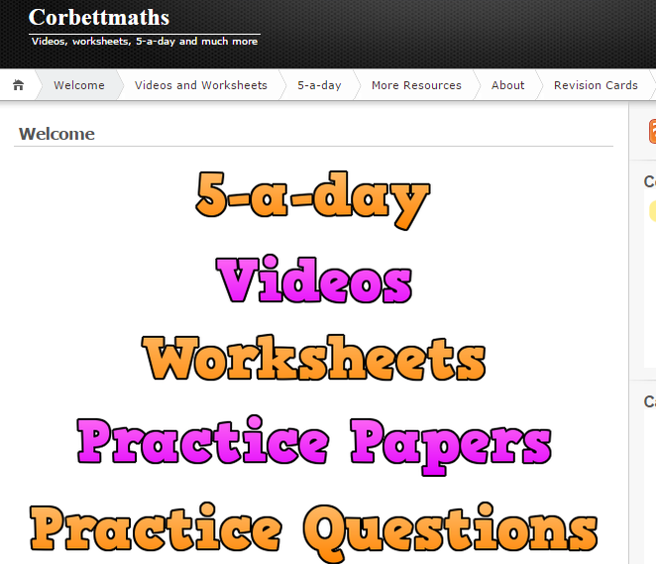

Slide 43
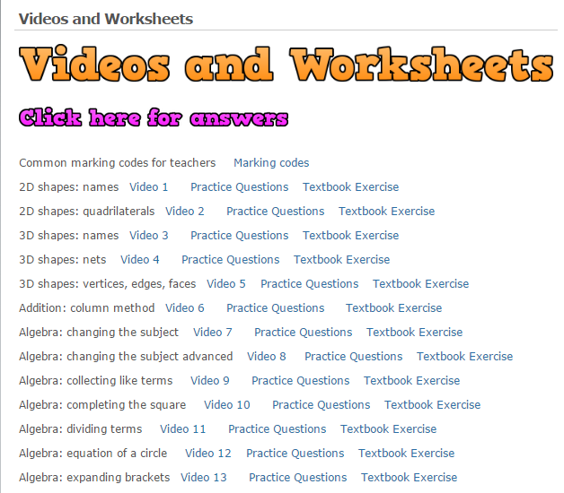

Slide 45
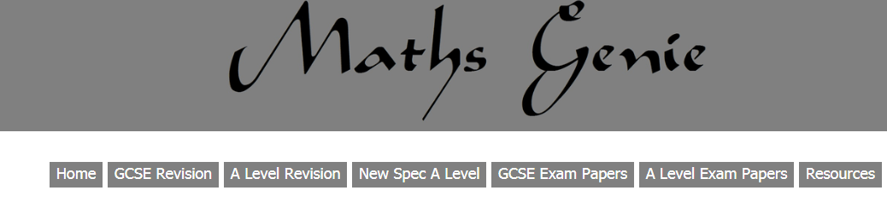

Slide 46
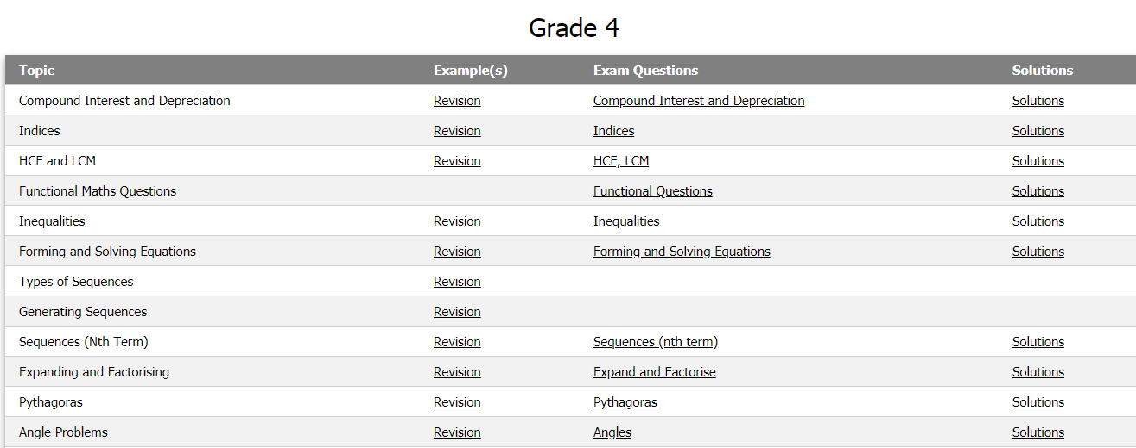

Slide 47
Revisit work you have done
ASK
YOUR
TEACHER!
There are a few weeks
of lessons left

Slide 48
Other Useful Sites
Onmaths.com – Online tests and revision worksheets
Mathsmadeeasy.com – past papers (old spec)

Slide 49


Slide 50
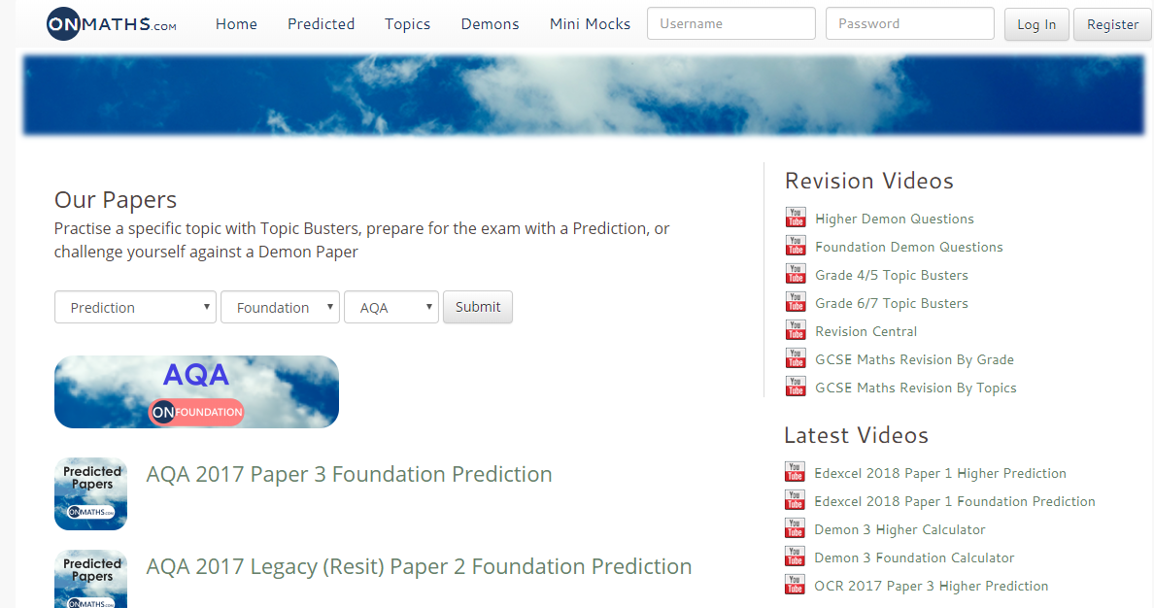

Slide 51
Past papers
Be aware of your target grade
Read the questions carefully
Show all working out
Please remember there are only 6 sets of AQA past papers and we have used some of them in school

Slide 52
Past Papers
www.mathsmadeeasy.co.uk

Slide 53
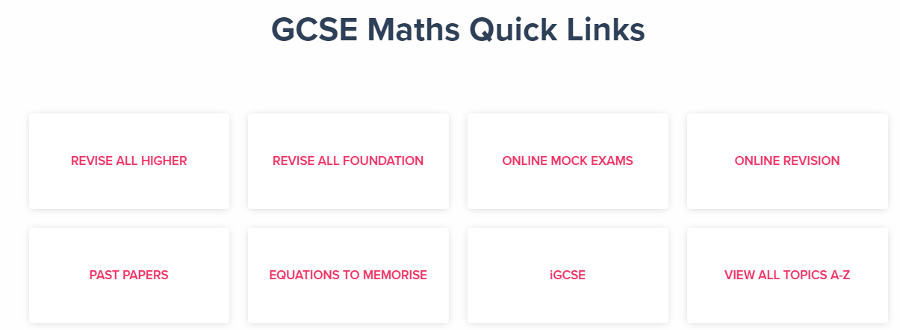

Slide 54
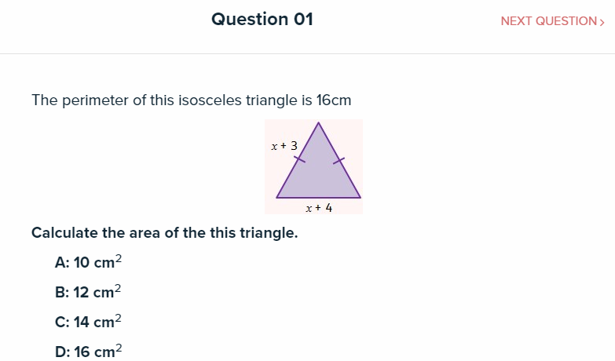

Slide 56
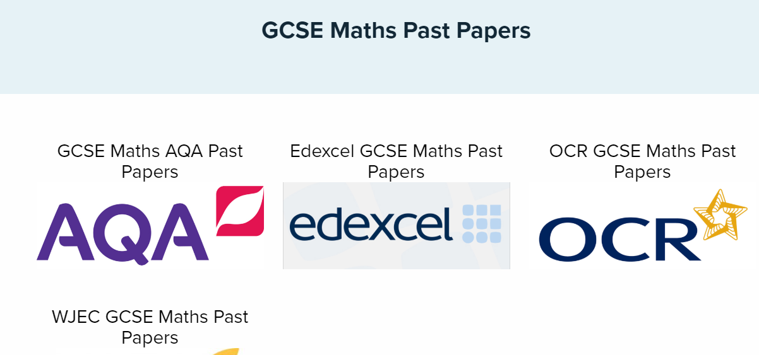

Slide 57
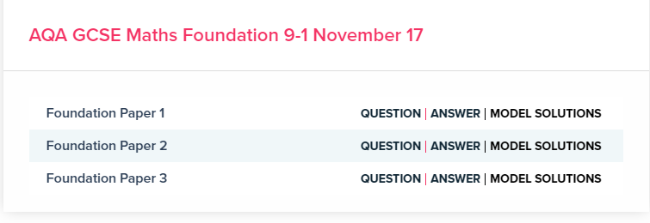

Slide 58
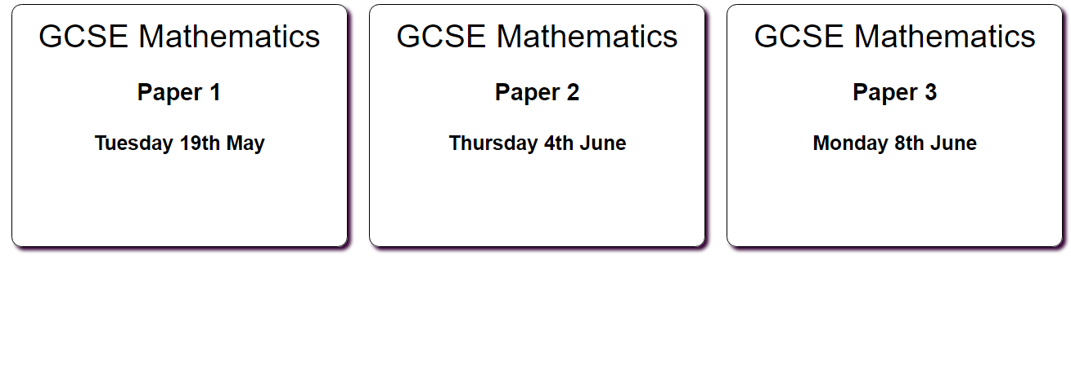
Some Dates

Slide 59
Some Dates
A revision session
(May Half Term – between paper 1 and 2)
Topic lists and best guess papers will be emailed out after papers 1 and 2

Slide 60
Checklist
These papers and revision checklists are based on the topics that either haven’t appeared or usually have a higher profile. As there are 3 papers, there is a possibility that topics from paper 1 may appear again

Slide 61
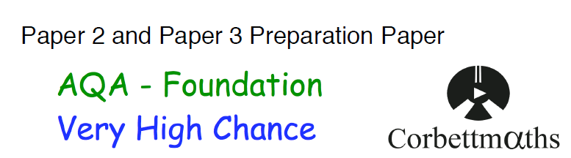

Slide 62
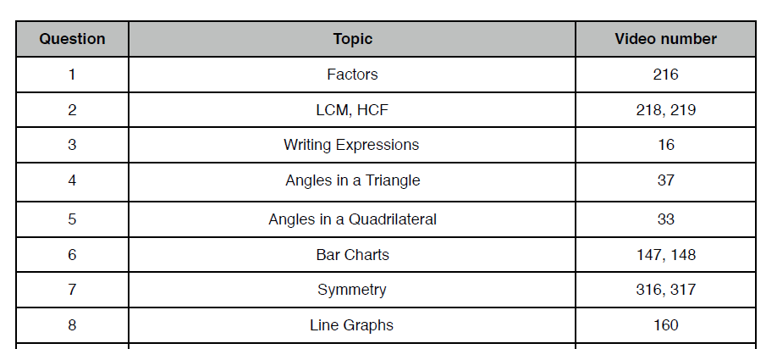

Slide 63
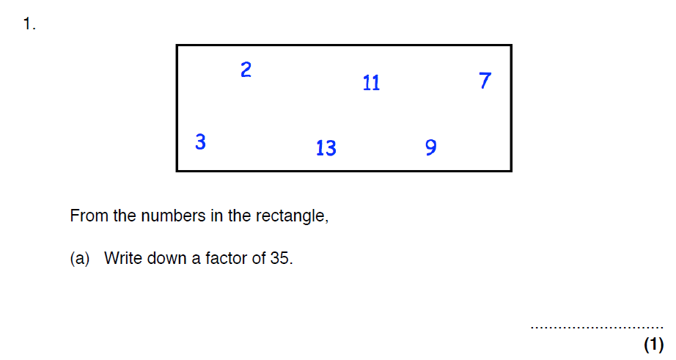

Slide 64
During the exam

Slide 65
Make friends with your calculator
Make sure it is in DEG mode...
Estimate your answers
Always show workings!

Slide 66
Show all stages in your calculations
NO working + wrong answer = NO marks
Correct working + wrong answer = SOME marks

Slide 67
AQA Head of Maths
Going right back to my school days, which were a long time ago, and beyond, teachers have been telling students to show their working clearly.
However, we still see many instances of work with little structure and no indication of what is happening at each step of working.
Well-structured answers with the odd word of explanation not only make the examiners’ task easier, but also make it much easier for the student to see what they are doing and make the right choice for the next step.

Slide 68
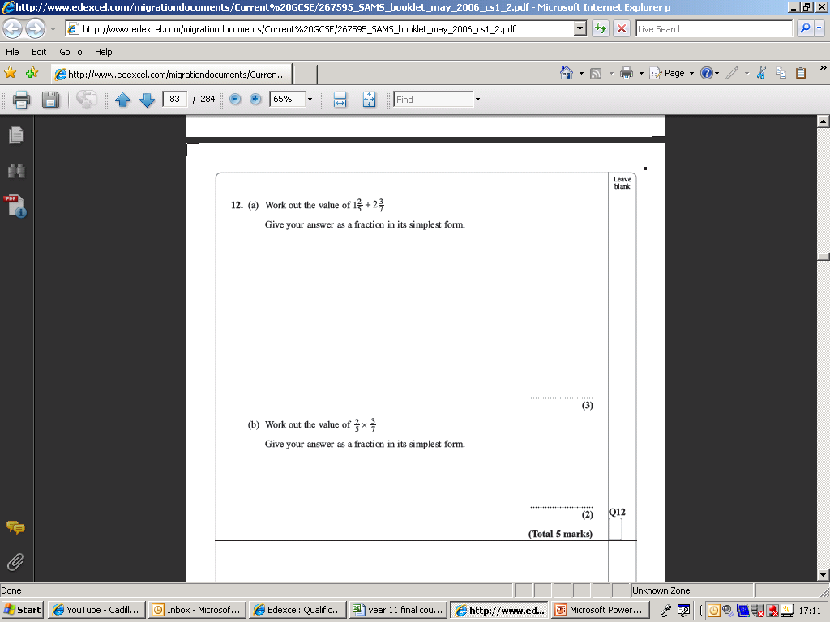
Amount of room is a hint about how much working out is necessary

Slide 69
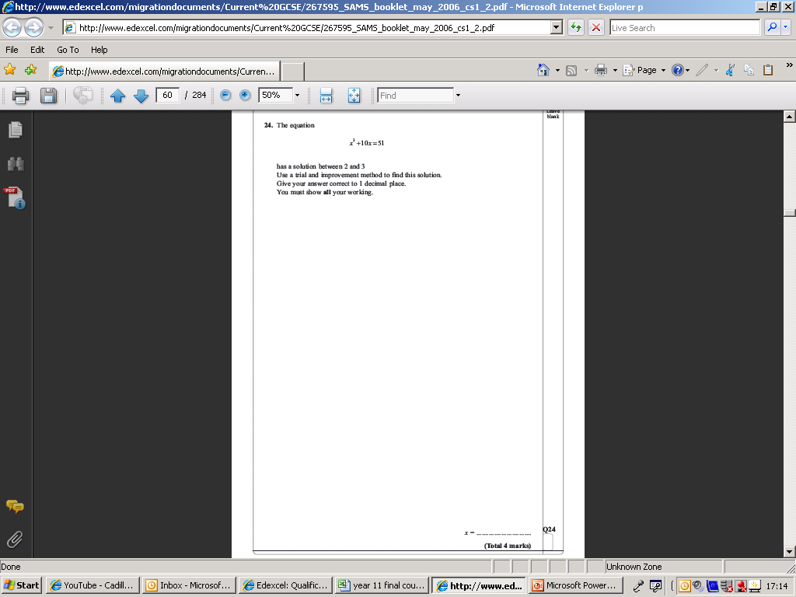
Lots of space = lots of working out expected

Slide 70
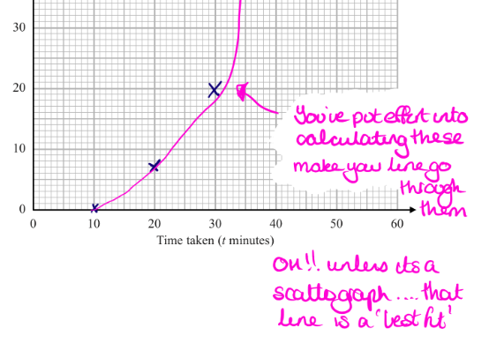
During the exam
In general, take pride in your work.
In particular, be accurate when drawing graphs.
Consider the exam as an opportunity to “show what you know”
Check your answers
Does the answer make sense?

Slide 71
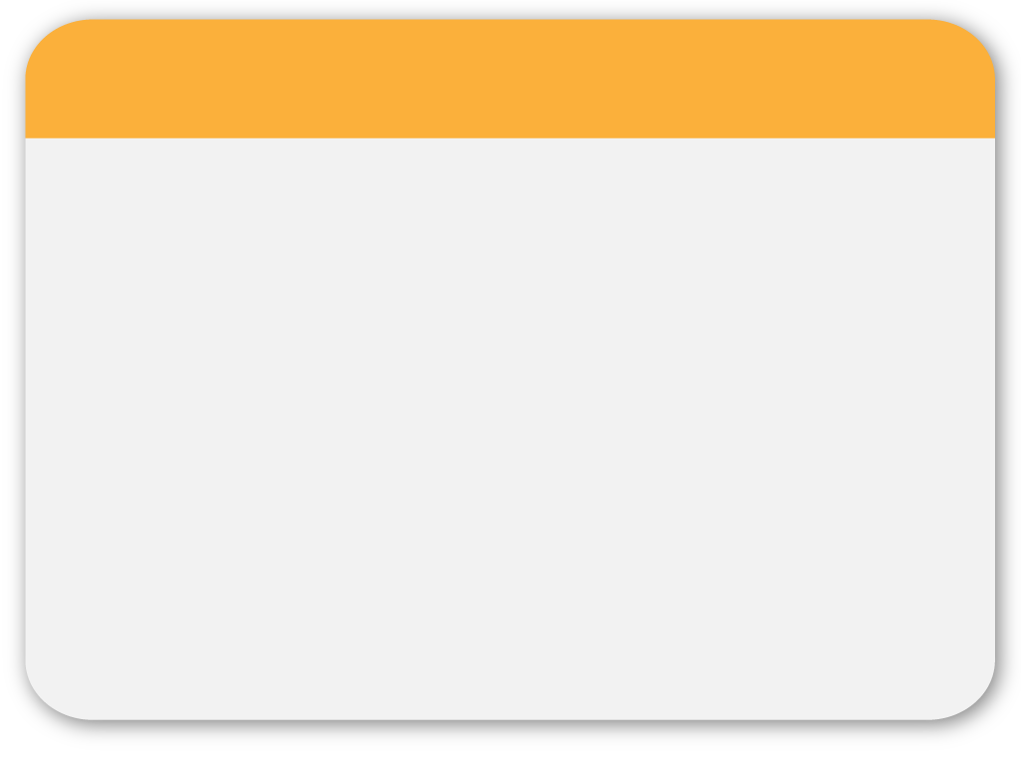
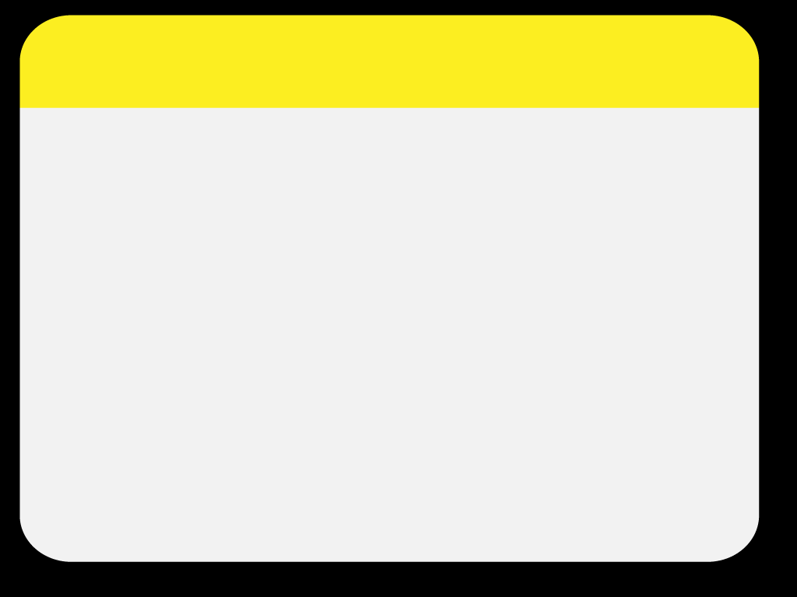





WINTER
GOOD LUCK
Template
Notes:
71

