Slide 1
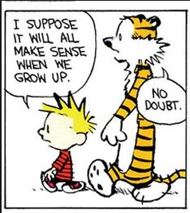
Getting ready for English

Slide 2
What and when?
Wednesday 13th May AM Literature Paper 1
Thursday 21st May AM Literature Paper 2
Tuesday 2nd June AM Language Paper 1
Friday 5th June AM Language Paper 2

Slide 3
Literature Paper 1 (1h45)
Romeo and Juliet by William Shakespeare
A Christmas Carol by Charles Dickens
Extract based questions
Write about the EXTRACT and the rest of the play/novel

Slide 4
Paper 1 Section A

Slide 5
Paper 1 Section B

Slide 6
Literature Paper 2 2h15
An Inspector Calls by JB Priestley
AQA Power and Conflict Poetry comparison
Unseen poetry + unseen comparison

Slide 7
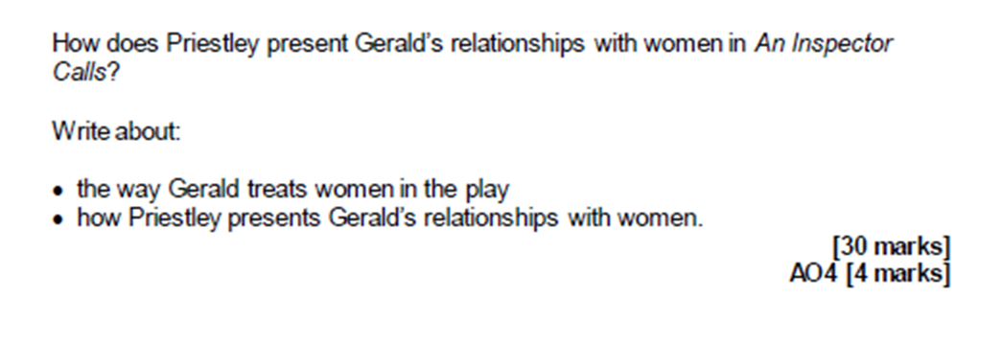
Paper 2 Section A

Slide 8
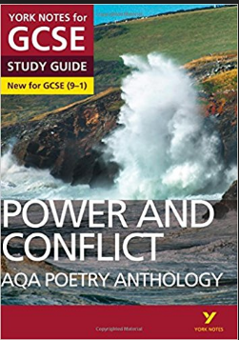
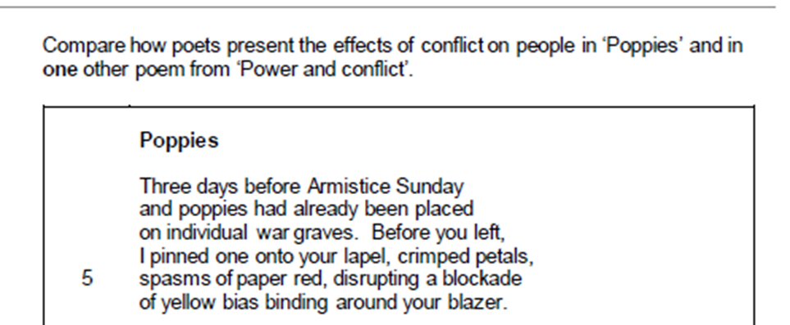
Paper 2 Section B

Slide 9
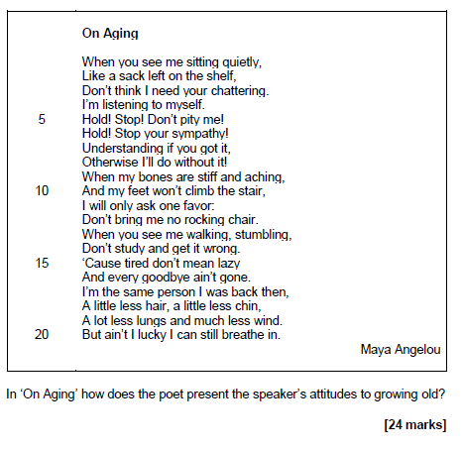
Paper 2 Section C

Slide 10
How can you revise?
Create flashcards of PLOT, CHARACTER and THEME for each of the set texts.

Slide 11
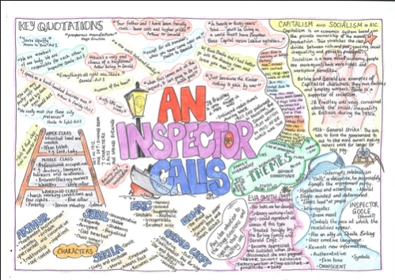
How can you revise?
Create mindmaps of PLOT, CHARACTER and THEME for each of the est texts.

Slide 12
How can you revise?
Cover your room/house with key quotes from the set texts.

Slide 13
What would the writer have said?
Dickens wanted to deliver a ‘sledgehammer blow’ to our complacent attitudes to poverty and inequality.
Priestley wanted a ‘nobler world in which ordinary, decent folk can find not only justice and security but also beauty and delight’.
Armitage wanted to give a voice to soldiers who had returned from war zones and were still struggling with the horrors they had witnessed.

Slide 14
Create your own questions.
Starting with this extract, explore how far Dickens presents X as Y
Starting with this moment in the play, how does Shakespeare present attitudes to X?

Slide 15
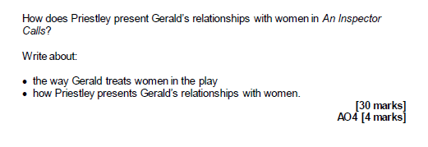
Create your own questions
How does Priestley present X as a ___ character?

Slide 16
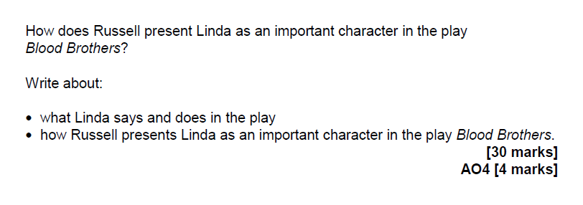
Create your own questions
How does Russell present X as a ___ character in the play?

Slide 17
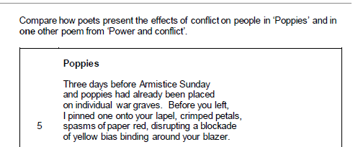
Create your own questions

Slide 18
Useful websites
https://www.bbc.com/education/subjects/zckw2hv BBC Bitesize
http://nfs.sparknotes.com/romeojuliet/ No Fear Shakespeare
Sparknotes
Cliffsnotes
http://www.aqa.org.uk/subjects/english/gcse/english-literature-8702 AQA

Slide 19
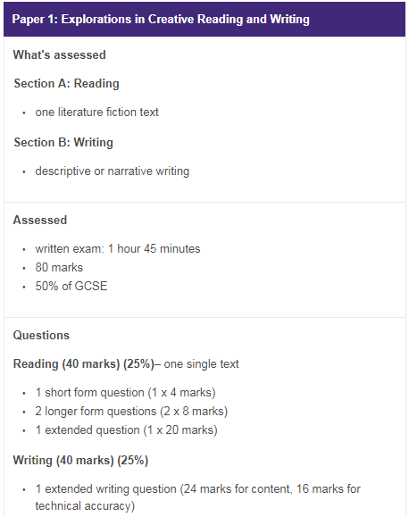
Language Paper 1

Slide 20
Reading Strategies – how to become a more active reader
Structure guidance
The Reading Process
1. Number Paragraphs
2. Look for clues in question/ title
3. Work through text/ highlight key words/ phrases
5. Summarise and prioritise
4. reread- think question and link
Retell and check what they know about reading- have they read with focus?
Active process- look for links to the question
This can work with any text: fiction or non-fiction, speeches or articles, novels or poems.
Careful, purposeful reading

Slide 21
Paper 1: How can you prepare?
Create a glossary of LINGUISTIC TERMINOLOGY. Don’t forget the basics – verbs, adjectives, lists – as well as the more sophisticated – lexical field.
Create a glossary of STRUCTURAL FEATURES –
shifting between different times or places
a sudden or gradual introduction of a new character at a significant point
combining external actions with internal thoughts
switching between different points of view
developing and reiterating: focussing on a point of view by expanding and repeating it
positioning of key sentences and their impact on the whole.

Slide 22
Evaluation
Create your own questions in this style, based on other literary texts or on the set texts for English Literature.

Slide 23
Writing Q5
It’s all about the planning.
Use a picture as inspiration for a piece of descriptive/narrative writing.
Practise planning responses: how will you introduce this? What have you decided re plot, character, setting? How will it end?
Plan the overall response and plan your paragraphs – it would be better to practise the planning than practise writing whole answers.

Slide 24
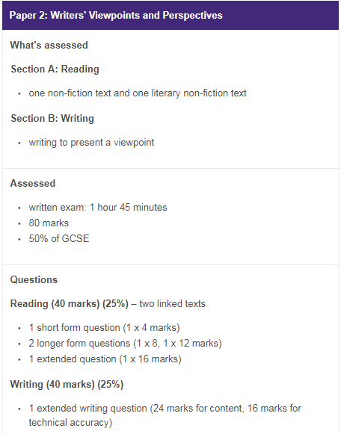
Language Paper 2

Slide 25
How can you prepare?
Read as much non-fiction as you can: opinion pieces, commentaries and speeches are more useful than a straightforward ‘news’ article.
Read articles about the same topics but that might have different approaches eg The Guardian and The Daily Mail might write about immigration differently!
Play Devil’s Advocate!
Can you explain how the writer feels about the subject she is writing about? How do you know?
What is the relationship between the writer and the subject matter?
Read online commentaries about current affairs, rather than news articles; scroll down to the online comment responses; how would you have reacted? Why?
Read any article from a (proper) newspaper and highlight any languistic/literary/structural techniques that the writer has used.

Slide 26
Useful websites
http://lifemoreextraordinary.com/revision/revise-english-language-gcse-aqa/
https://www.bbc.com/education/examspecs/zcbchv4
https://thelearningprofession.wordpress.com/about/
http://www.aqa.org.uk/subjects/english/gcse/english-language-8700
http://www.bl.uk/learning/langlit/texts/context.html

Slide 27
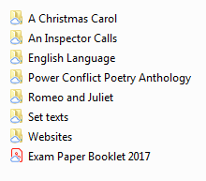
SWA GCSE Learning Platform

