Slide 1
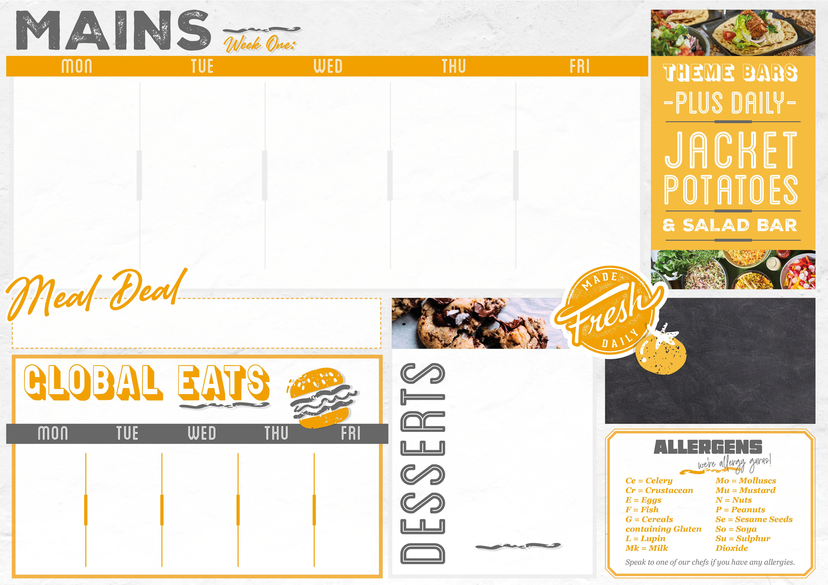
From £2.65
21/04/25, 12/05/25,02/06/25,23/06/25
Burger bar
Asian flavours
Greek gyros
Masala moments
fish & chip shop
Quarter Pound Beef Burger in a Bun (G,Se) Or Spicy Chicken Burger in a Bun (G,Se,Mu) Crispy Falafel Burger in a Bun (G,Se) (Vegan) Oven Baked Wedges Crunchy Seasonal Salad Extras: Onion Rings (G) | Yakisoba Stir Fried Chicken with Toasted Seeds (G,So,Se,Mu) Eat Curious Stir-Fried Yakisoba Vegetables with Toasted Seeds (G,So,Se,Mu) Egg Noodles with Garlic, Ginger & Soy (G,So,E) Roasted Chinese Leaf & Cabbage (So,G) Extras: Prawn Crackers (Su,Cr) | Chicken Gyros with Yoghurt & Mint & Chilli Sauce (Mk,E,G) Sweet Potato Falafel Gyros with Yoghurt & Mint & Chilli Sauce (Mk,E,G) Greek Cabbage Salad (Su) Extras: Crispy Potato Wedges | Butter Chicken Makhani (G,So,Mk) Butter Paneer & Vegetable Makhani (G,So,Mk) Mango Chutney Pilau Rice Aromatic Roasted Cauliflower Extras: Toasted Naan (G) | Battered Fish Fillet (G,F) Tartare Sauce (E) Grilled Jumbo Sausage (Su,G) Vegetable Spring Roll with Sweet & Sour Sauce (G,So) Chips Peas Baked Beans Extras: Curry Sauce (So,Mk)
Jackets & Pasta
Only £3.00
Check out what’s on offer today, available for free school meals!
Bolognaise (G)
Basil Pesto (G,Mk)
Tomato & Basil (G)
Mac ‘n’ Cheese (G,Mk,Mu)
MONDAY
Lemon Blondie (G,E)
TUESDAY
American Pancake Bar
(G,Mk,E)
WEDNESDAY
Blueberry Muffin Cake with
Carrot Streusel Topping (G,Mk,E)
THURSDAY
Chocolate Sponge Pudding
(G,Mk,E)
FRIDAY
Dorset Apple Cake
(G,Mk,E)
Served with
Garlic Bread (G,So,Mk) & Cheese (Mk)
From £0.65
From £2.65
Loaded Chilli Beef Nachos (G,Mk,So) | Hot Dog with Crispy Onions & Mustard (G,So,Se,Mu) | Buffalo Chicken Burger with Ranch Slaw (G,Se,E) | BBQ Pulled Pork Sub (G,Se,Mu) | Cajun Chicken Quesadilla (G,Mu,Mk)
From £1.58

Slide 2

From £2.65
28/04/25, 19/05/25,09/06/25
Fiesta flavours
Taste of the us
HOME COMFORTS
Katsu kitchen
fish & chip shop
Chilli Con Carne with Sour Cream & Pico de Gallo (G,Mk) Curious Smoky Veggie Chilli Pico De Gallo & Vegan Sour Cream (G,Ce,Mu) (Vegan) Spring Onion Rice Roasted Corn & Pepper Salad Extras: Tortilla Chips (So) | New Orleans Gumbo with Rice (G,Mu,Ce) Pizza Mac & Cheese with Garlic & Herb Bread (G,So,Mk) Cajun Corn & Peppers (Mu) BBQ Boston Beans Extras: Onion Rings (G) | Butchers Sausages with Caramelised Onion Gravy (G,Su) Grilled Veggie Sausages with Caramelised Onion Gravy (So) (Vegan) Creamy Mashed Potatoes Roasted Broccoli Extras: Yorkshire Pudding (G,E,Mk) | Crispy Chicken Katsu (G,E) Crispy Sweet Potato Katsu (G,So,E) Katsu Curry Sauce (G,So) Steamed Rice Asian Salad Extras: Prawn Crackers (Su,Cr) | Battered Fish Fillet (G,F) Tartare Sauce (E) Grilled Jumbo Sausage (Su,G) Wholemeal Curried Vegetable Pasty (G) (Vegan) Chips Peas Baked Beans Extras: Curry Sauce (So,Mk)
Jackets & Pasta
Only £3.00
Check out what’s on offer today, available for free school meals!
Creamy Chicken & Sweetcorn (G,Mk)
Spicy Tomato Arrabbiata (G)
Mac ‘n’ Cheese (G,Mk,Mu)
MONDAY
Sticky Baked Jam Doughnut (G)
TUESDAY
Jamaican Ginger Cake
(G,Mk,E)
WEDNESDAY
Apple Crumble & Custard
(G,So,Mk,E)
THURSDAY
Frosted Carrot Cake
(G,Mk,E)
FRIDAY
Chocolate Brownie (G,E)
Served with
Garlic Bread (G,So,Mk) & Cheese (Mk)
From £0.65
From £2.65
Fajita Chicken Nachos (Mk,So) | Fully Loaded Cheeseburger (G,Se,Mk) | Korean BBQ Chicken Wings & Rice (G,Su,So,Se,Mu,Ce) | Texas Chilli Beef Burrito (G,Mu,Mk) | Cheese & Tomato Pizza (G,Mk,So)
From £1.58

Slide 3

From £2.65
05/05/25, 26/05/25,16/06/25,07/07/25
Spanish specials
Asian flavours
HOME COMFORTS
Fiesta flavours
fish & chip shop
Authentic Chicken & Chorizo Paella Baked Spanish Frittata with Onions, Potatoes & Spinach (Mk,E) Spanish Style Green Beans Extras: Charred Corn on the Cob with Smoked Paprika (Mu) | Korean Chicken Bulgogi with Kimchi (G,So,Se,F) Korean Tofu & Mushroom Sriracha Stir-Fry (G,So,Mu) (Vegan) Wholegrain Rice Soy & Ginger Broccoli (G,So) Extras: Prawn Crackers (Su,Cr) | Classic Lasagne Al Forno (G,Mk,E) with Garden Salad Mediterranean Roasted Vegetable Lasagne (G,Mk,E) with Garden Salad Baked Potato Wedges Steamed Seasonal Greens Extras: Garlic Bread (G,So,Mk) | Tex Mex-Chicken Burrito with Salsa & Sour Cream (G,Mu,Mk) Curious Tex-Mex Burrito with Salsa & Sour Cream (G,Mu,Mk) Mexican Spicy Rice (Ce) Zesty Mexican Slaw (Mu,E) Extras: Tortilla Chips (So) | Battered Fish Fillet (F,G) Tartare Sauce (E) Oven Fried Buttermilk Chicken (G,So,Mk) Homemade Pea & Potato Samosa with Mango Chutney (G) (Vegan) Chips Peas Baked Beans Extras: Curry Sauce (So,Mk)
Jackets & Pasta
Only £3.00
Check out what’s on offer today, available for free school meals!
Bolognaise (G)
Basil Pesto (G,Mk)
Tomato & Basil (G)
Mac ‘n’ Cheese (G,Mk,Mu)
MONDAY
Apple & Sultana Strudel
(G,So,Mk,E)
TUESDAY
Tip to Toe Banana & Chocolate Brownie (G,So,Mk,E)
WEDNESDAY
Peach Crumble with Custard (G,So,Mk,E)
THURSDAY
Sticky Toffee Pudding
(G,So,Mk,E)
FRIDAY
Lemon & Ginger Shortbread (G)
Served with
Garlic Bread (G,So,Mk) & Cheese (Mk)
From £0.65
From £2.65
Eat Curious Lamb Kofta with Pitta (G,So,Mk) | Hot Roast Baguette with Stuffing & Mini Roasties Turkey Pork (G,Mk) | Meatball Marinara Panini (G,Mk) | Fish Finger Dog with Crunchy Slaw (G,Se,F,E) | Sweet & Sour Chicken Noodles (G,So,E)
From £1.58

